Slide 1
Why does this keep happening?
An Overview of Treatment Relapse in Interventions for Severe Problem Behavior
Savannah Autism Conference, 2024
Kayla R. Randall, Ph.D., BCBA-D
Georgia Southern University
Notes:
Hurd & Brown, 40% over 10 year period
Response system
QR for outline
Examples of successful treatment
Tie in Podelsnik article

Slide 2
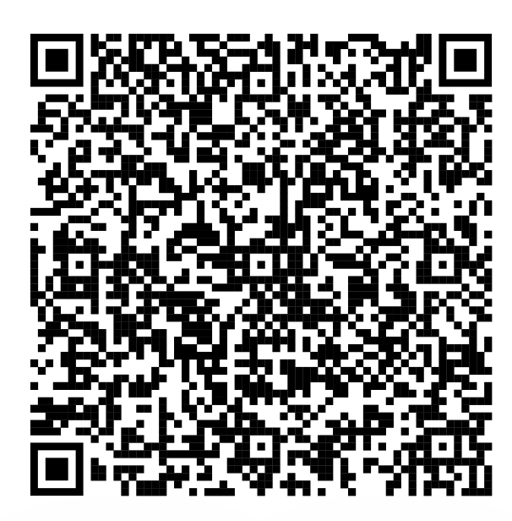

Slide 3
Malik
Anthony
Landon
Houston
Kylie
Lawrence
Ishmael
Sarah
Notes:
If you were my PSYC 1101 students and I was teaching on perception, I might try to challenge you to play a word association game.

Slide 4
Malik
Anthony
Landon
Houston
Kylie
Lawrence
Ishmael
Sarah
Notes:
University Center for Excellence in Developmental Disabilities

Slide 5
Treatment Relapse
Notes:
Treatment Relapse

Slide 6
317
Notes:
Dr. Fisher- 236
Brian Greer- 59
Amanda Zangrillo-22
2022 BACB recipient of the Michael Hemmingway award

Slide 7
Treatment Relapse
Notes:
Treatment Relapse

Slide 9
Treatment Relapse
Return of the problem after successful treatment
Notes:
Treatment Relapse

Slide 10
Treatment Relapse
Return of the problem after successful treatment
Alcoholism
Poly drug use
Smoking
Symptoms of Schizophrenia
Cancer
Destructive behavior
Notes:
Treatment Relapse

Slide 11
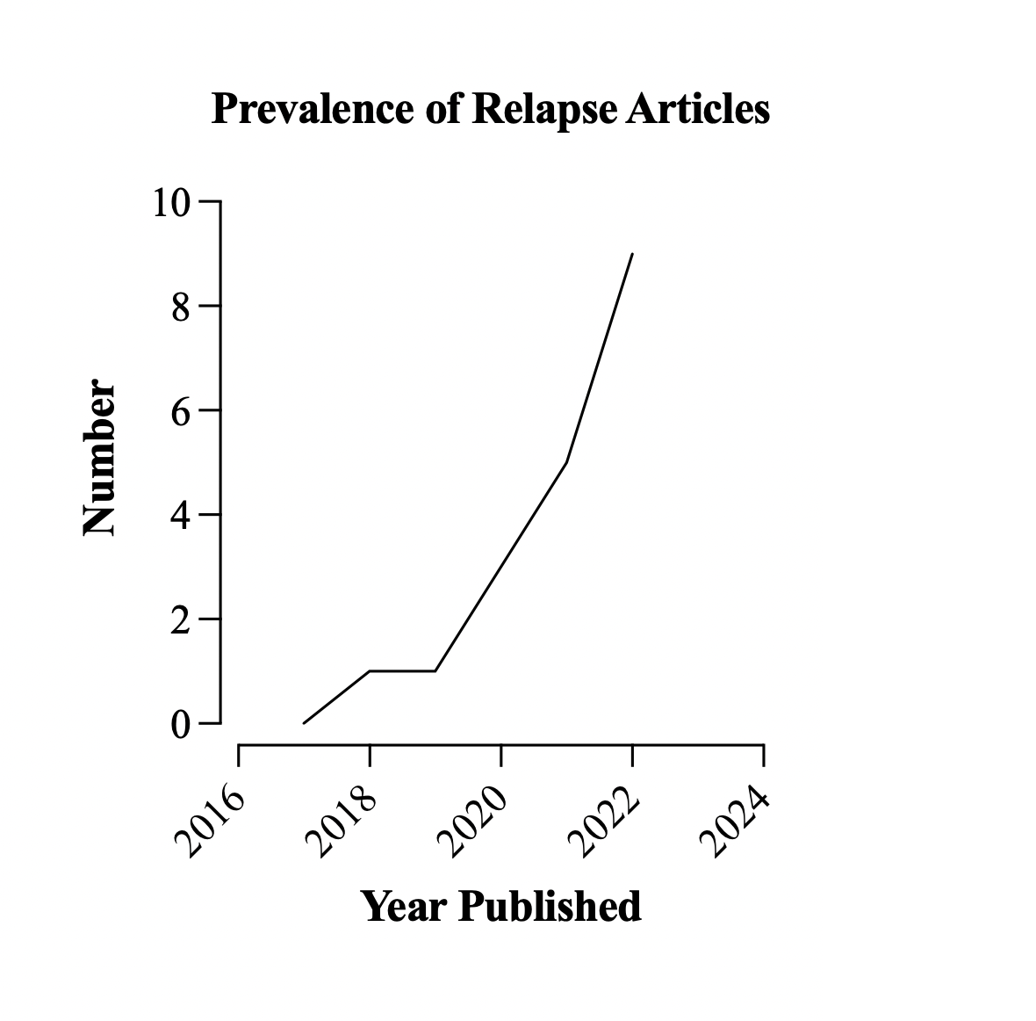
Falligant et al., 2022
Haney et al., 2022
Mitteer et al., 2022
Kranak et al., 2021
Falligant et al., 2021
Muething et al., 2020 b
Muething et al., 2020 a
Briggs et al., 2018

Slide 12
Name some examples of problem behavior you’ve encountered……Give me your hardest! ☺

Slide 13
Successful Treatment

Slide 15
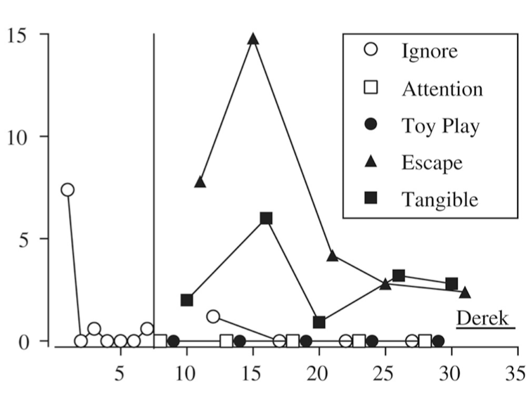
Responses per Minute
Sessions
Fisher, Greer, Fuhrman, Saini, & Simmons, 2018
Notes:
Fisher, Greer, Fuhrman, Saini, Simmons, 2018

Slide 16
Notes:
FCT often begins with extinction (click) for a destructive behavior such as aggression. Meaning that aggression will no longer produces access to the reinforcer.

Slide 17
Notes:
Instead, in FCT (click) a therapist teaches and reinforces an alternative functional communication response or FCR. This may be a touch to a card (click) with a picture of the reinforcer. When this response occurs (click) it produces access to the reinforcer.

Slide 18
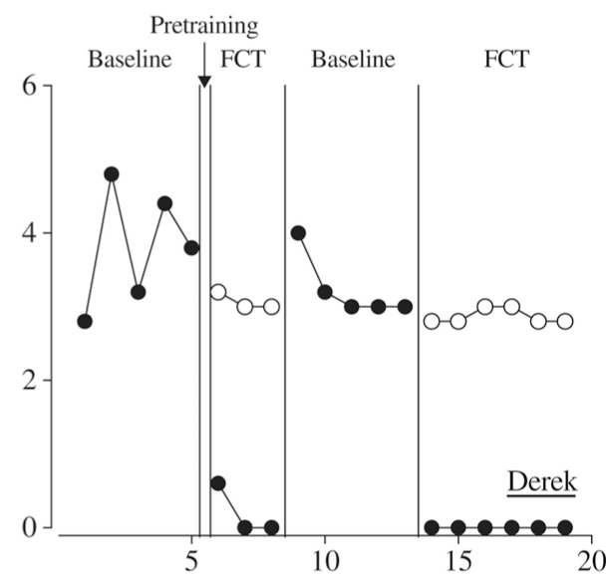
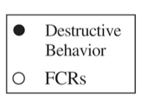
Responses per Minute
Sessions
Fisher, Greer, Fuhrman, Saini, & Simmons, 2018
Notes:
Fisher, Greer, Fuhrman, Saini, Simmons, 2018

Slide 19
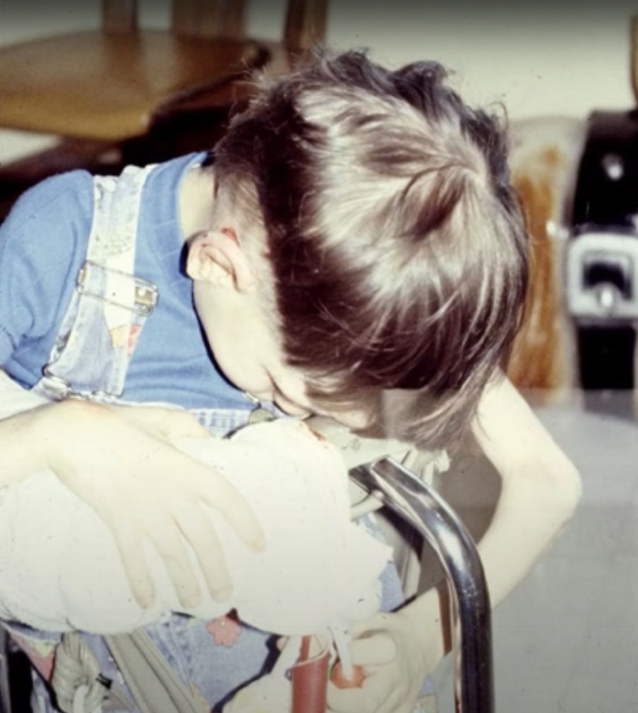
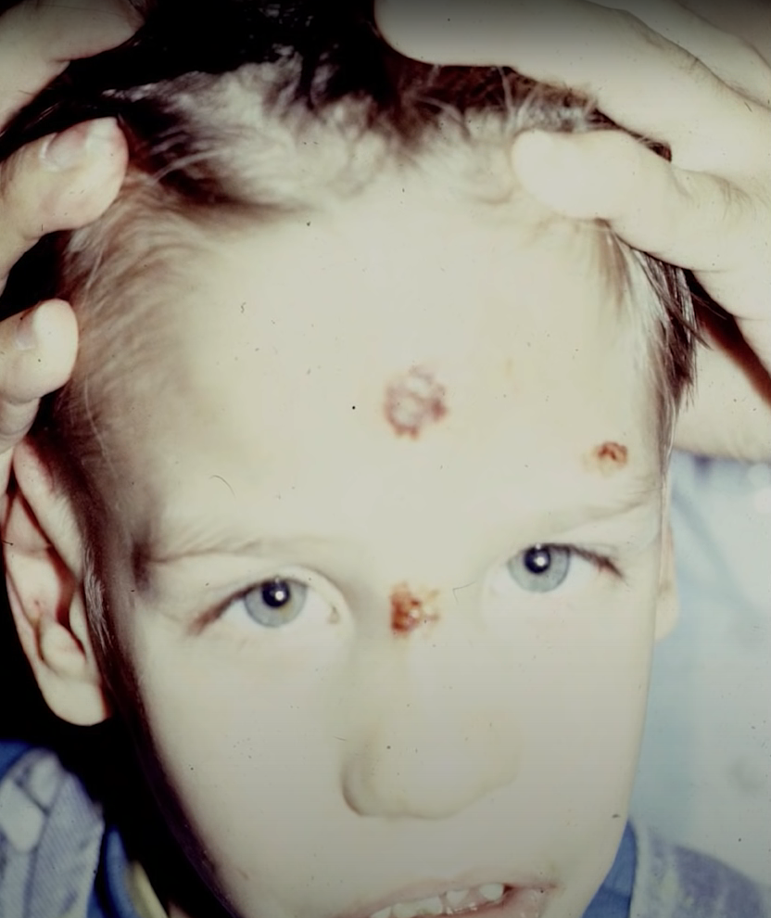
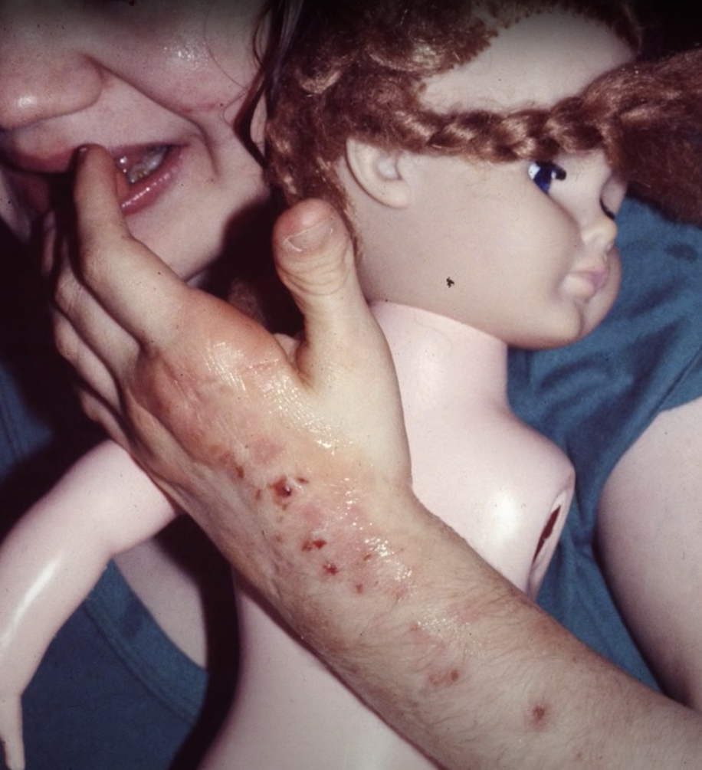
Adapted from Dr. Brian Iwata’s presentation on the assessment and treatment of SIB at Western Michigan University, 2014
Notes:
Photos of destructive behavior

Slide 20
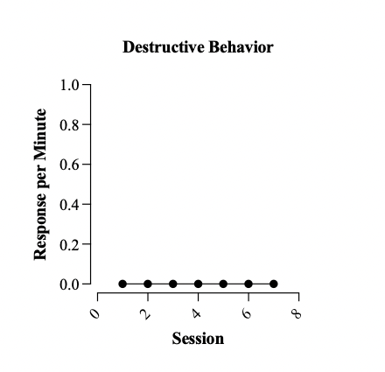

Slide 21
Name some examples of treatment you’ve implemented……Give me your best! ☺

Slide 22
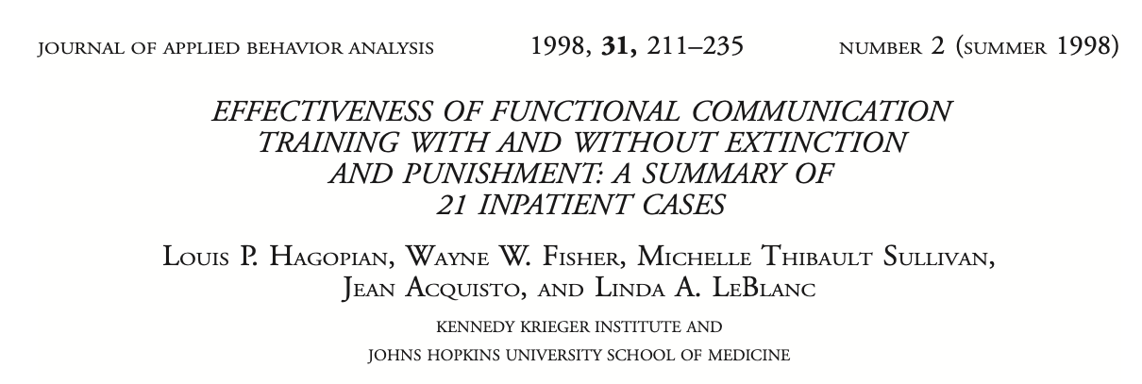
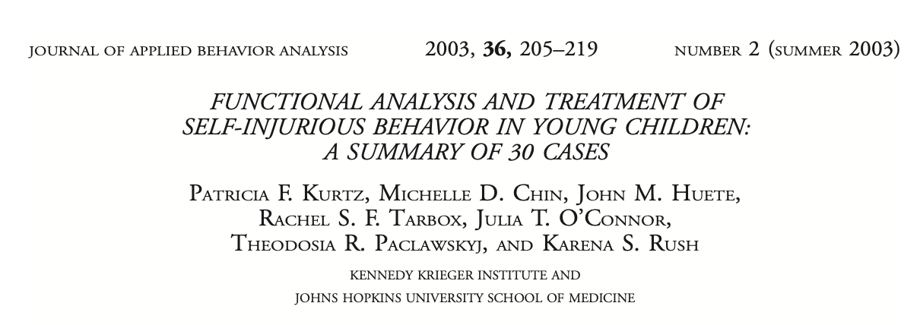
Notes:
21
30
25
25 (add Jessel)

Slide 23
Malik
Anthony
Landon
Houston
Kylie
Lawrence
Ishmael
Sarah

Slide 24
Treatment Relapse
Return of the problem after successful treatment
Resurgence
Renewal
Reinstatement
Recovery
Notes:
Treatment Relapse

Slide 25
Resurgence
Renewal
Reinstatement
Recovery
Resurgence
Renewal
Reinstatement
Recovery
Resurgence
Renewal
Reinstatement
Recovery
Resurgence
Renewal
Reinstatement
Recovery
Resurgence
Renewal
Reinstatement
Recovery
Resurgence
Renewal
Reinstatement
Recovery
Resurgence
Renewal
Reinstatement
Recovery
Resurgence
Renewal
Reinstatement
Recovery
Resurgence
Renewal
Reinstatement
Recovery
Resurgence
Renewal
Reinstatement
Recovery
Resurgence
Renewal
Reinstatement
Recovery
Resurgence
Renewal
Reinstatement
Recovery
Resurgence
Renewal
Reinstatement
Recovery
Resurgence
Renewal
Reinstatement
Recovery
Resurgence
Renewal
Reinstatement
Recovery
Resurgence
Renewal
Reinstatement
Recovery
Resurgence
Renewal
Reinstatement
Recovery
Resurgence
Renewal
Reinstatement
Recovery
Resurgence
Renewal
Reinstatement
Recovery
Resurgence
Renewal
Reinstatement
Recovery
Resurgence
Renewal
Reinstatement
Recovery
Resurgence
Renewal
Reinstatement
Recovery
Resurgence
Renewal
Reinstatement
Recovery
Resurgence
Renewal
Reinstatement
Recovery
Notes:
Say it 5 times fast ☺

Slide 26
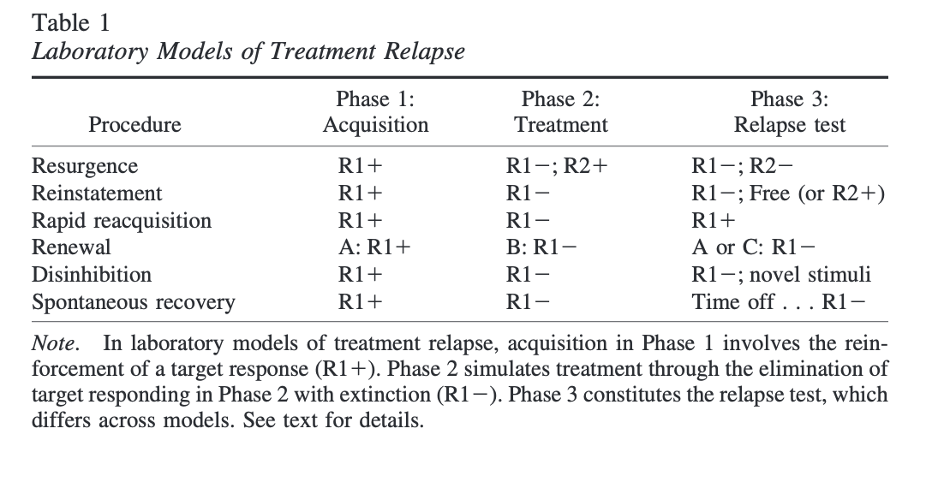

Slide 27
Treatment Relapse
Return of the problem after successful treatment
Resurgence: Problem comes back because the alternative response is challenged

Slide 28
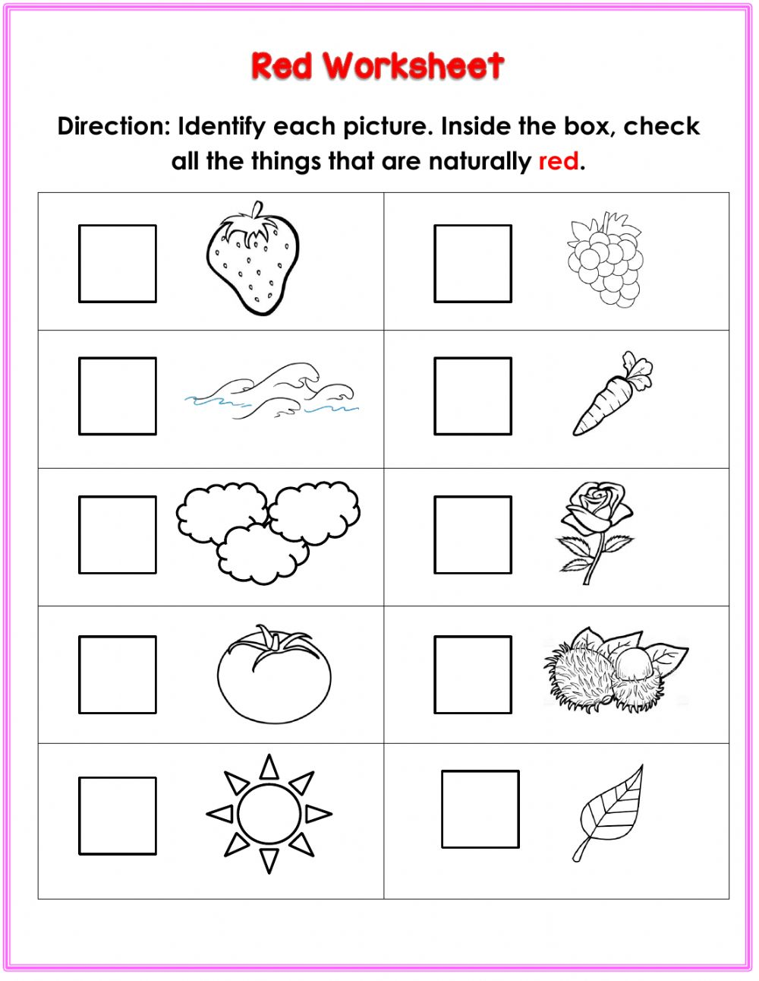
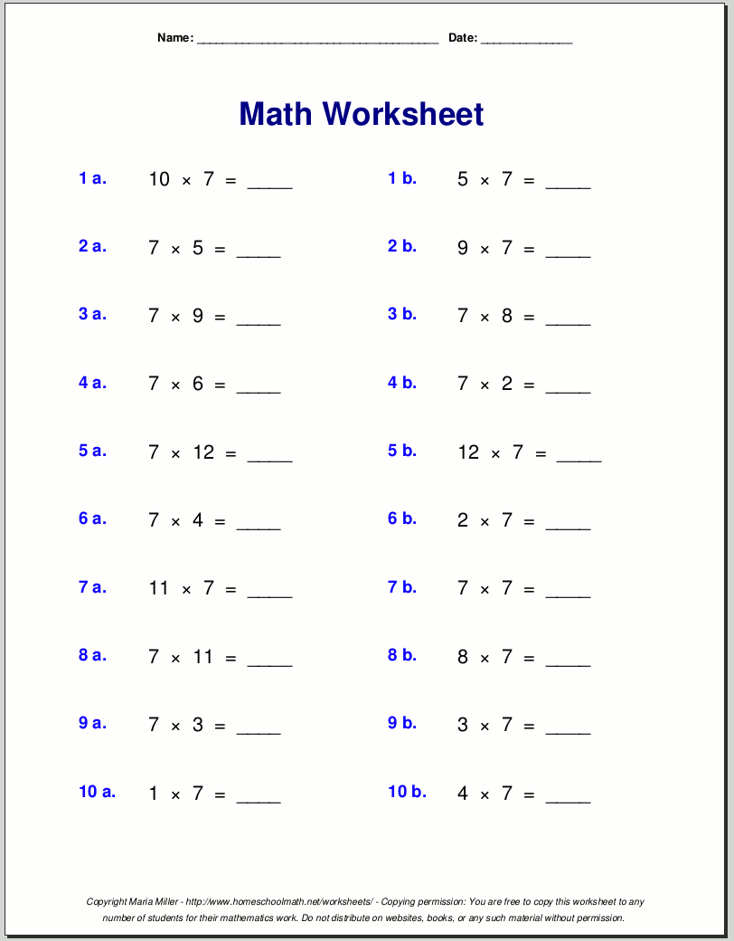
Resurgence Example
Session 1
Session 8
Notes:
PAUSE AND EXAMPLES

Slide 29
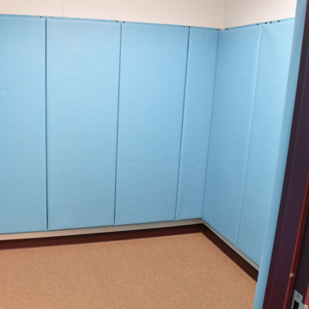
Treatment Relapse
Return of the problem after successful treatment
Renewal: Problem comes back because of change in context
Notes:
Treatment Relapse

Slide 30
Renewal Example
Session 1-3
Session 4
Notes:
PAUSE AND EXAMPLES

Slide 31
Treatment Relapse
Return of the problem after successful treatment
Reinstatement:
Problem returns after free delivery of the reinforcer
Notes:
Treatment Relapse

Slide 32
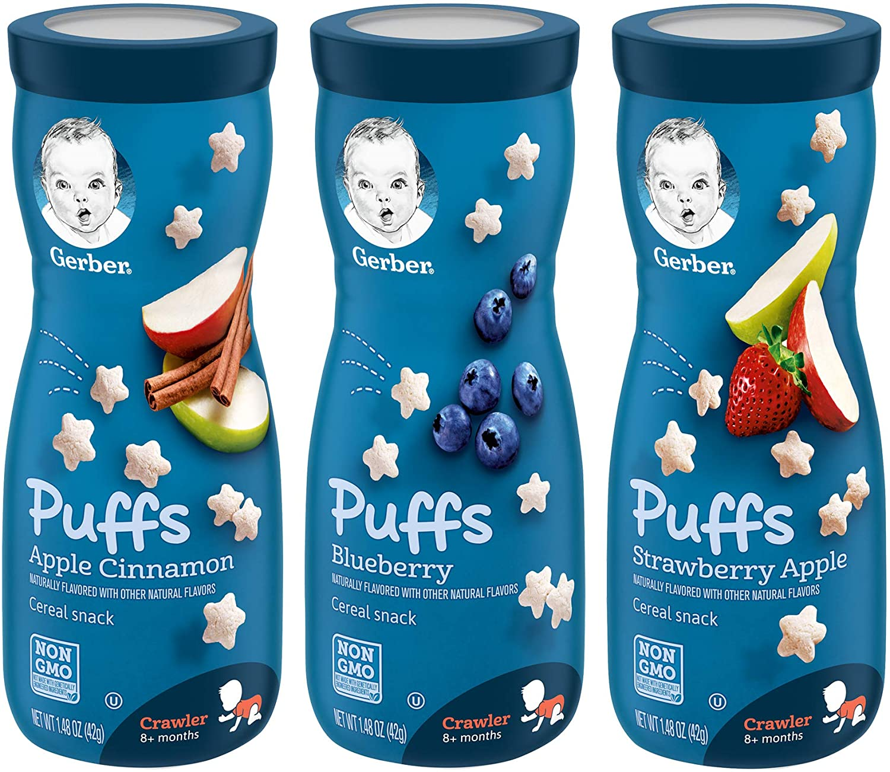
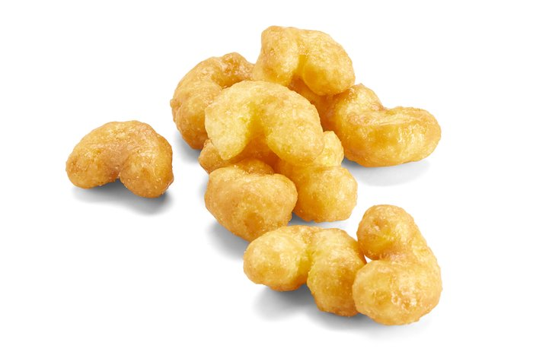
Reinstatement Example
Mom
Aunt Kay Bay
Notes:
PAUSE AND EXAMPLES

Slide 33
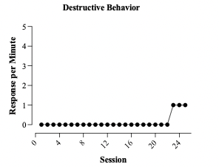
Treatment Relapse
Return of the problem after successful treatment
Recovery:
Problem comes back after awhile
🤷‍♀️
Notes:
Treatment Relapse

Slide 34
Recovery Example
Weeks of Successful Intervention
Spontaneous Recovery
Notes:
PAUSE AND EXAMPLES

Slide 35
Treatment Relapse
Return of the problem after successful treatment
Resurgence
Renewal
Reinstatement
Recovery
🤷‍♀️

Slide 36
Resurgence
Renewal
&

Slide 37
Resurgence
How do we evaluate its occurrence in research?
How do we evaluate its occurrence in clinical work?

Slide 38
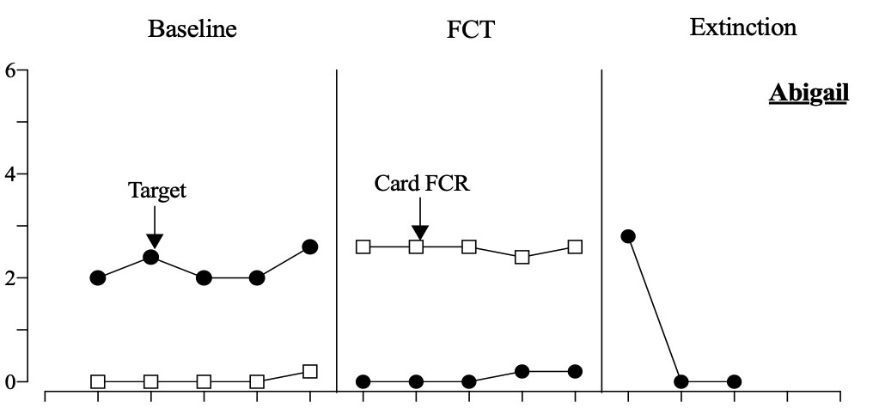
Responses per Minute
Sessions
Randall, Greer, Smith, & Kimball, 2021

Slide 39
Responses per Minute
Sessions

Slide 40
Responses per Minute
Sessions
Randall, Greer, Smith, & Kimball, 2021

Slide 41
Responses per Minute
Sessions

Slide 42
Responses per Minute
Sessions
Randall, Greer, Smith, & Kimball, 2021

Slide 43
Responses per Minute
Sessions

Slide 44
Responses per Minute
Sessions
Randall, Greer, Smith, & Kimball, 2021

Slide 45
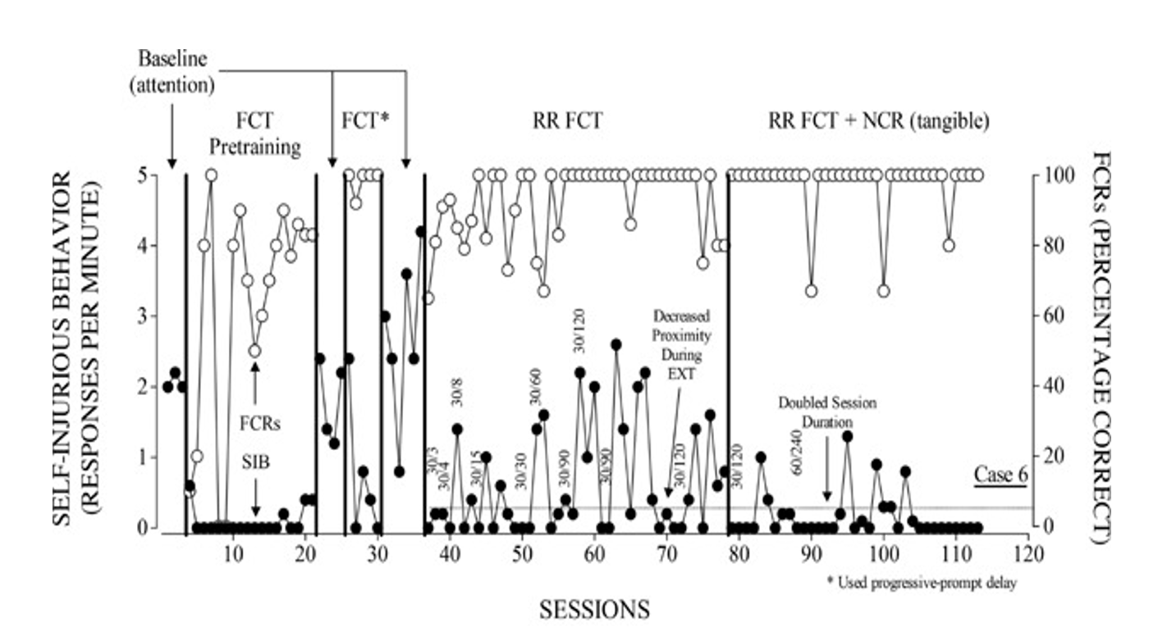
Greer, Fisher, Saini, Owen, & Jones, 2015

Slide 46
How prevalent is resurgence in clinical cases?

Slide 47
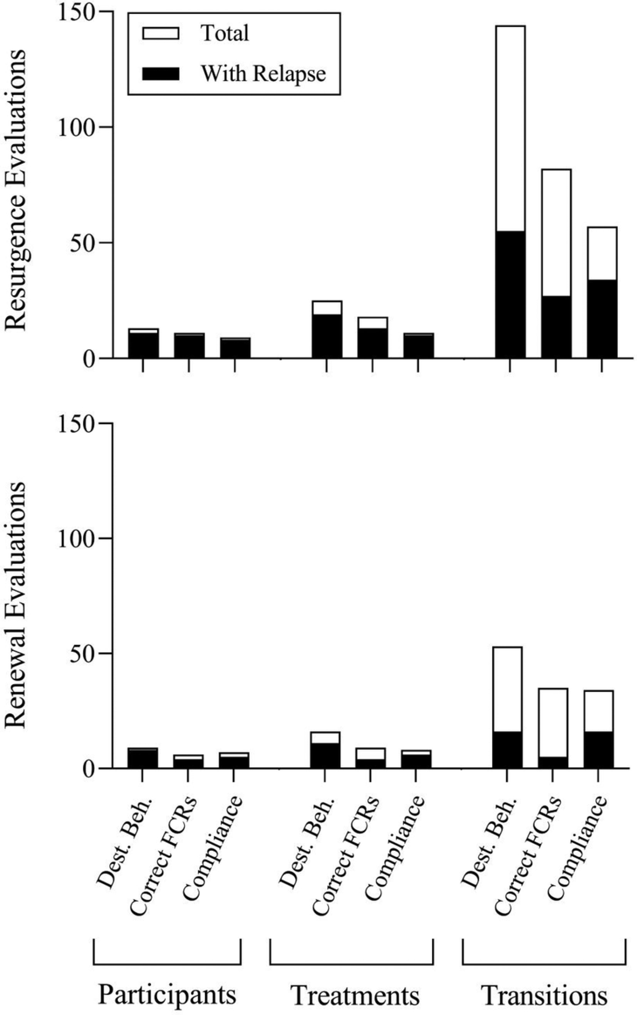
Mitteer, Greer, Randall, & Haney, 2022

Slide 48
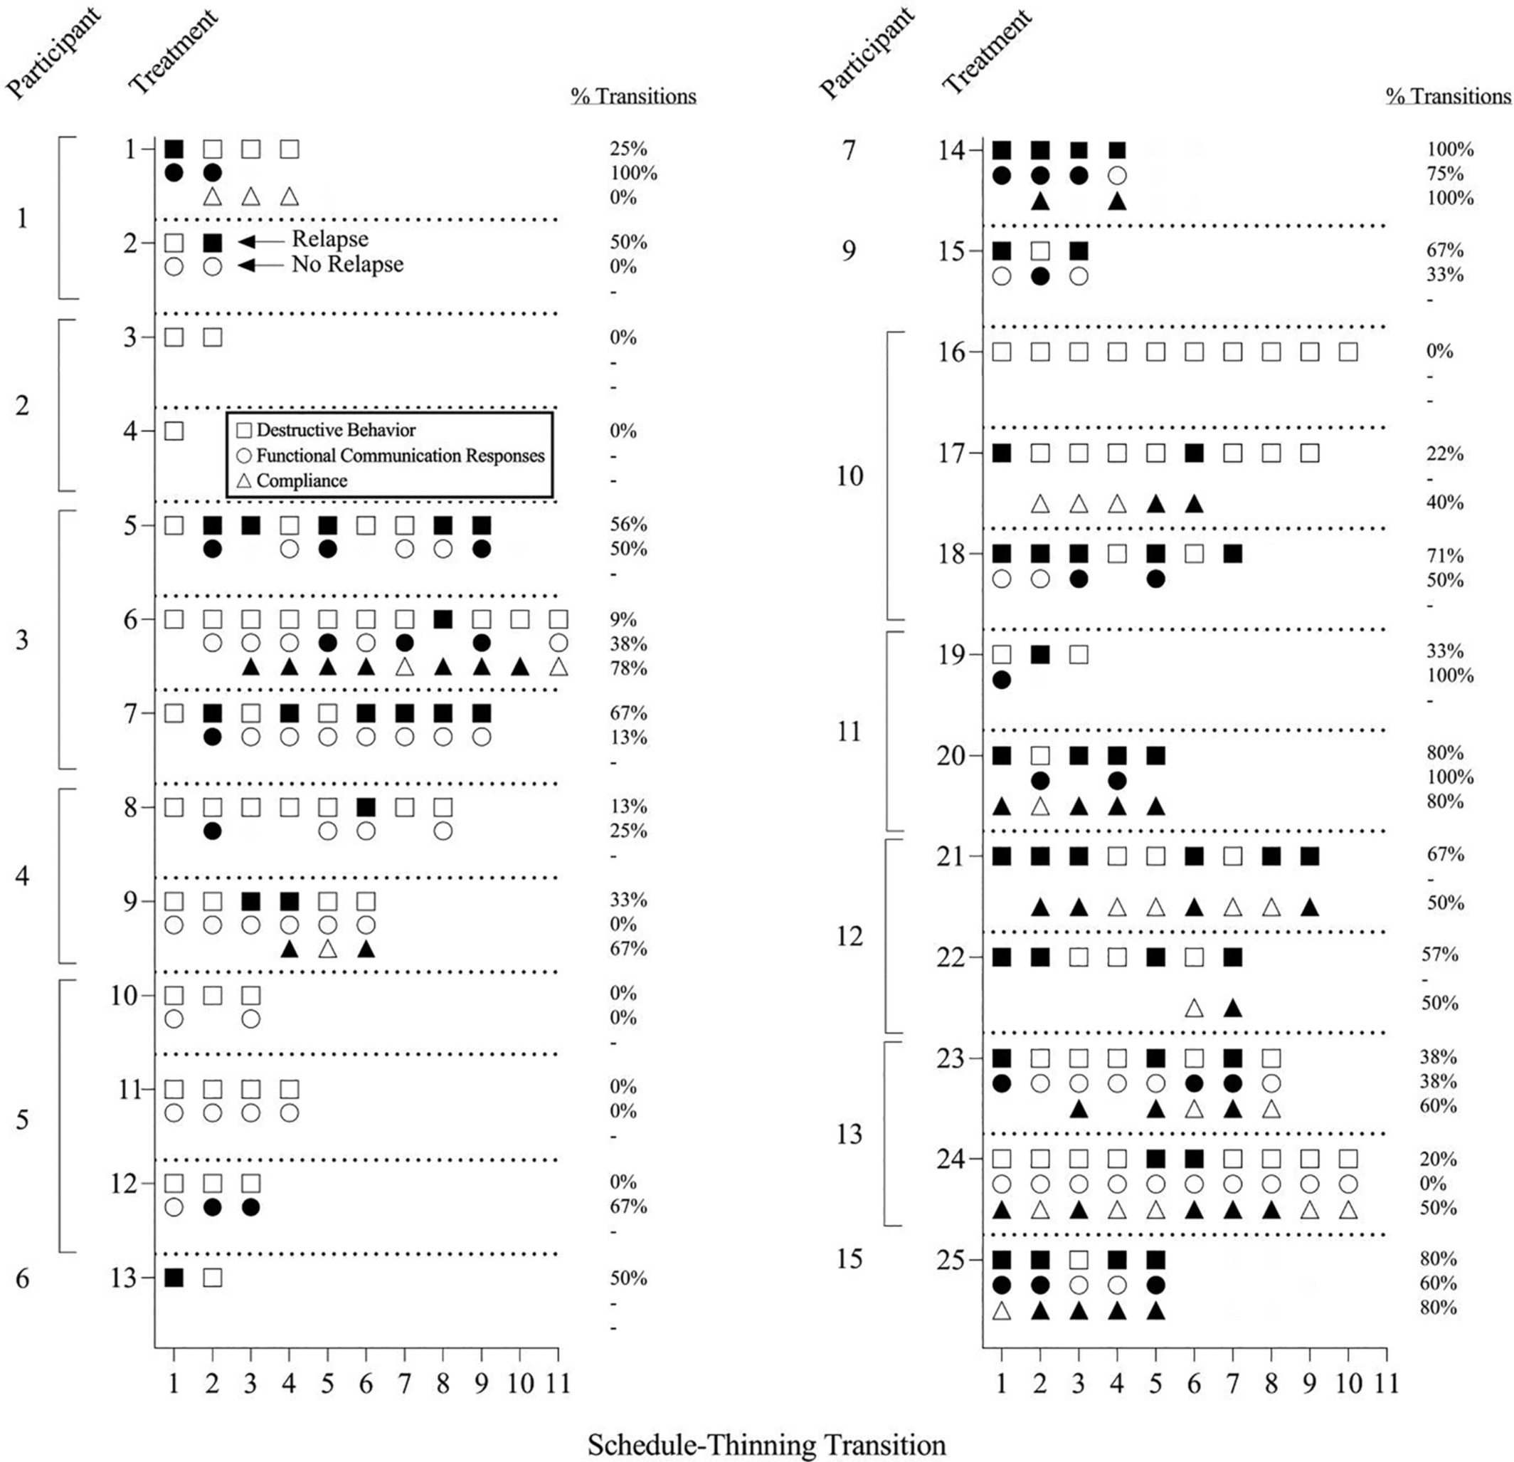
Mitteer, Greer, Randall, & Haney, 2022

Slide 49
Generality of Prevalence of Resurgence
76% (Briggs et al., 2018)
91% (Kranak et al., 2021)
91% (Muething et al., 2021b)
76% (Mitteer et al., 2022)
Notes:
Resurgence

Slide 50
Renewal
How do we evaluate its occurrence in research?
How do we evaluate its occurrence in clinical work?

Slide 51
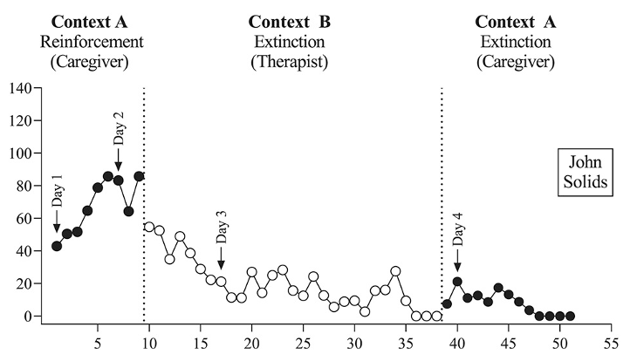
Context A
Context B
Context A
Inappropriate Mealtime Behavior per Minute
Sessions
Haney, Piazza, Peterson, & Greer, 2021

Slide 52
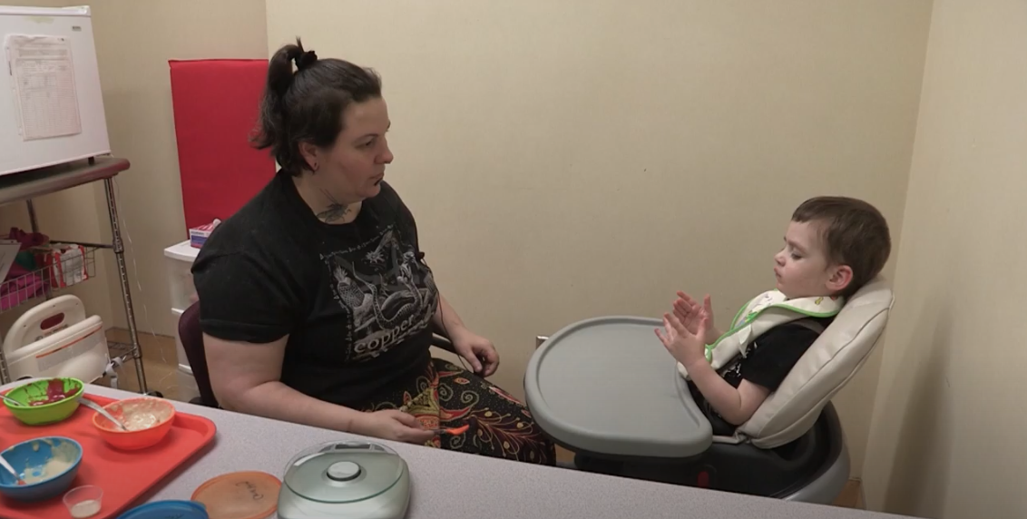
Adapted from Munroe-Meyer Pediatric Feeding Disorder’s Program, 2019

Slide 53
Context A
Context B
Context A
Inappropriate Mealtime Behavior per Minute
Sessions
Haney, Piazza, Peterson, & Greer, 2021

Slide 54
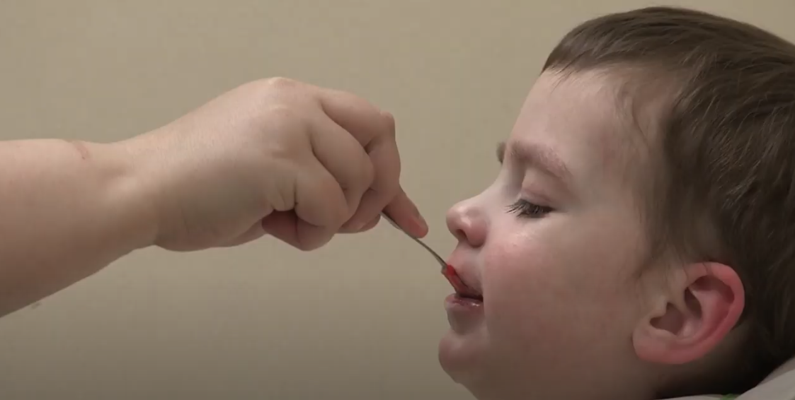
Adapted from Munroe-Meyer Pediatric Feeding Disorder’s Program, 2019

Slide 55
Context A
Context B
Context A
Inappropriate Mealtime Behavior per Minute
Sessions
Haney, Piazza, Peterson, & Greer, 2021

Slide 56
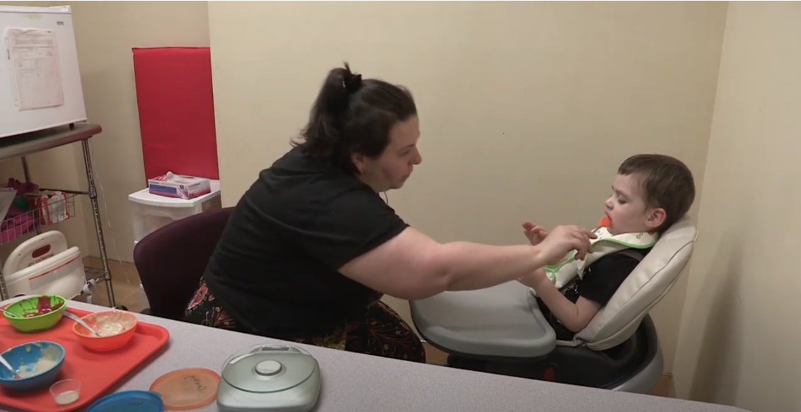
Adapted from Munroe-Meyer Pediatric Feeding Disorder’s Program, 2019

Slide 57
Context A
Context B
Context A
Inappropriate Mealtime Behavior per Minute
Sessions
Haney, Piazza, Peterson, & Greer, 2022

Slide 58
How prevalent is renewal in clinical cases?

Slide 59
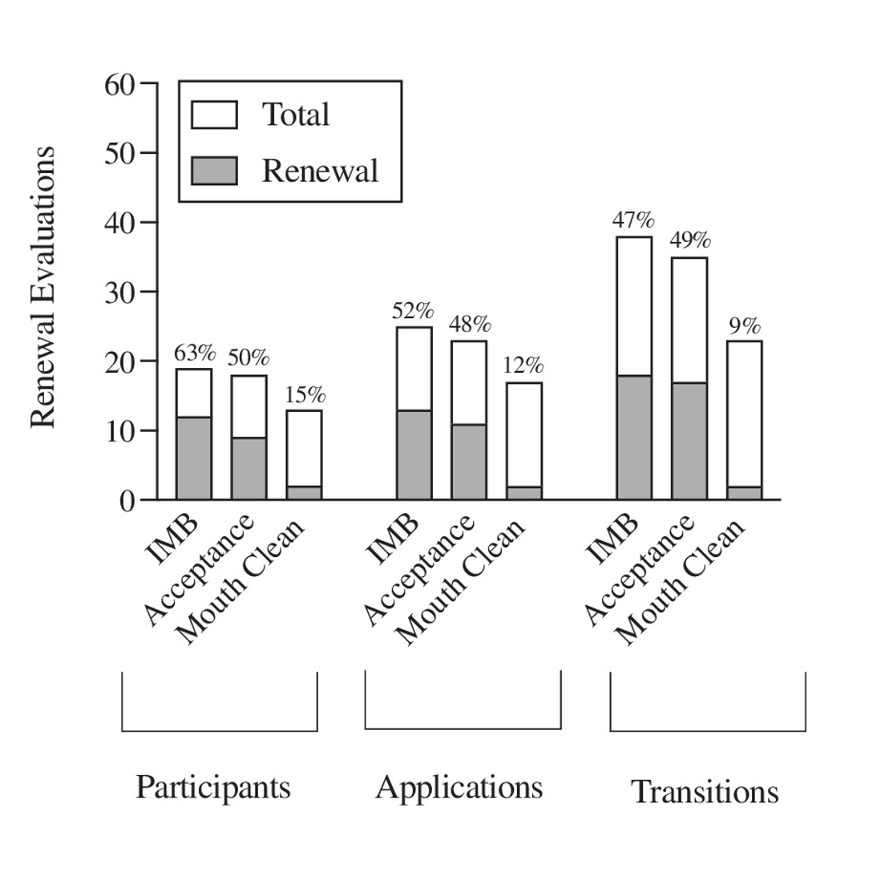
Haney, Greer, Mitteer, & Randall, 2022

Slide 60
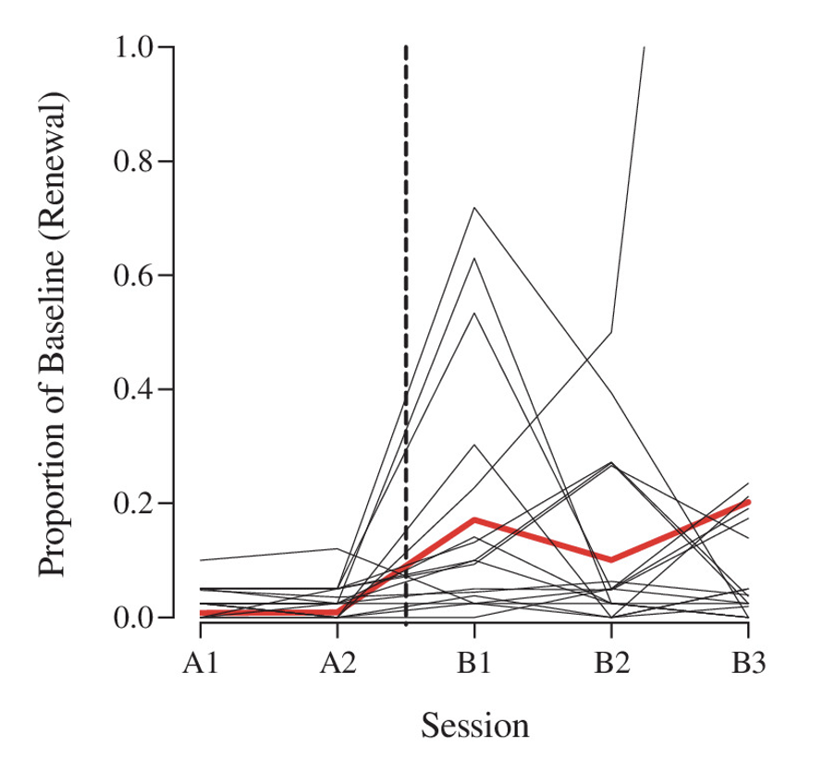
Haney, Greer, Mitteer, & Randall, 2022

Slide 61
Generality of Prevalence of Renewal
52% (Haney et al., 2022) (Feeding)
58% (Falligant et al., 2021)
67% (Muething et al., 2020)
69% (Mitteer et al., 2022)
Notes:
Resurgence

Slide 62
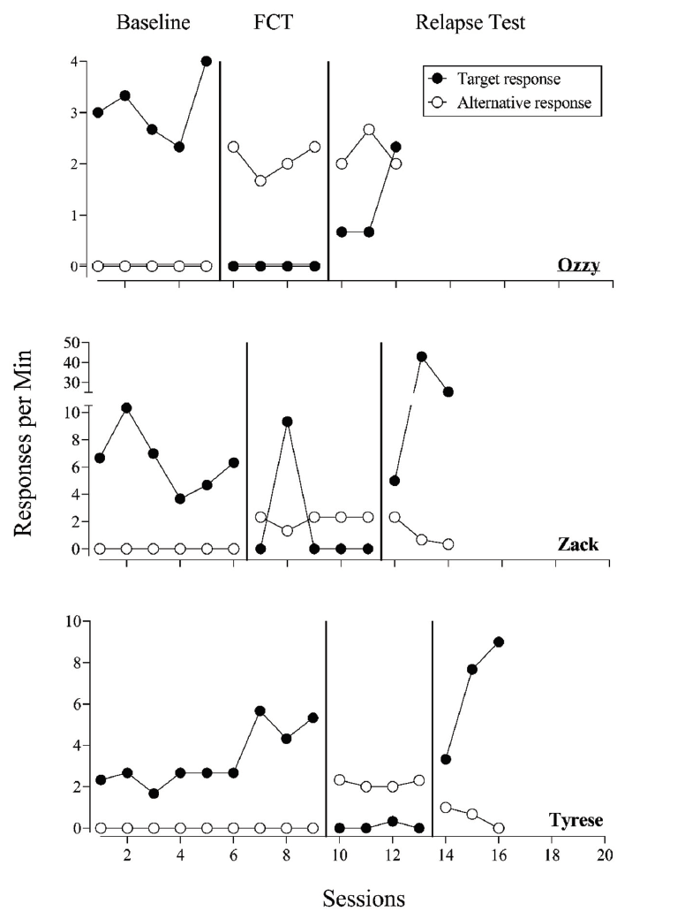
Resurgence &
Renewal
Mitteer, Greer, Randall, Kimball, & Smith, 2021

Slide 63
Malik
Anthony
Landon
Over 10-year period, 40% of cases had at least one readmission (Hurd & Brown, 2022)
Houston
Kylie
Lawrence
Ishmael
Sarah

Slide 64
Mitigating Resurgence
Discriminative/
Correlated Stimuli
Fisher et al., 2020
Craig et al., 2017
Fisher et al., 2016
Gradually thin SR+
Falligant et al., 2021
Shahan & Greer, 2021
Increase Tx Duration
Fisher et al., 2018a
Greer et al., 2020
Smith & Greer, 2021
Competing Items
Fuhrman et al., 2018
On/Off Alternative Reinforcement
Shahan et al., 2020
Wacker et al., 2013
Select Non-Retractable Alternative Responses
Kimball et al., 2018
Randall et al., 2021
Minimize EO Exposure
Fisher et al., 2018b
Randall et al., 2021
Lambert et al., 2021
Serial Alternative Responses
Lambert et al., 2015, 2017
Fuhrman et al., 2021
Use lean SR+ in Baseline
Fisher et al., 2018
Notes:
Underlined are approach with caution

Slide 65
Mitigating Renewal
Multiple Context Training
Kelley et al., 2018
Context Fading
Haney et al., 2021
Program Correlated Stimuli
Fisher et al., 2015
Mace et al., 2010
Incorporate alternative reinforcement
Kimball et al., 2020
Combine correlated stimuli and multiple contexts
Podlesnik et al., 2017

Slide 67
Caregiver Take Home Points
You are not alone! You have not failed!
When possible, attempt to keep consistent and simple
Take notes and data when you can (baseball counters, Countee, notes app)
Consider the context and consider how you responded to the behavior
Use signals, rules, and enriched environments
Remember behavior takes time to change!
Seek resources available to you, I’m here to help you or put you in touch with someone who can!
krandall@georgiasouthern.edu
Notes:
Resurgence

Slide 68
Clinician Take Home Points
Evaluate if discharge criteria are sufficient
Spend more time training the alternative response (Randall, Brown, Kimball, Niercessan, & Bach, 2022)
More practice the better!
Conduct regular client follow up
Consider a family-centered care approach (Brown, Hurd, Randall, Szabo, & Mitteer, submitted)
Consider conducting clinical research
Read basic, applied, and translational research ☺
Kimball & Kranak, 2022; St. Peter, 2015
Notes:
Resurgence

Slide 69
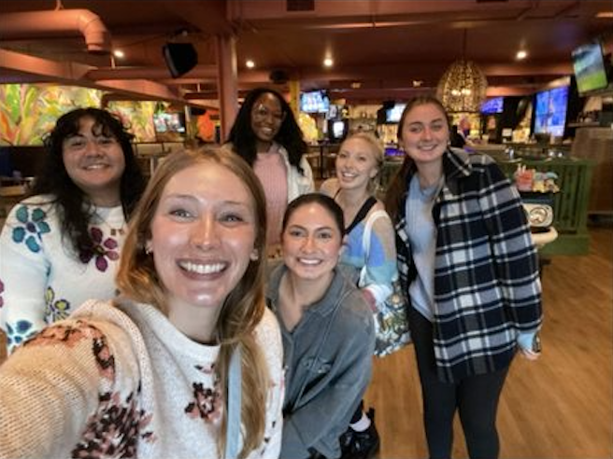
Students of Translational and Applied Research with Dr. Randall (STARR) LAB

Slide 70
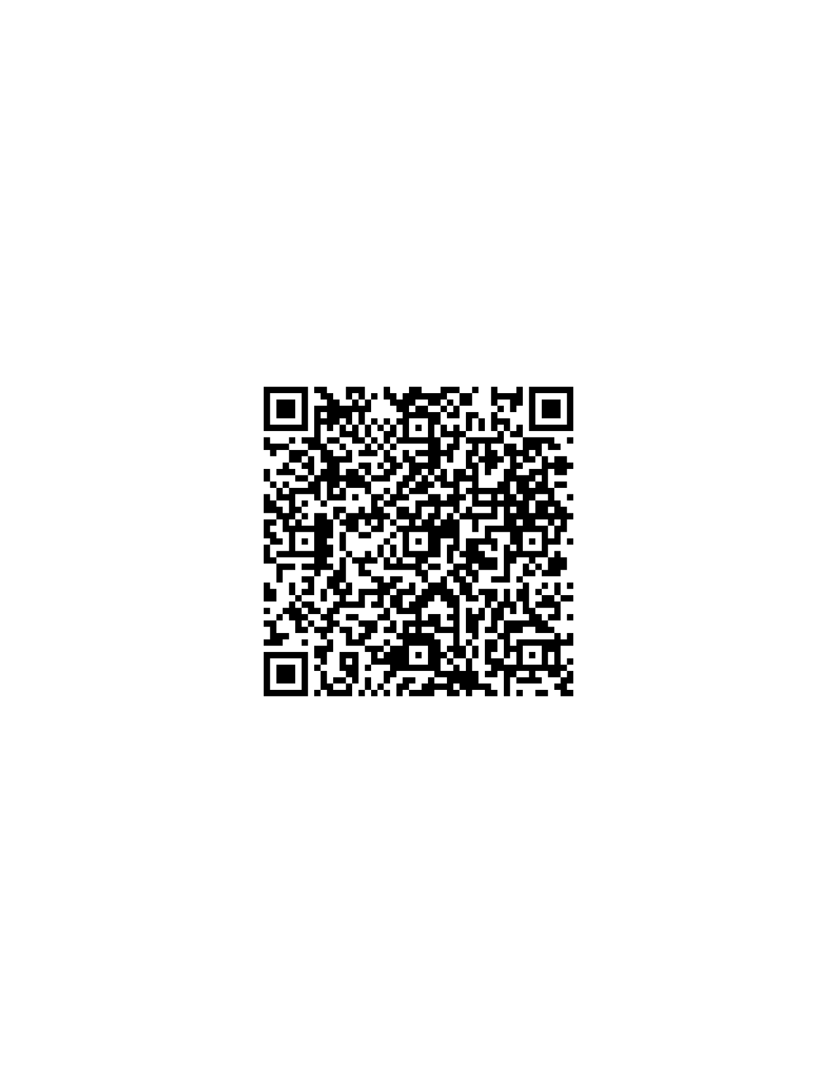
Ongoing Studies!

Slide 71
Dr. Kayla Randall krandall@georgiasouthern.edu

Slide 72
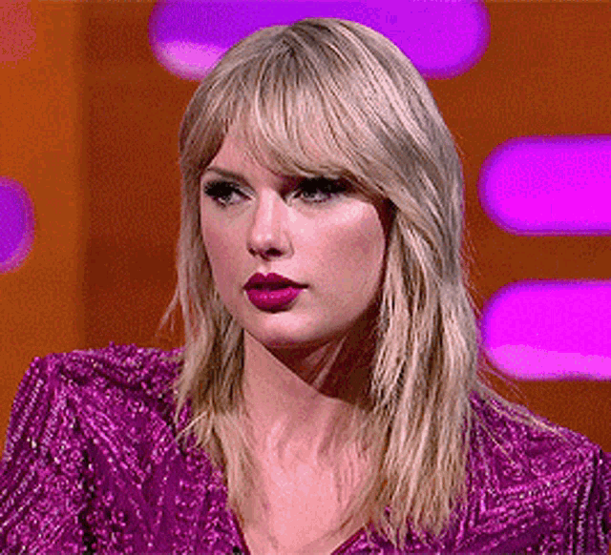

Slide 73
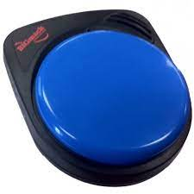
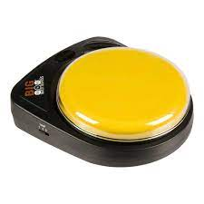
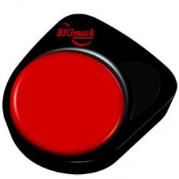
Mitigating Resurgence
“Toys, please.”
“Toys.”
“I want toys.”
Serial Alternative Responses
Lambert et al., 2015, 2017
Fuhrman et al., 2021

Slide 74
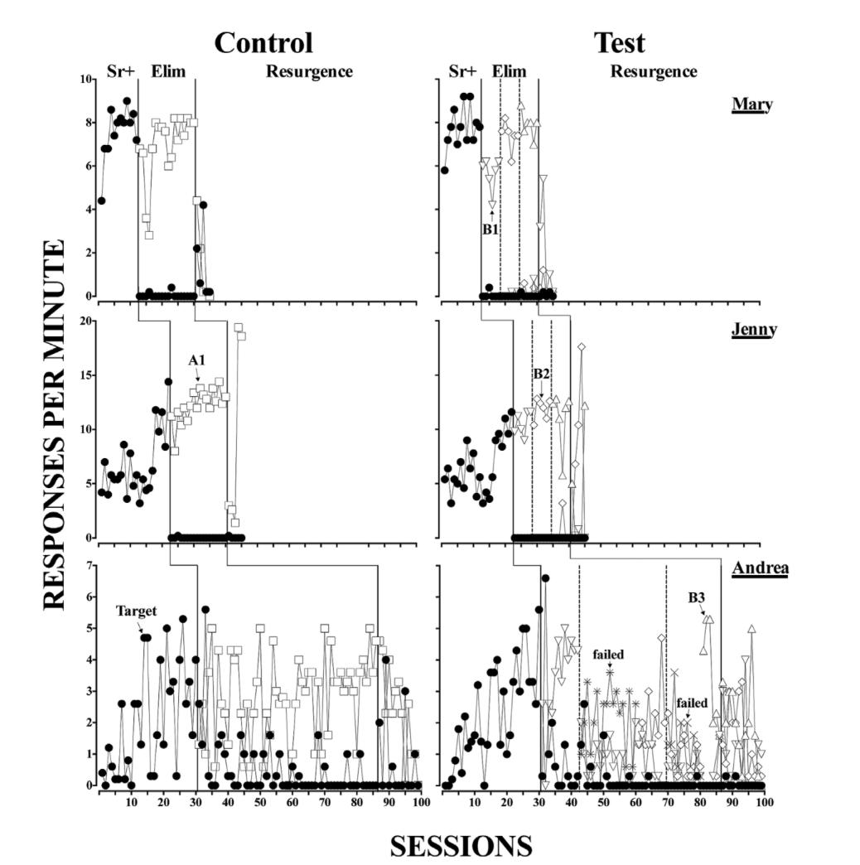
Response 1
Response 2
Response 3
Response 4
Lambert, Bloom, Samaha, Dayton, & Rodewald, 2015
Notes:
But see Fuhrman et al., 2021 on a review of expanded operant

Slide 75
Mitigating Resurgence
Discriminative/
Correlated Stimuli
Fisher et al., 2020
Craig et al., 2017
Fisher et al., 2016
Adapted from Dr. Wayne Fisher’s presentation on clinical applications of FCT at Western Michigan University, 2014
Notes:
SET UP THIS VIDEO

Slide 76
SR+
Ext

Slide 77
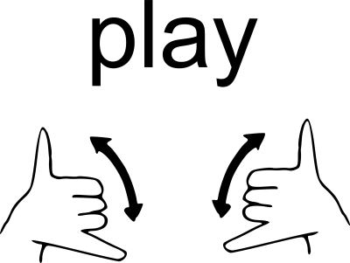
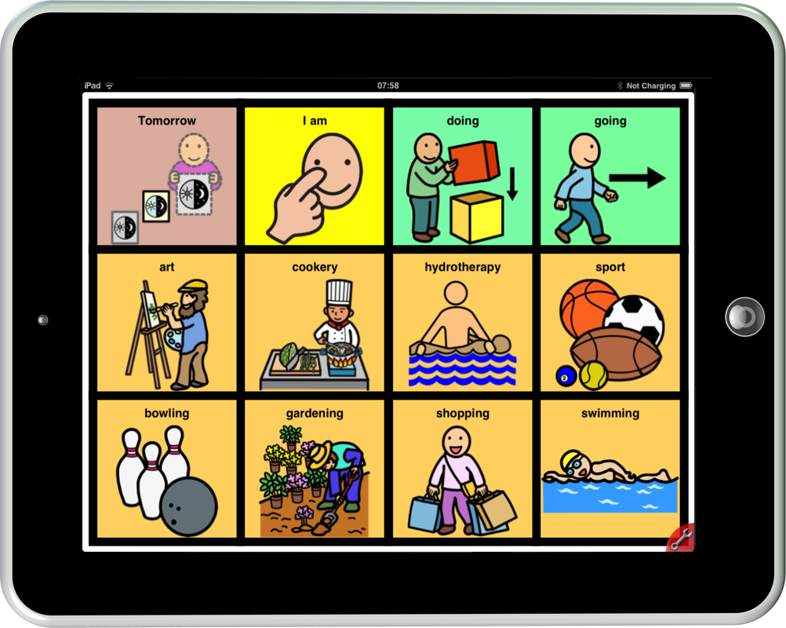
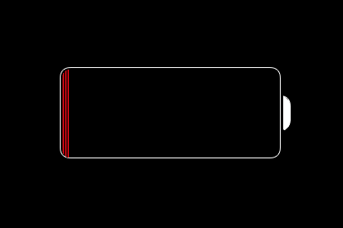
Mitigating Resurgence
Select Non-Retractable Alternative Responses
Kimball et al., 2018
Randall et al., 2021
Notes:
Only translational research

Slide 78
Therapist Behavior
Say “May I?”
Time (s)
Participant Behavior
Randall, Greer, Smith, & Kimball, 2021

Slide 79
Mitigating Resurgence
S^{D}
S∆
Gradually thin SR+
Falligant et al., 2021
Shahan & Greer, 2021
³⁰
³⁰
Reinforcement component is never less than about 25% of extinction component
³⁰
⁴⁵
³⁰
⁶⁰

Slide 80
30-s
2-s
SR+
EXT
”Slime, please.”
”Slime, please.”

Slide 81
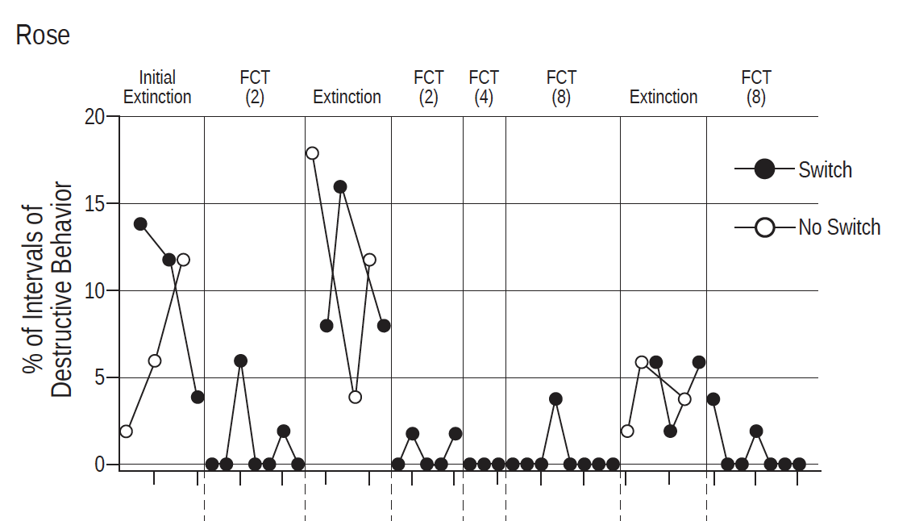
Mitigating Resurgence
^{Sessions 1-8: Treatment}
On/Off Alternative Reinforcement
Shahan et al., 2020
Wacker et al., 2013
^{Sessions 9-15: Extinction}
Wacker et al., 2013
^{Sessions 16-21: Treatment}

Slide 82
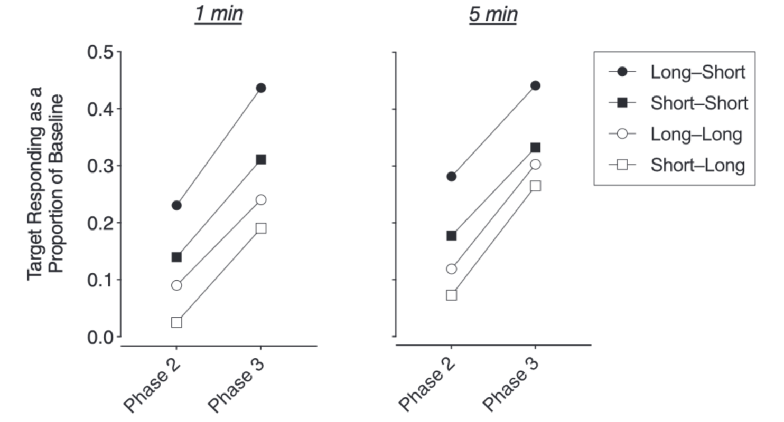
Mitigating Resurgence
Increase Tx Duration
Fisher et al., 2018a
Greer et al., 2020
Smith & Greer, 2021
Shorter baselines and longer time in treatment generally mitigates resurgence
Smith & Greer, 2021

Slide 83
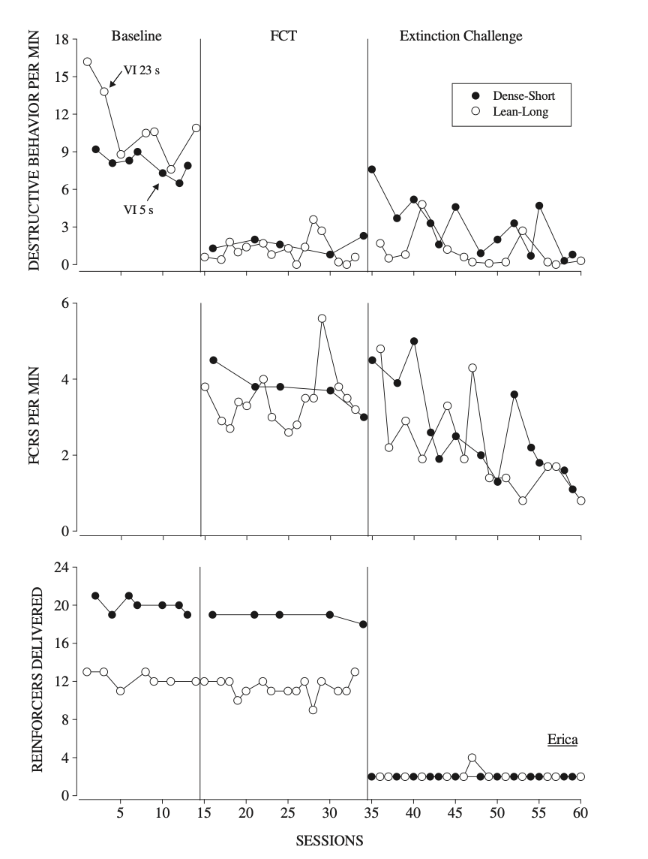
Dense Schedules of Reinforcement
+
Shorter Treatment Duration
=
More Resurgence
Lean Schedules of Reinforcement
+
Longer Treatment Duration
=
Less Resurgence

Slide 84
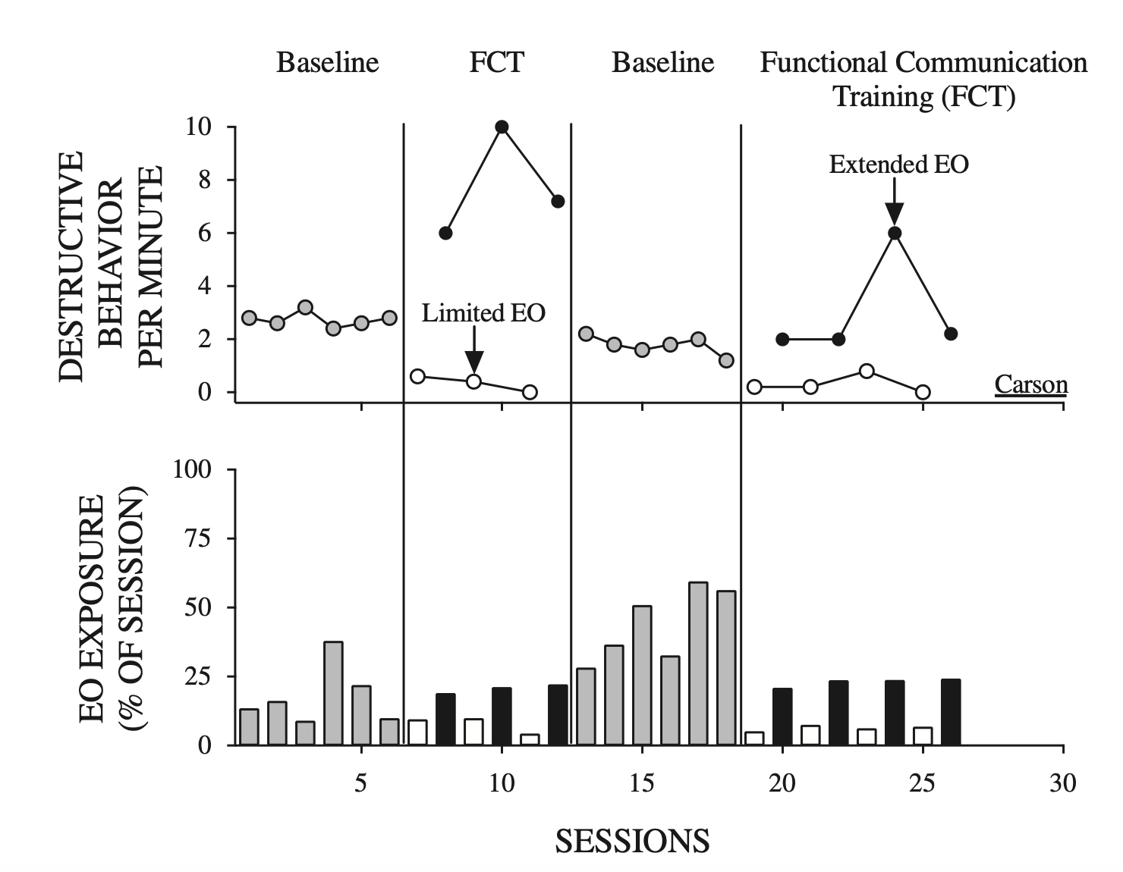
Mitigating Resurgence
Fisher et al., 2018b
Minimize EO Exposure
Fisher et al., 2018b
Randall et al., 2021
Lambert et al., 2021
Notes:
Did not specifically evaluate resurgence; Within application

Slide 85
EO

Slide 86
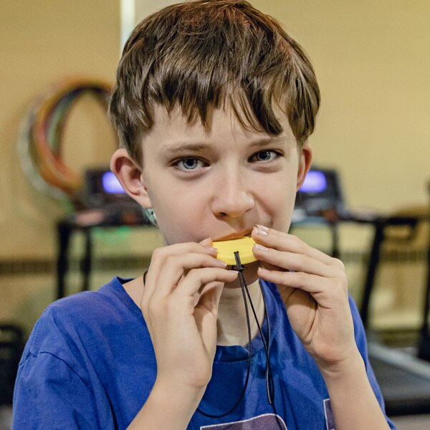
Mitigating Resurgence
S∆
Competing Items
Fuhrman et al., 2018
Notes:
Hands down, waiting, hands in lap, waiting for changes in conversation

Slide 87
S∆
Notes:
Competing items, increase reinforcing effects of S-Delta

Slide 88
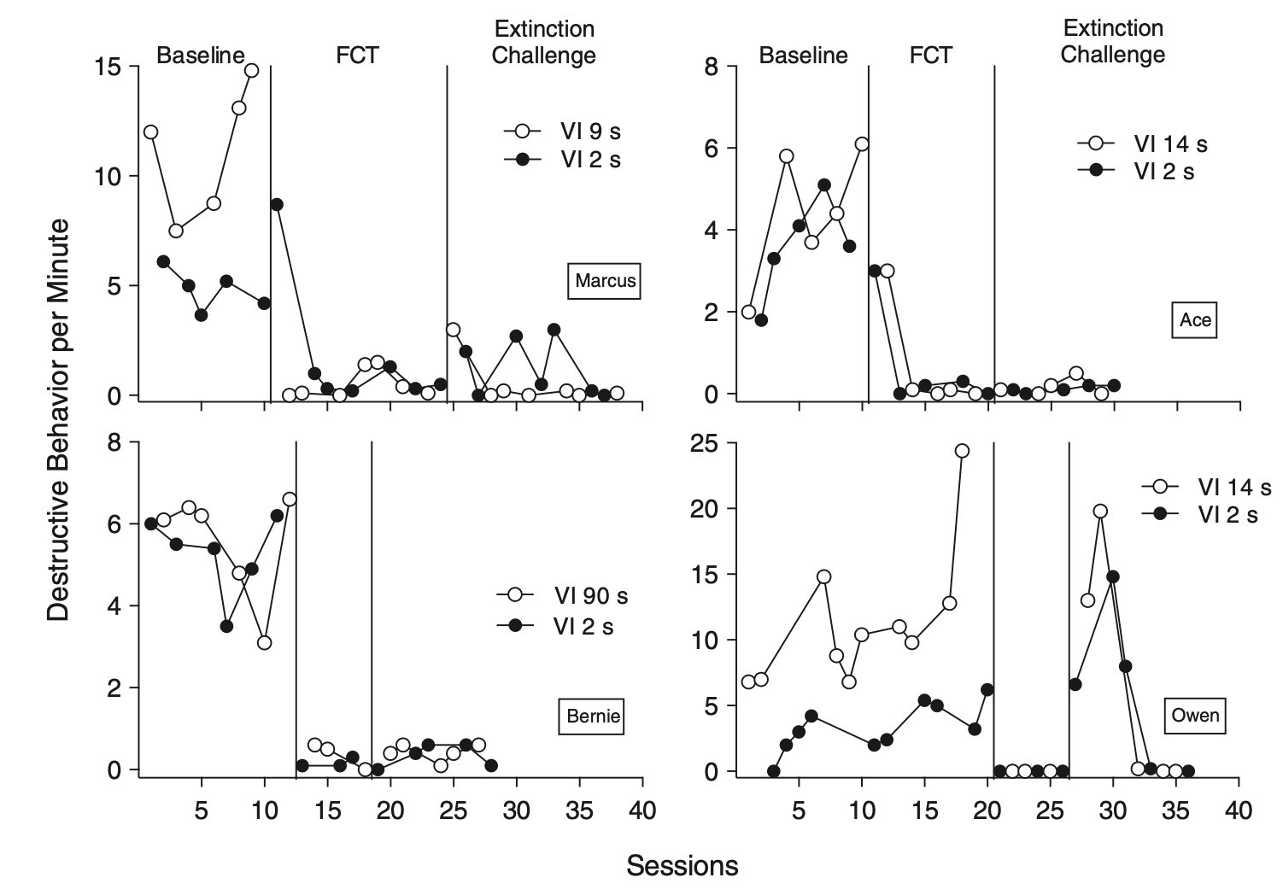
Mitigating Resurgence
Progressive Interval Assessment
&
Latency Analysis
Use lean SR+ in Baseline
Fisher et al., 2018a

Slide 89
Progressive Interval Assessment to inform Baseline

Slide 90
Mitigating Renewal
Multiple Context Training
Kelley et al., 2018
Context Fading
Haney et al., 2021
Program Correlated Stimuli
Fisher et al., 2015
Mace et al., 2010
Incorporate alternative reinforcement
Kimball et al., 2020
Combine correlated stimuli and multiple contexts
Podlesnik et al., 2017

Slide 91
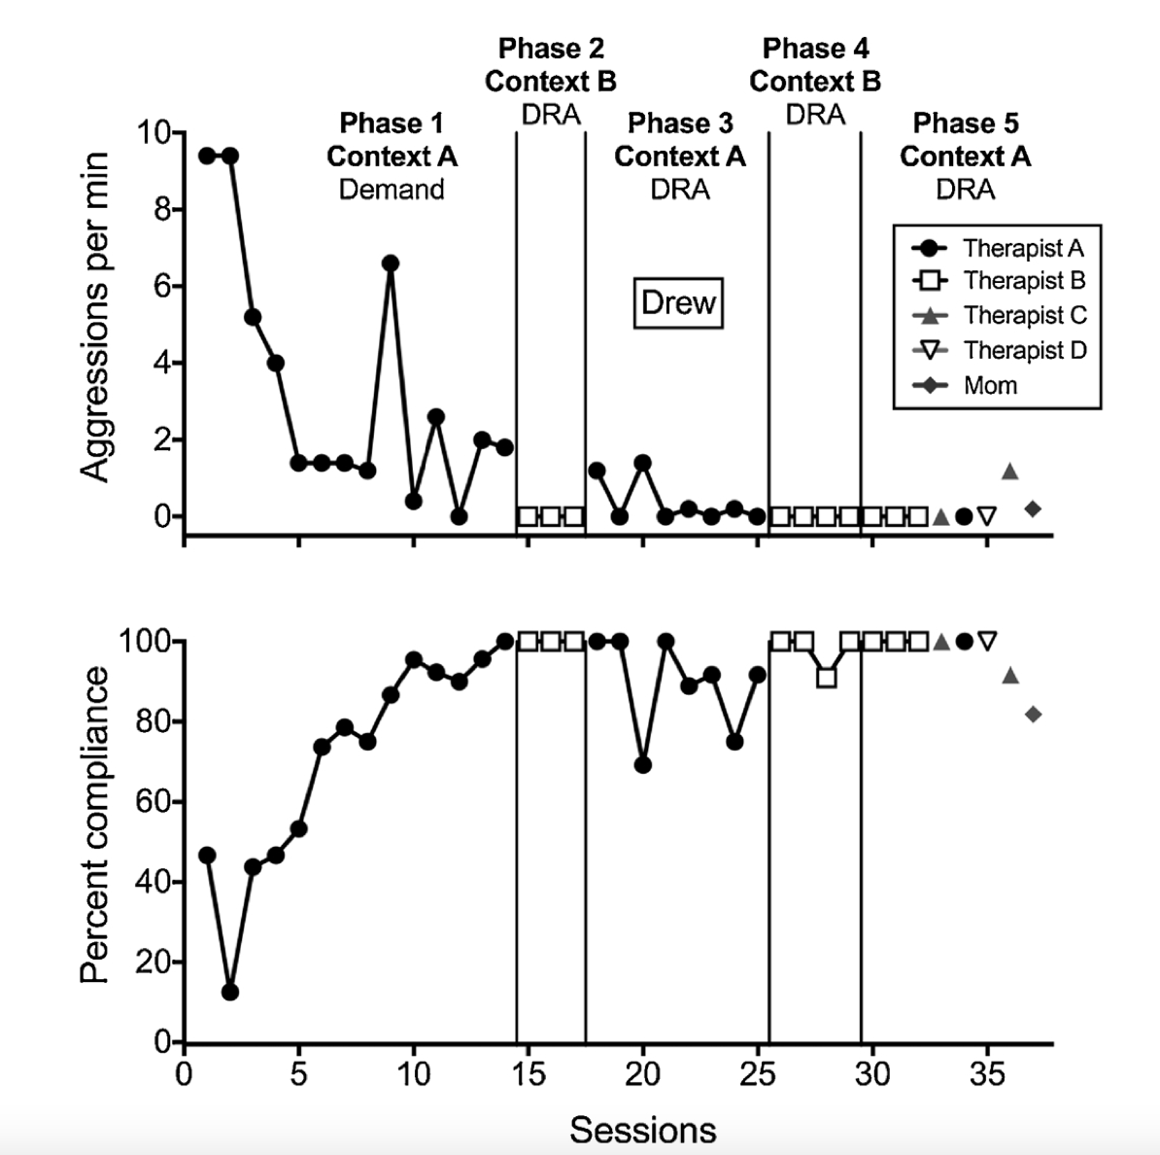
Mitigating Renewal
Multiple Context Training
Kelley et al., 2018
A
B
A
×
∝
×
∗
∝
∝
×
∅

Slide 92
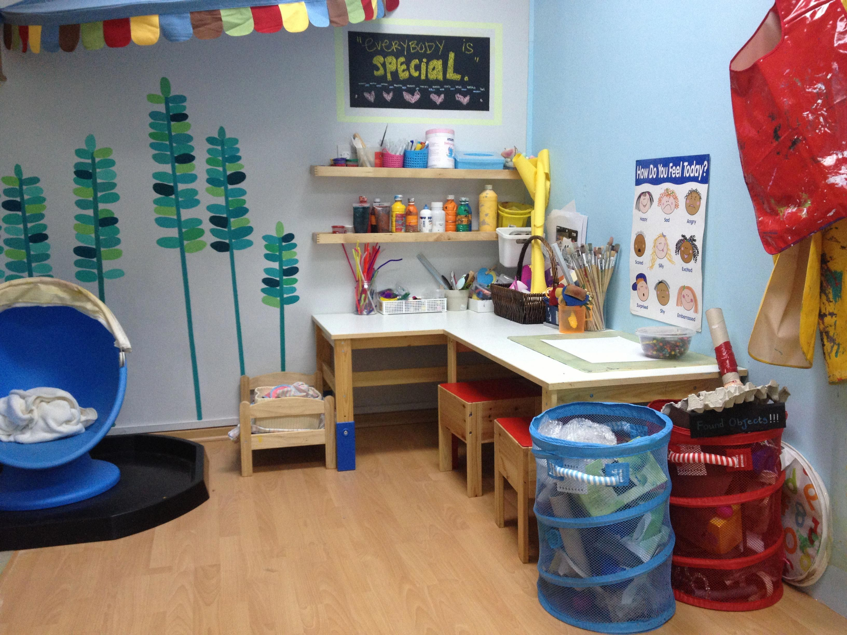
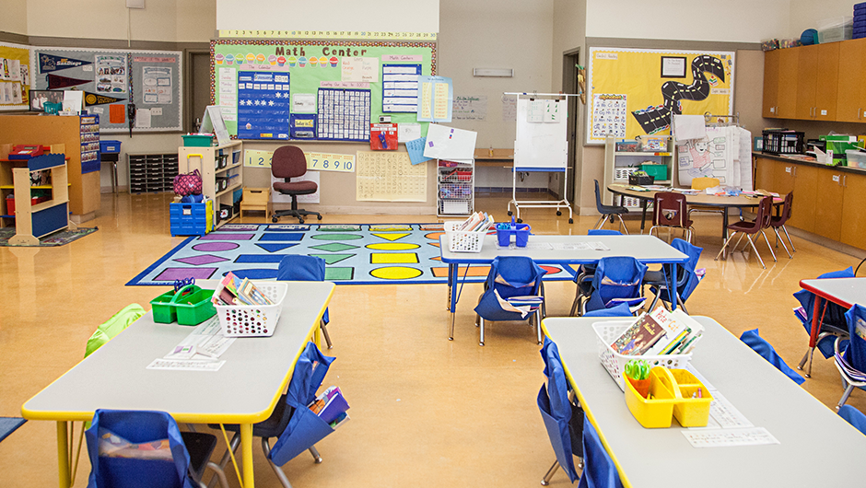
Context B, Therapist B
Context A, Therapist A
Context A, Therapist A, B, C, D

Slide 93
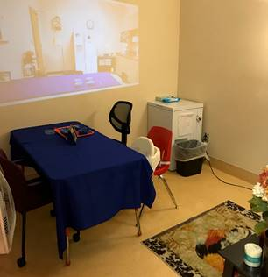
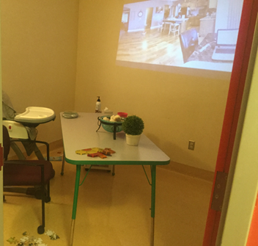
Mitigating Renewal
Context Fading
Haney et al., 2021
Julian
Jade

Slide 94
Haney, Piazza, Peterson, & Greer, 2021

Slide 95
Mitigating Renewal
Program Correlated Stimuli
Fisher et al., 2015
Mace et al., 2010

Slide 96
Extinction Cues
Fisher, Greer, Fuhrman, Saini, & Simmons, 2018

Slide 97
Mitigating Renewal
Incorporate alternative reinforcement
Kimball et al., 2020
DRA + Ext vs. Ext Alone

Slide 98
Mitigating Renewal
∝
∝
∗
×
∅
Combine correlated stimuli and multiple contexts
Podlesnik et al., 2017

Slide 99
Mitigating Other Forms of Relapse
Progressive ratio schedules paired with discriminative stimuli appeared to mitigate reinstatement (Kranak, Rooker, Aravelo, & Robinson, 2022)
Incorporating punishment into phase 2 appeared to mitigate resurgence in non-human animals (Kestner, Redner, Watkins, & Poling, 2015)

Slide 100
Other Potential Considerations
Evaluate if discharge criteria are sufficient
Spend more time training the alternative response (Randall, Brown, Kimball, Niercessan, & Bach, 2022)
Conduct regular client follow up
Consider a family-centered care approach (Brown, Hurd, Randall, Szabo, & Mitteer, submitted)
Consider conducting clinical research
Read basic, applied, and translational research ☺
Kimball & Kranak, 2022; St. Peter, 2015
Notes:
Resurgence

Slide 101
Positive Aspects of Relapse
Resurgence of previously taught responses to solve quadratic equations (Williams & St. Peter, 2019)
Resurgence of appropriate communication for individuals with ASD and severe problem behavior (Hoffman & Falcomata, 2014)
Resurgence of conditional discriminations in college students (Wilson & Hayes, 1996)

Slide 102
Questions/Stories to Share?

Slide 104
Thank you!
krandall@georgiasouthern.edu

