Slide 1

The Importance of Play in Development Implications for Practice,
Facilitating Regulation
Matthew Weneta, M.Ed.
Owner/ Director Aerie Experiences
HOME||FAQS|CAMPUSES|CONTACT US

Slide 2
Objectives:
To conceptualize play in a meaningful framework
To integrate play into programming in an intentional and prescriptive manor
To consider “play” as a tool to meet developmental tasks

Slide 3

The Apothecary

Slide 4
The Prescription: “Ludus”
Expands attention span
Boost boys’ problem solving abilities
Increase self-confidence and self-regulation
Strengthen social competence and teaches social skills
Develop identity
Reduces anxiety and diminishes stress
Boosts physical health
Expands neurological development
Antidote to loneliness, isolation, anxiety, and depression

Slide 5
Ludus Side Effects
Connects us to others
Fosters creativity, flexibility, and learning
Teaches us how to cooperate with others
Heal emotional wounds
Boosts children’s creativity and imagination.
Build new competencies
Develops resilience

Slide 6
Play Defined
Play, verb – to amuse or entertain oneself, as in recreation; to take part in a game – Webster
Play, verb – Of living beings: Active bodily exercise; brisk and vigorous action of the body or limbs, as in fencing, dancing, leaping, swimming, clapping of the hands – Oxford, 1971
Synonyms; disport, recreate, sport, amuse, divert, engage, entertain, frolic, rollick, romp - Webster

Slide 7
Conceptualize vs. Define

Slide 8
Schole
Ancient Greek concept of having time for oneself, being occupied in something for its own sake and embracing the experience and not the outcome

Slide 9
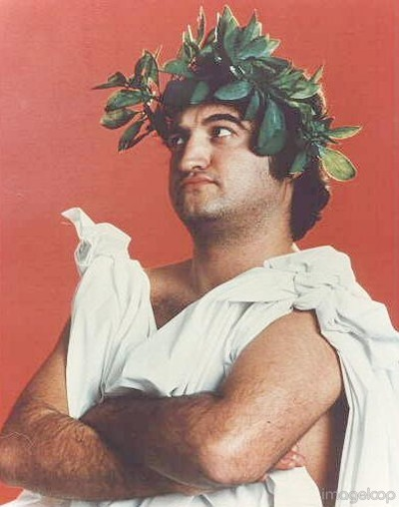
Aristolian Leisure
Leisure is a state of being or condition
Spiritual and intellectual open and passive taking in of one’s surroundings, an ownership of knowledge
A way of life or perpetual openness and connection to the experience of life
With true leisure comes a truer understanding of self
Meta-cognition

Slide 10
Johan Huizinga
Play is:
  A voluntary activity or occupation executed within certain fixed limits of time and place, according to rules freely accepted but absolutely binding, having its aim in itself and accompanied by a feeling of tension, joy, and the consciousness this it is “different” from “ordinary” life

Slide 11

Huizinga’s Play Sphere
Rules and ritual
Absorption
Contest
Order
Tension
Movement
Change
Whimsical but needed
Rhythm
Rapture
Representation or Metaphor
Make believe or pretend

Slide 12
Csiksentmihalyi & Flow
“There are two ways to improve ones life, one to change or control external conditions, second, to change ones perceptions of these conditions.”

Slide 13
Elements of Flow
Challenging activity that requires skill
The merging of action and awareness – complete concentration
Clear goals and feedback
Perception of control loss of need for control
Environmental feedback
Concentration of task at hand – loss of outside influence,
Loss of self consciousness
Transformation of time
Effortless physical or intellectual motion

Slide 14
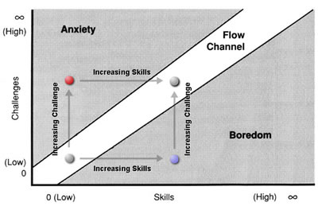
Flow Channel

Slide 15
Autotelic Experience
Auto (self)
Telos (goal)
Verb, having a purpose in and not apart from itself

Slide 16
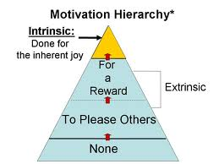
Intrinsic Motivation and Perception of Freedom

Slide 17


Slide 18


Slide 19
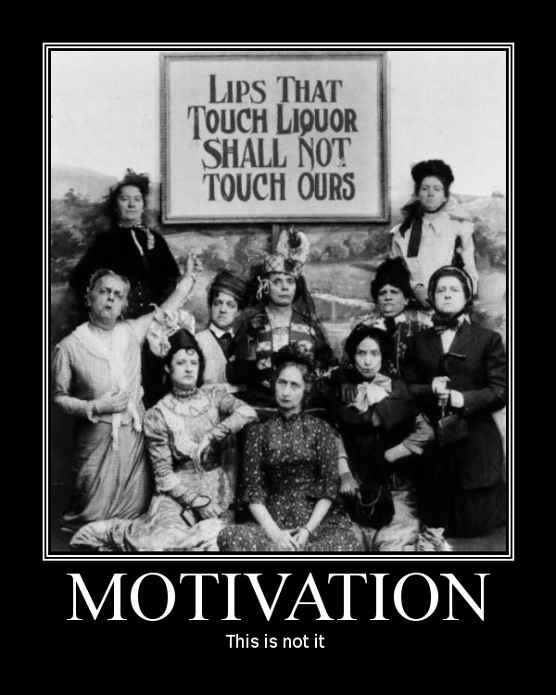

Slide 20
11 executive functions
PLANNING/PRIORITIZATION
Ability to create a roadmap to reach a goal. Making decisions on what is important
ORGANIZATION
Ability to create and maintain systems to keep track of information and materials.
WORKING MEMORY
Ability to hold information in memory while performing complex tasks. Draw on past to apply to present.

Slide 21
11 executive functions
RESPONSE INHIBITION
Capacity to think before acting. Evaluate before take action.
EMOTIONAL CONTROL
Ability to manage emotions to achieve goals and direct behavior.
COGNITIVE FLEXIBILITY
Ability to revise plans in the face of obstacles, new information, or mistakes.

Slide 22
11 executive functions
SUSTAINED ATTENTION
Capacity to keep paying attention despite distractions, fatigue, or boredom.
TASK INITIATION
Ability to begin projects without undue procrastination.
GOAL DIRECTED PERSISTENCE
Capacity to have a goal and follow through, while avoiding distractions for competing interests.

Slide 23
11 executive functions
METACOGNITION
Ability to zoom out of a situation/task to observe, problem solve, and reflect. Self-monitoring and self-evaluation.
TIME MANAGEMENT
Capacity to estimate how much time one has, how to allocate it, and how to stay within time limits.

Slide 24


Slide 25

The Anxiety Wheel

Slide 26
Differentiation and Modulation

Slide 27
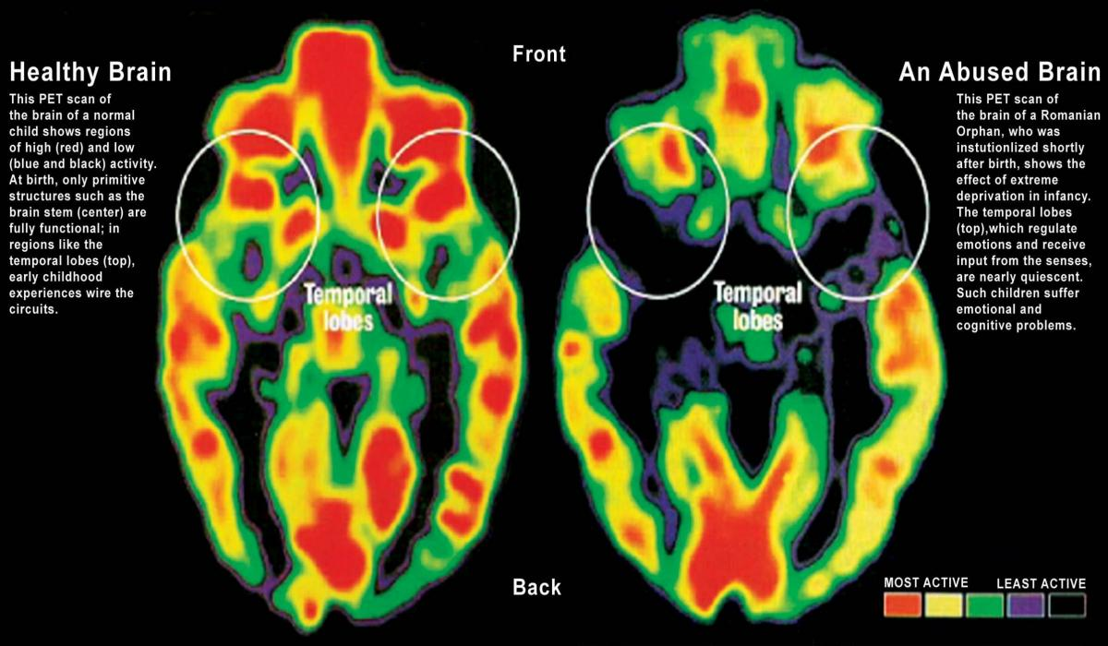

Slide 28
Pleasure vs. Enjoyment
Biological Basis of Pleasure
Enjoyment and psychic energy
Relaxed Leisure and Transitional Leisure

Slide 29
The Social Context to Play
Opportunity for both differentiation and integration
Identity foreclosure
Role experimentation
Social norms

Slide 30
Imagination
Private Speech and self regulation
Problem solving
Role play
Symbol and metaphor

Slide 31
Kohlberg's Stages of Moral Development and the Individuals Development in Play
Solitary Play
Obedience and Punishment
Individualism and Exchange
Parallel Play
Good Interpersonal Relationships
Maintaining Social Order
Social or Cooperative Play
Social Contracts and Individual Rights
Universal Principles

Slide 32
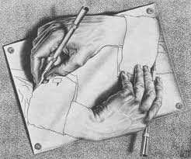
Paradox of Play in Practice

Slide 33
Intentionality
Connect treatment goals to probable outcomes
  Clinical goal: Learn and practice strategies to tolerate and regulate strong affect without the use of substances
  Climbing objective: Experience, observe, and process individual affective response to climbing and utilize cognitive-behavioral strategies to tolerate and regulate affect during climbs
Teach through play
Plan ahead
Be present

Slide 34

Play as Assessment
You can discover more about a person in an hour of play than in a year of conversation. - Plato

Slide 35
Tone Setting
Ritual
Example
Environment
Authentic and Genuine

Slide 36
Congruent Environmental Feedback

Slide 37
Processing – Giving Name and Symbol to the Experience
Huizinga and language
Freud
Defining own experience
Bridge building
Referee

Slide 38
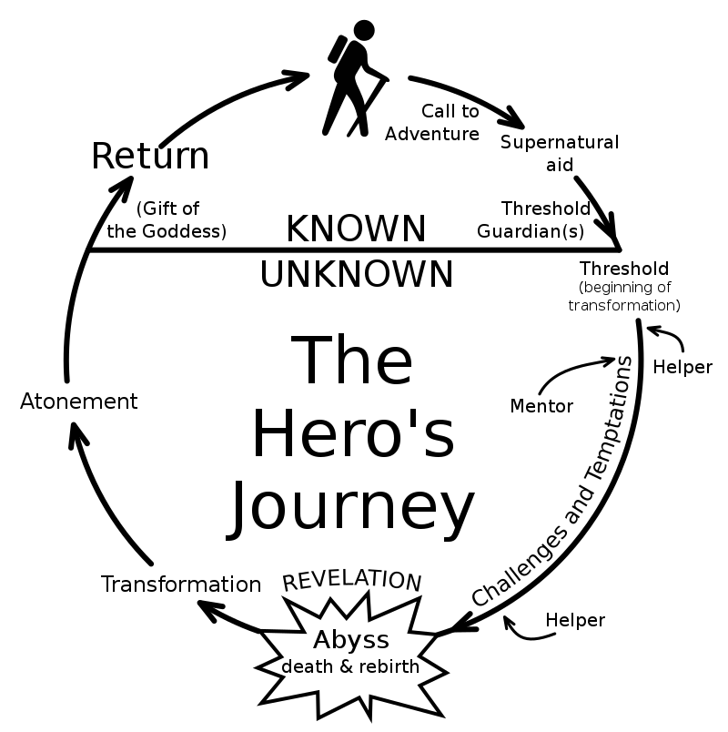
Who is the hero of the story?

Slide 39
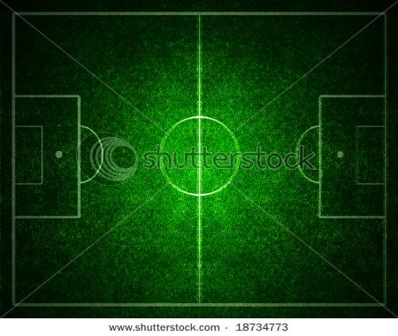
Context vs. Content

Slide 40
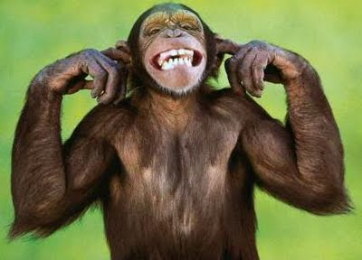
Silly Monkey

Slide 41




Neuro-Sequential Lense In Practice

Slide 42
Erickson’s Developmental Tasks
Infancy (birth - 2 years)
Social Attachment
Sensorimotor intelligence and primitive causality
Object permanence - peek a boo
Maturation of sensory and motor functions
Emotional development

Slide 43
Erickson’s Developmental Tasks
Toddlerhood (2-4 years)
Elaboration of locomotion
Fantasy and play
Language development
Self control

Slide 44
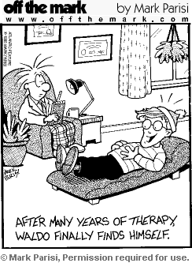
Erickson’s Developmental Tasks
Early school age (5-7 years)
Sex identification
Concrete operations
Early moral development
Group play

Slide 45
Erickson’s Developmental Tasks
Middle school age (8-12 years)
Social cooperation
Self-evaluation
Skill learning
Team play

Slide 46
Erickson’s Developmental Tasks
Early adolescence (13-17 years)
Physical maturation
Formal operations
Emotional development
Membership in the peer group
Heterosexual relationships

Slide 47
Erickson’s Developmental Tasks
Later adolescence (18-22 years)
Autonomy from parents
Sex-role identity
Internalized morality
Career Choice

