Slide 1
ABA 101: What is ABA and How it Brings Meaningful Change for Those With Autism
Traci Cole, M.A., BCBA

Slide 2
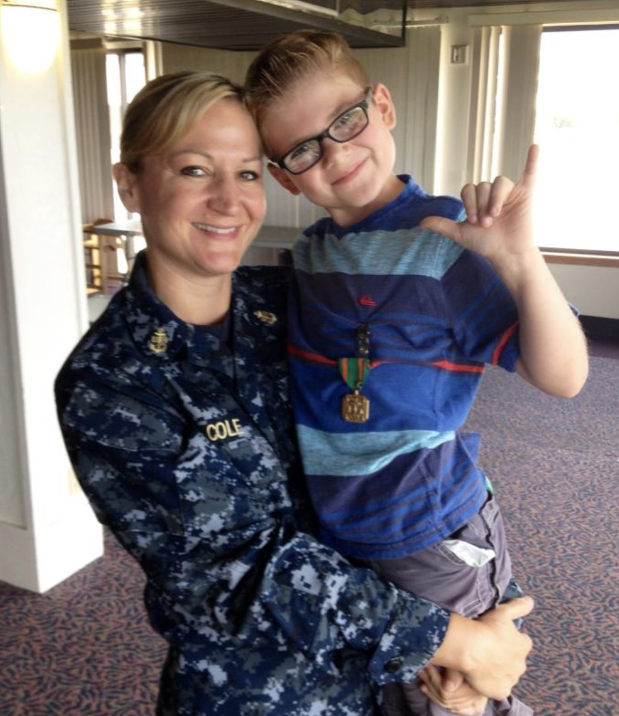
Traci Cole
Retired from the Navy after 22 years
Master’s Degree in Clinical Mental Health Counseling
BCBA
Dylan’s Mom

Slide 4
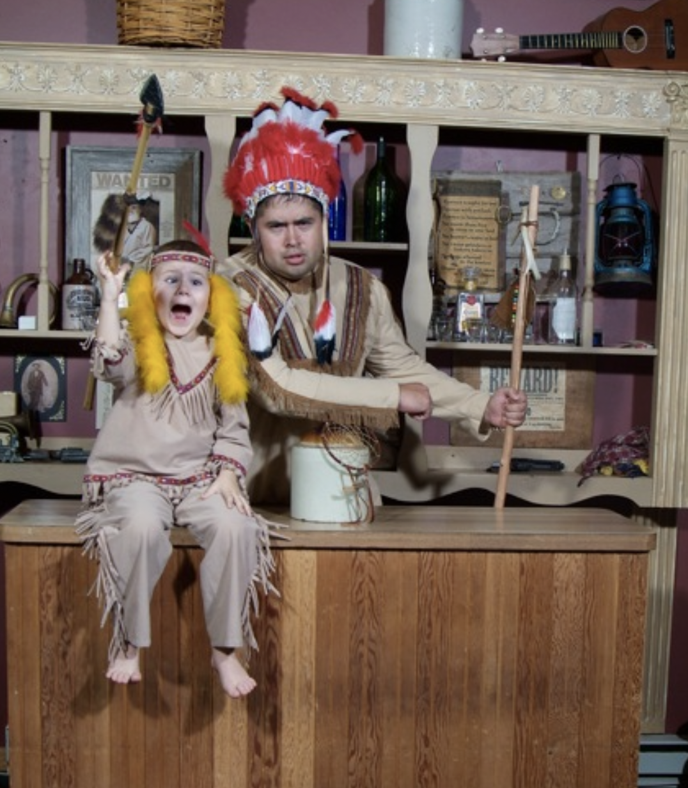

Slide 5
Today’s Agenda
What is ABA?
What is the controversy with ABA?
What ABA therapy should look like
ABA Basics
How ABA can help with symptoms of Autism

Slide 6
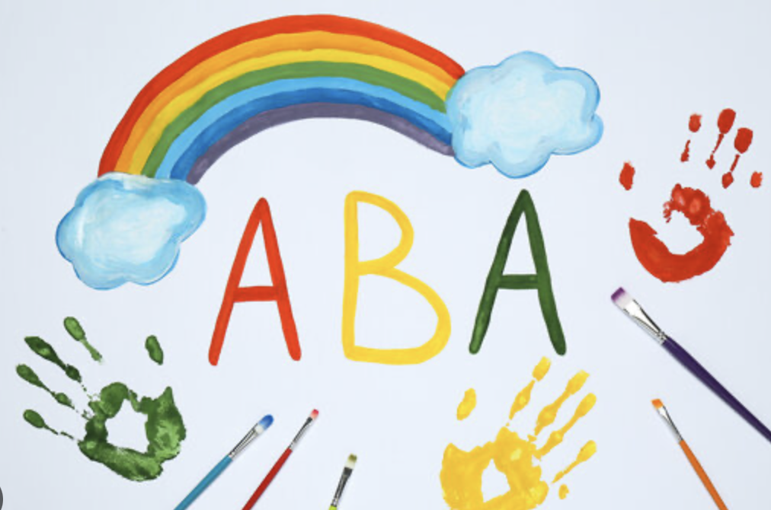
What is ABA?
A data driven, evidence based approach that aims
to increase functional, socially significant skills and
reduce behaviors that interfere with an individuals
quality of life.

Slide 7
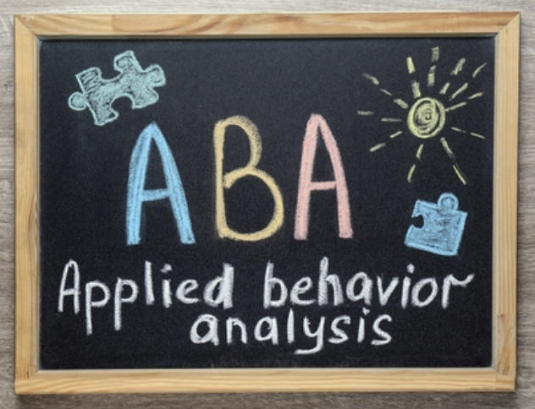
What is ABA?
Applied– We use the principles of ABA to change socially significant behaviors
Behavior – The behavior of interest must be observable and measurable.
We need to see it so that we can take data
Analysis – We take data on the behavior and make data-based decisions.
We use data to assess the function of the behavior and make changes in
the environment

Slide 8
What is the controversy?
Common objections:
ABA encourages punishing children
ABA is bribery
ABA tries to cure autism
Also, BCBAs act like they know it all
Notes:
As a field ABA is still very young.

Slide 9
It was not the science of ABA, it was the delivery
Some adults who had ABA when they were young had a negative experience and we should listen
Yes, some BCBAs do act like they know it all

Slide 10
Identity-First
or
Person-First?

Slide 11
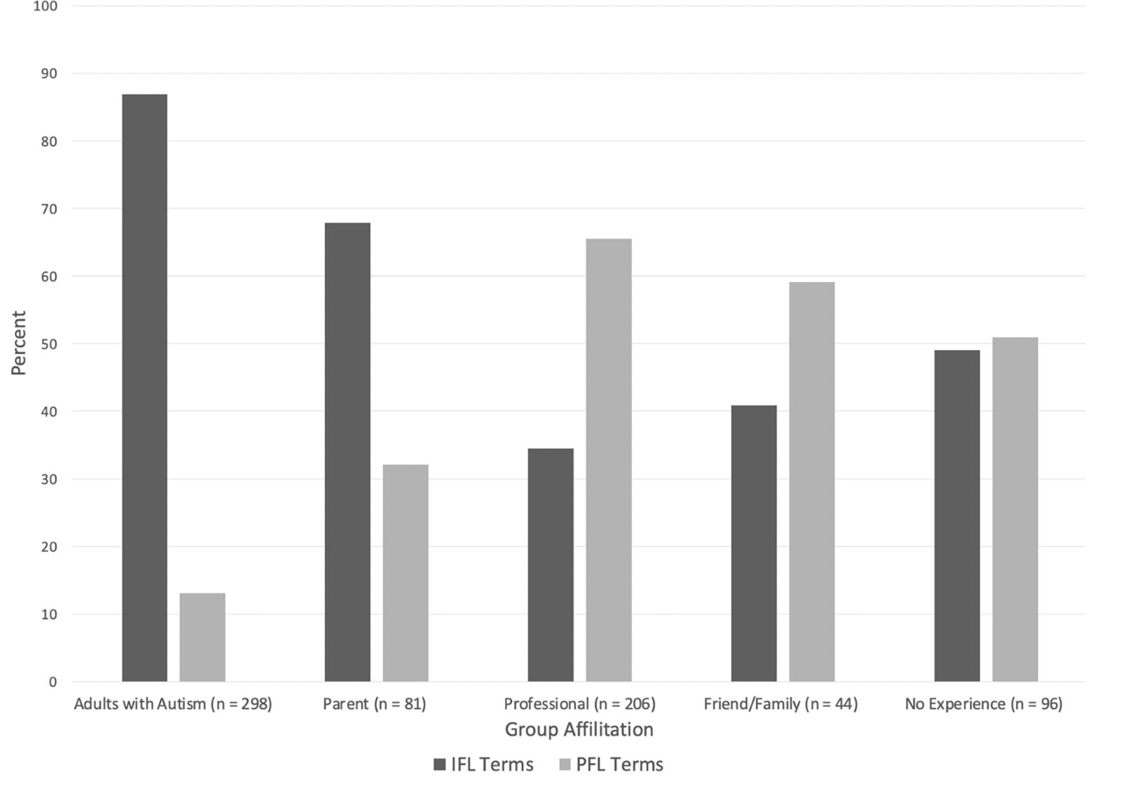
Autistic Person or Person with Autism?
(Taboas et al., 2022)

Slide 12
What Should ABA Look Like?
Best learned in the natural environment
Should look like fun and play
Be individualized and meet the person where they are
Should integrate with family and routine
*If the person receiving services dreads us coming,
we are not doing it right

Slide 13
The ABCs of ABA
Help us to explain, predict, and change behavior

Slide 15
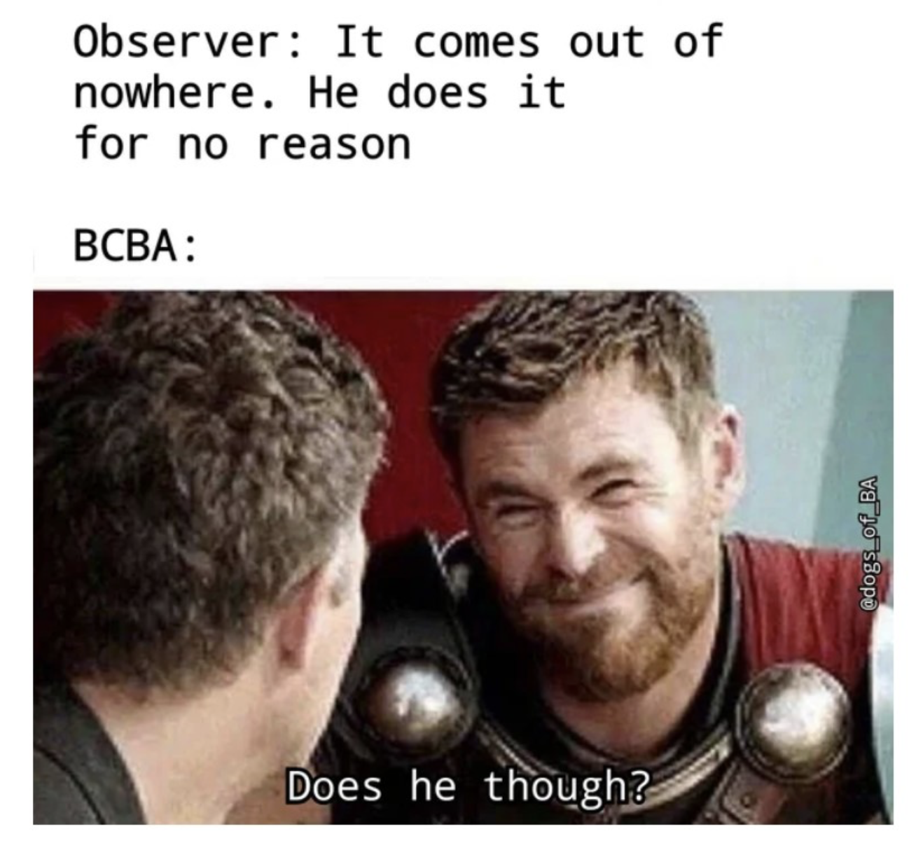
A is for Antecedent
What happens immediately
before the behavior

Slide 16
B is for Behavior
Examples of socially significant behavior
Aggression toward others
Self injurious Behavior (SIB)
Eloping (running away)
Screaming
Eating non-food items
Destroying property
Notes:
Behavior that is stopping them from living their lives. Example..Depression

Slide 17
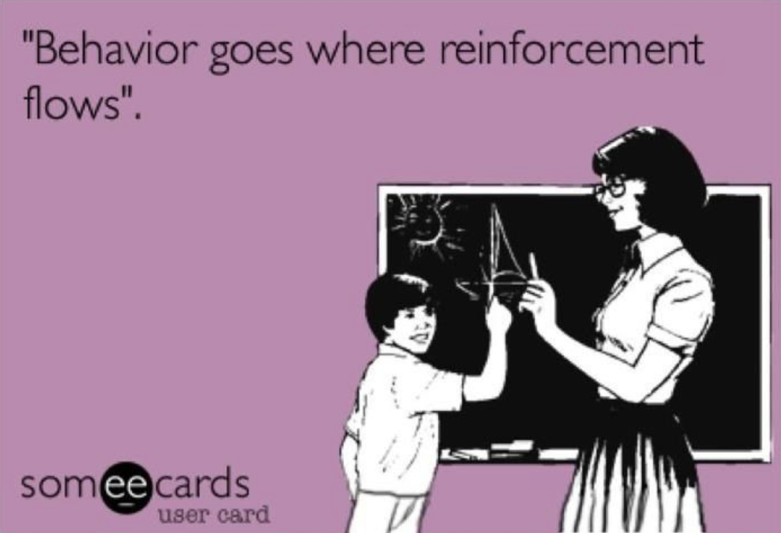
C is for Consequence
What happened right
after the behavior
Notes:
Examples

Slide 18
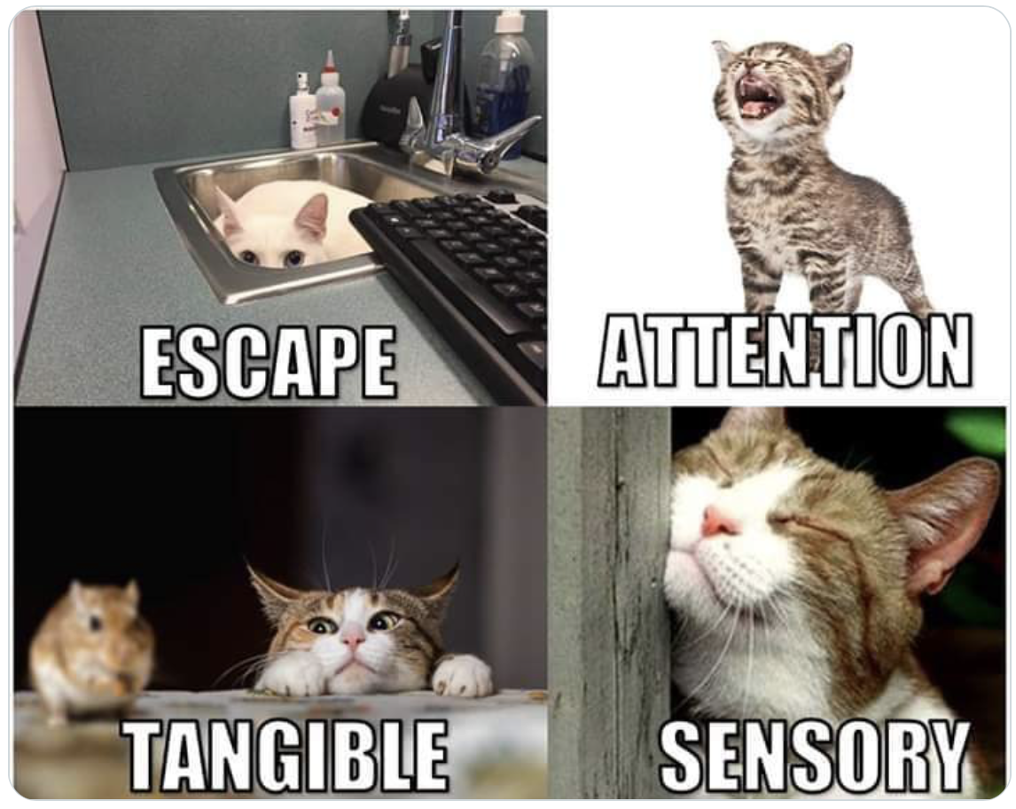
Functions of Behavior
* Also pain attenuation

Slide 19
Tangible
The behavior functions as a way to gain
access to items, activities, locations
Examples: Electronics, cookies,
Target toy aisle, anything a sibling has

Slide 20
Sensory
The behavior functions as stimulating
or self-soothing
Examples: Rocking, hand flapping, squinting
mouthing objects, sitting and bouncing your leg
We all engage in self stimulatory behavior
*Does it occur when the person is alone?

Slide 21
Attention
The behavior is functioning to obtain social interaction
from others. It can be positive or negative.
Example: A student who interrupts and makes jokes
trying to be funny to make their classmates laugh.
Notes:
Attention is not good or bad. We all seek attention. You are seeking attention when you call a friend on the phone. There are appropriate ways of getting attention, such as this child raising her hand. There are other ways of getting attention such as throwing her work on the floor.

Slide 22
Escape
The behavior functions to avoid a condition or
situation It could be a task, an overstimulating
environment or a social situation
Example: You tell your child to do their homework.
Your child yells at you, and you send them to
their room.
Notes:
Needs to be motivated
Punishment should be last option

Slide 23
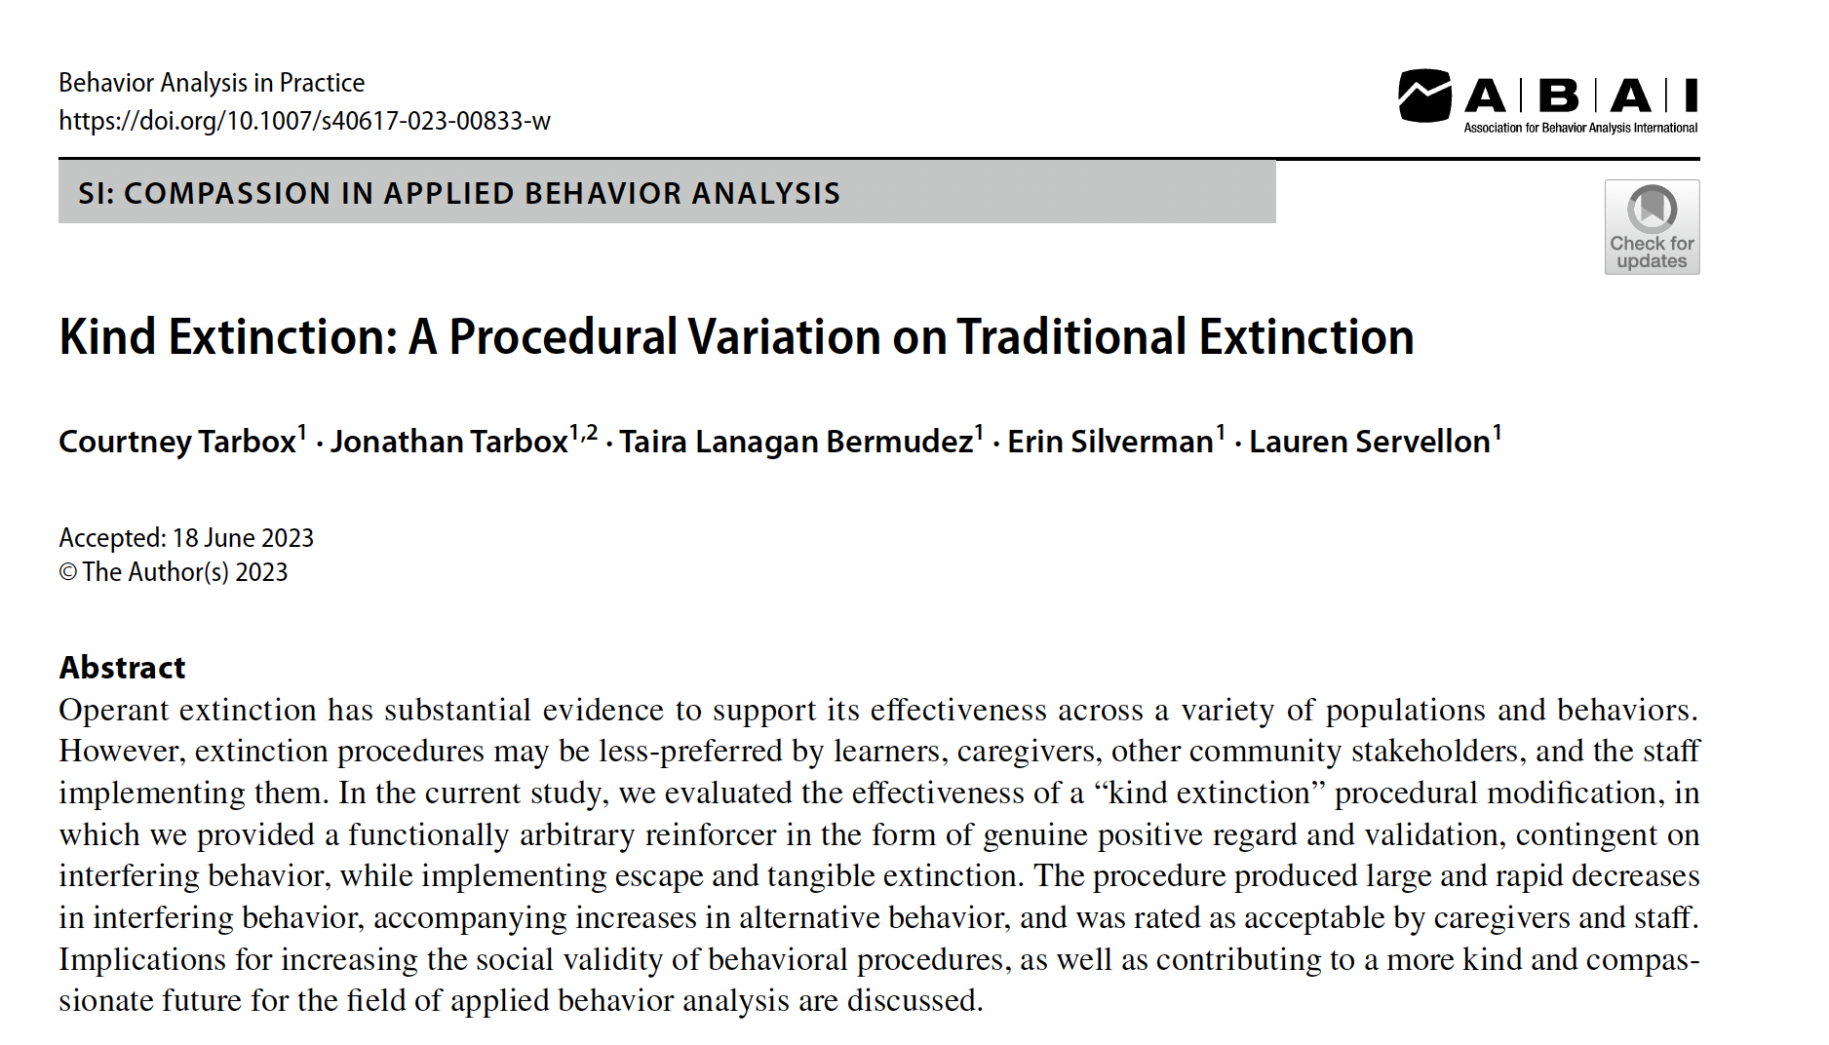
(Tarbox et al., 2023)

Slide 24
Power Struggles
Power struggles usually happen when the child is asked to do something
and the child does not want to do it
Everyone gets emotional, there is arguing and often we can’t
even remember what we originally asked the child to do.
Notes:
If you hear yourself saying things like: Do it because I told you to.

Slide 25
Example of a Power Struggle *also known as the last time I took my child hiking

Slide 27
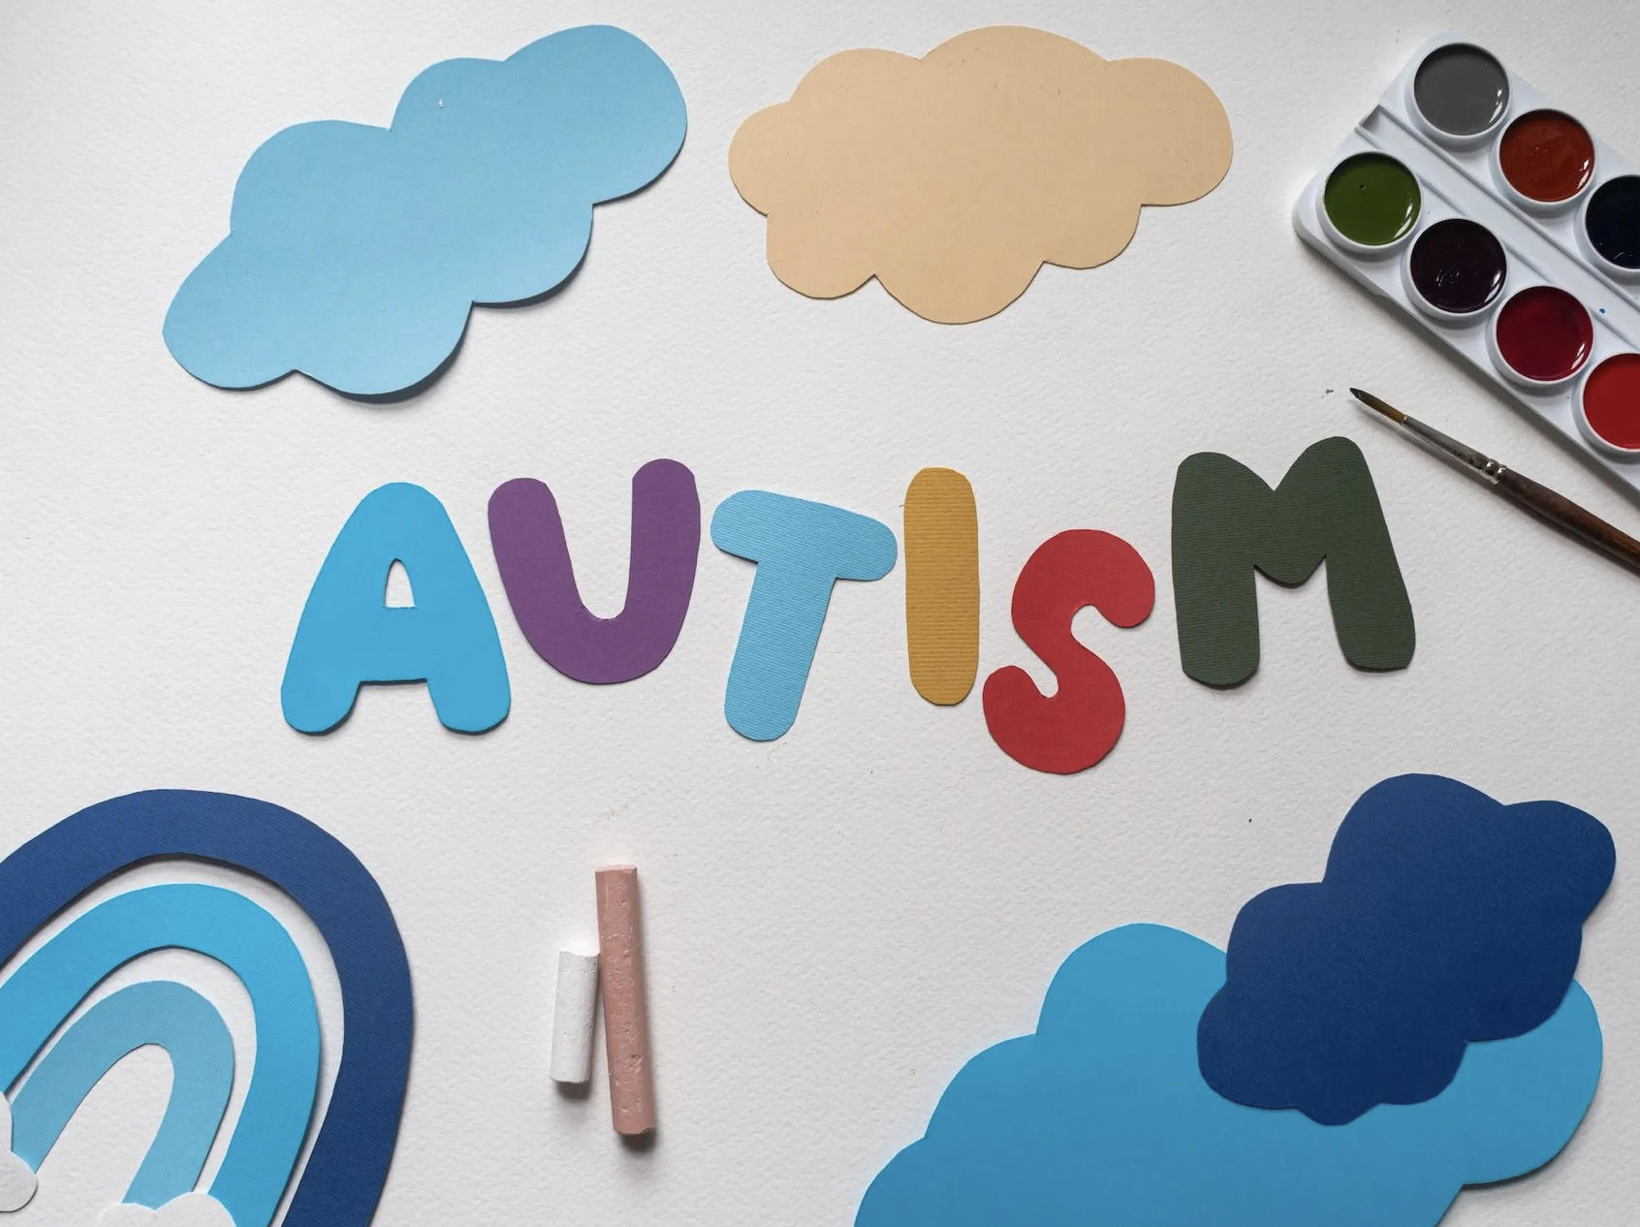
How does the DSM-V define Autism
and how can ABA help?

Slide 28
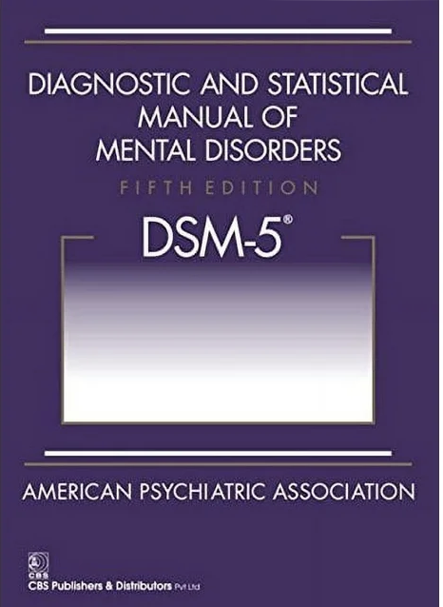
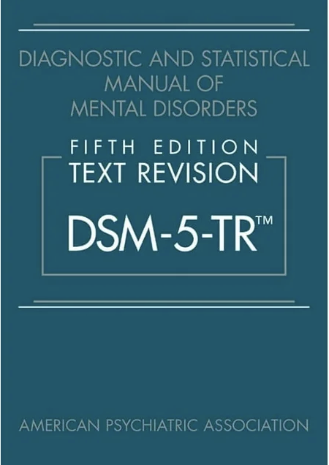
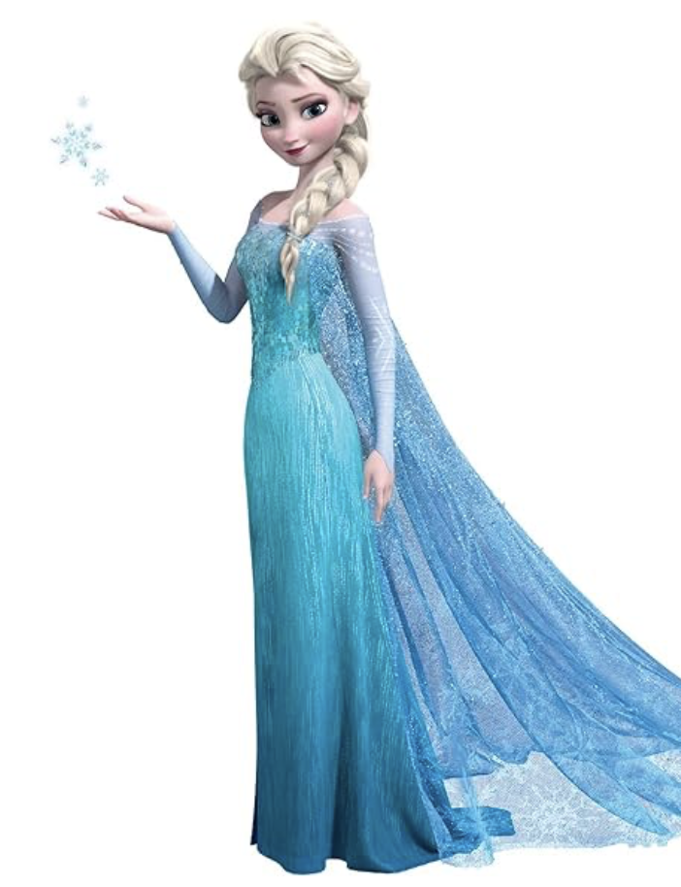
2013
“persistent deficits in social communication and social interaction across multiple contexts, as manifested by ALL of the following”

Slide 29
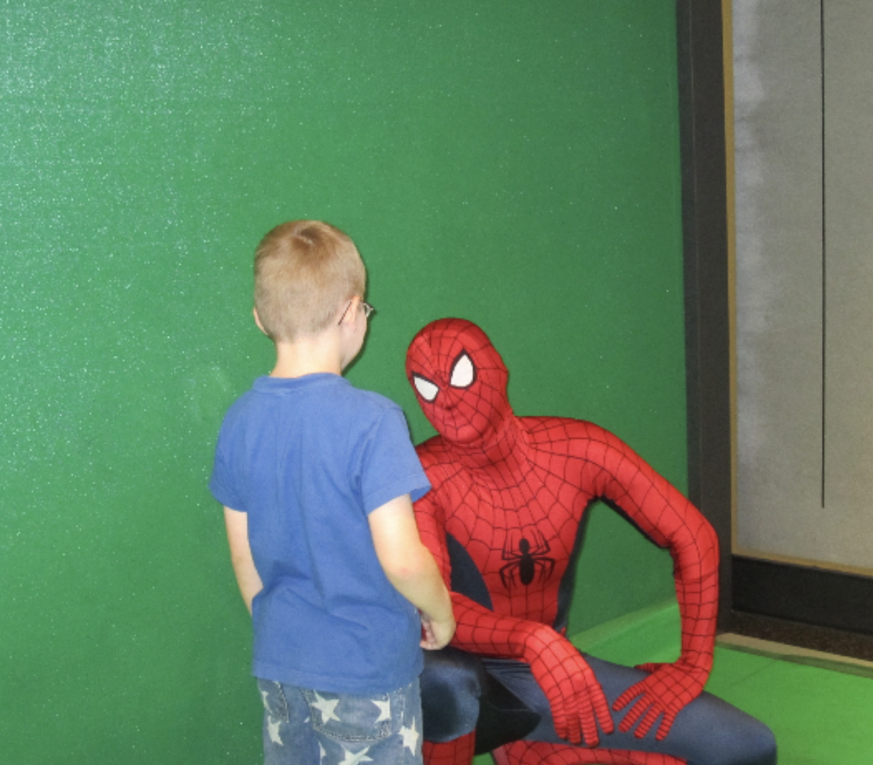
DSM Criteria A
A: Persistent deficits in social communication and social interaction
Deficits in social-emotional reciprocity
Deficits in non-verbal communication
Deficits in developing and maintaining,
relationships
Notes:
A: What they are interested in, difficulty initiating conversations, small talk, may use pre-scripted lines, difficulty with conversations outside their interests
B: Eye contact, difficulty using appropriate volume and affect may be flat, difficulty understanding body language or gestures
C: Difficulty maintaining friendships, shared imaginative play or group activities that require a lot of reciprocal communication

Slide 30
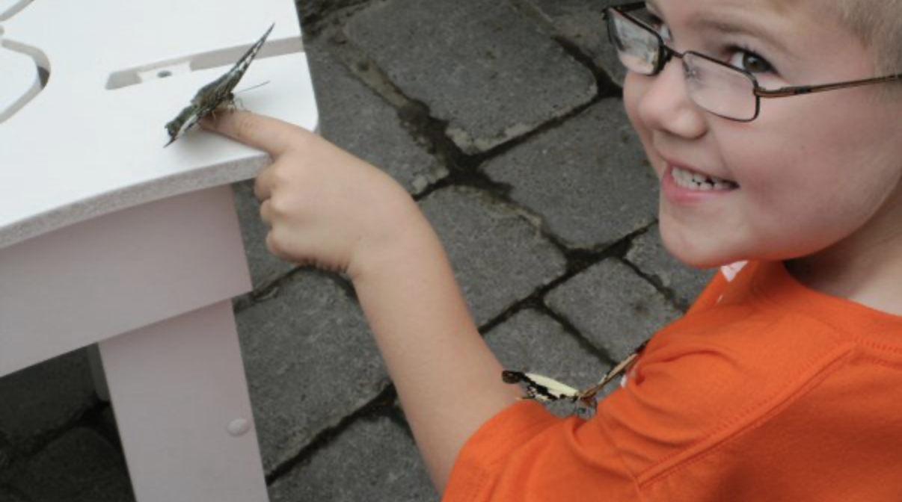
DSM Criteria B
B: Restricted, repetitive patterns of behavior, interests or activities
Stereotyped or repetitive motor movements
Insistence on sameness, inflexible adherence to routines
Highly restricted, fixated interests that
are abnormal intensity or focus
Hyper- or hypo-reactivity to sensory
input
Notes:
Need to have 2:
Stimming, hand flapping or pacing, echolalia, collecting items, and reorganizing, meant to self-soothe, lining up toys
Security in routines and predictability, difficulty in changing routines, especially if they did not change it
Fixated interests are a good way to make friends
Hyper or Hypo reactivity. Could be sensitive to light, smells certain sounds. Hypo-sensory responses may have a dulled experience of pain or sensory input

Slide 31
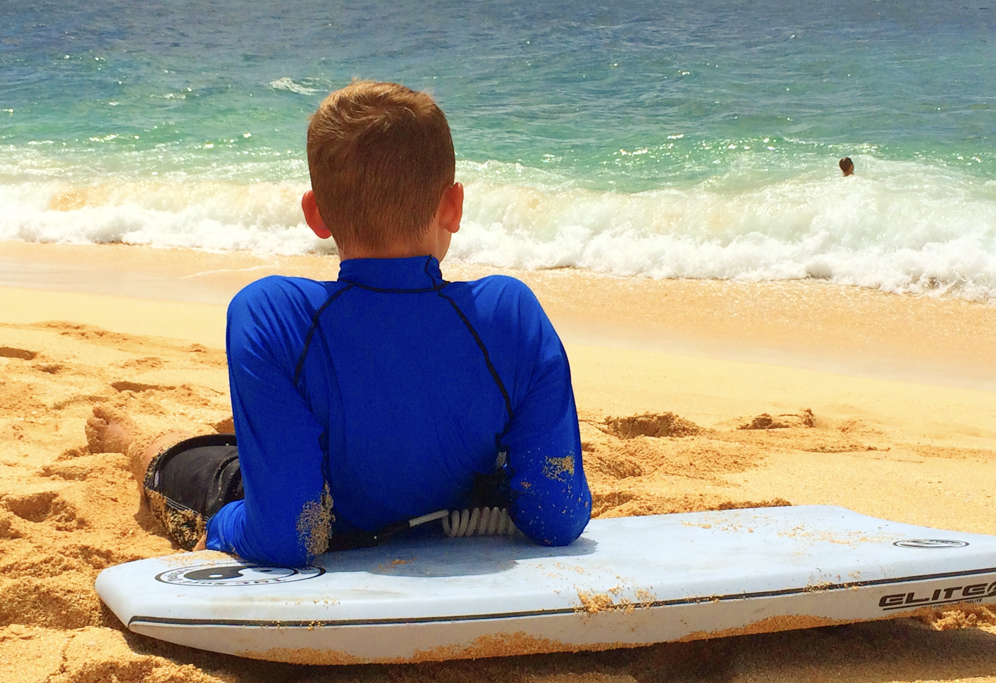
Volcom House
Haliewa, Hawaii

Slide 32
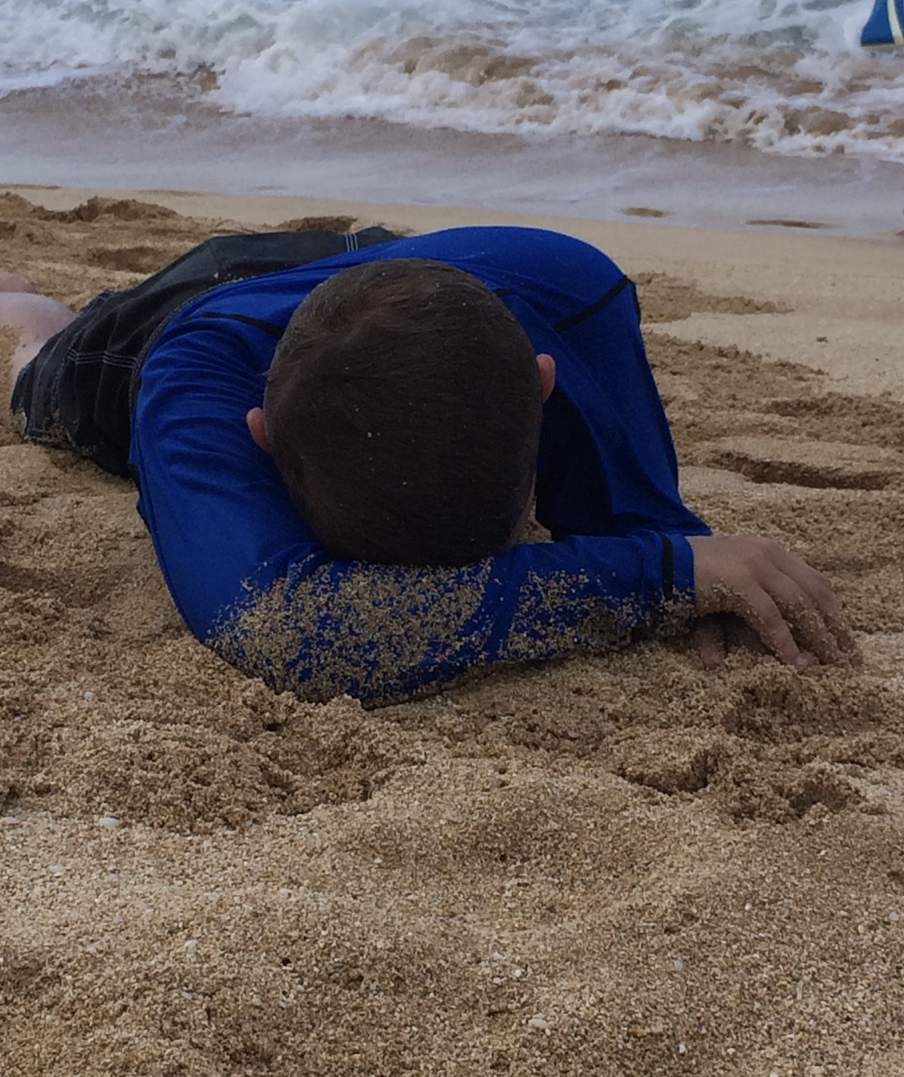
*Mom Fail

Slide 33
DSM Criteria C, D and E
C: Symptoms must be present in early development (may not manifest until
social demands exceed limitations)
D: Symptoms cause clinically significant impairment in social, occupational
or other important areas of current functioning
E: These disturbances are not better explained by an intellectual disability or
global development delay
Notes:
C: Dylan summer camp
D: Clinically significant
E: This does not mean that a person with an intellectual disability or global development delay

Slide 34
Not mentioned in the DSM
Aggression
Toilet training
Academics
Speech delay or disorder
Fine motor skill delay
Gross motor skill delay
* I am not, nor do I pretend to be, a speech therapist, occupational therapist, physical therapist,
or teacher

Slide 36
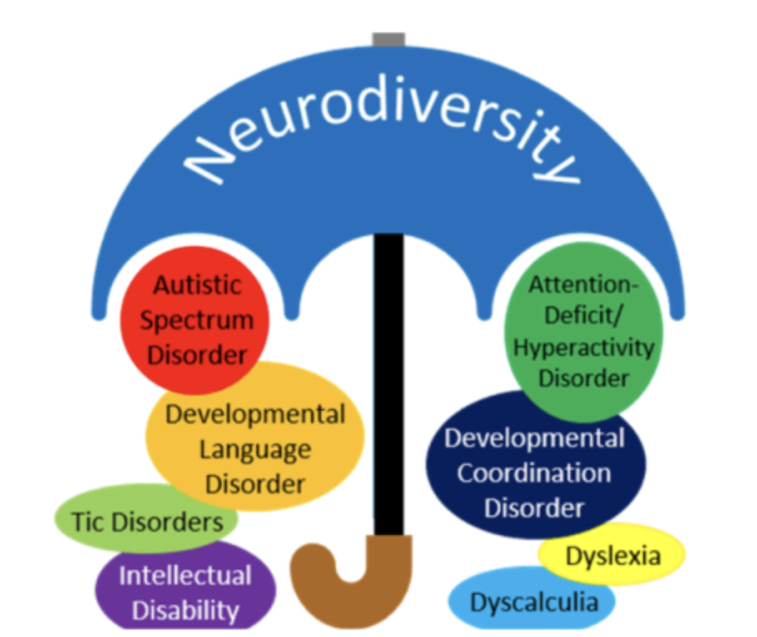
Comorbidities in Autism Spectrum Disorder
Study published in February 2023 by
Khachadourian et al.
42,569 individuals with ASD and their siblings
(full and half-siblings)

Slide 37
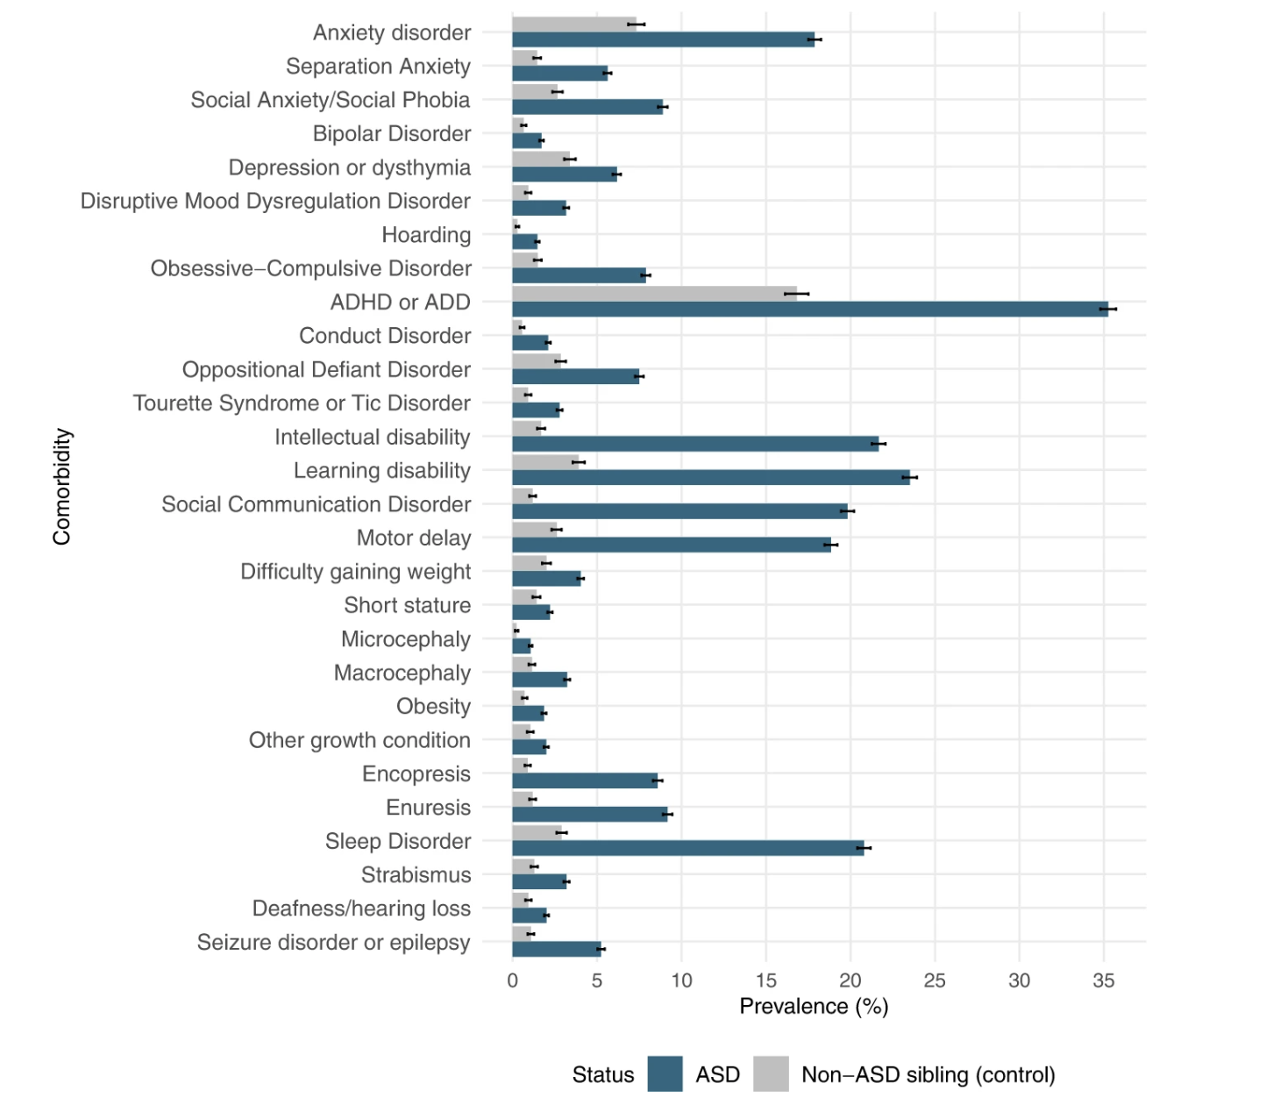

Slide 38
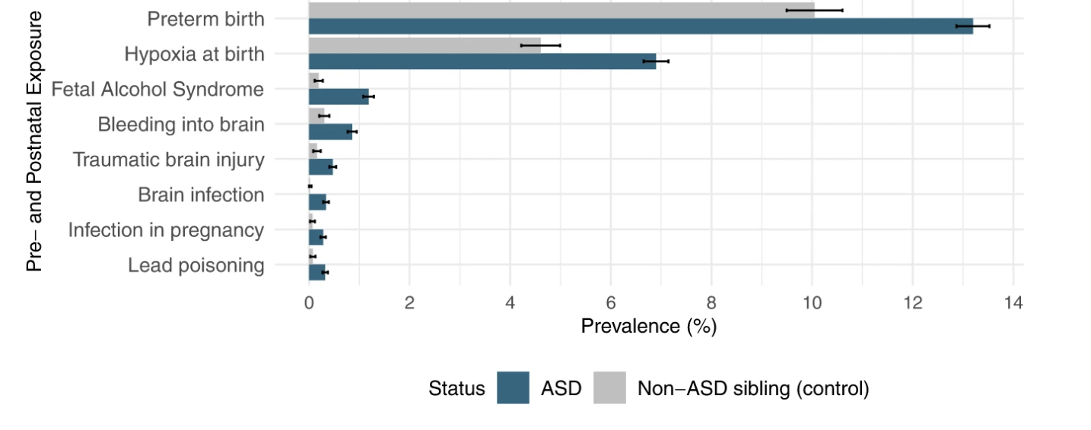
One more interesting analysis:
(Khachadourian et al., 2023)

Slide 39
For you parents, hang in there!
Keep advocating and don’t be so hard
on yourselves!

Slide 40
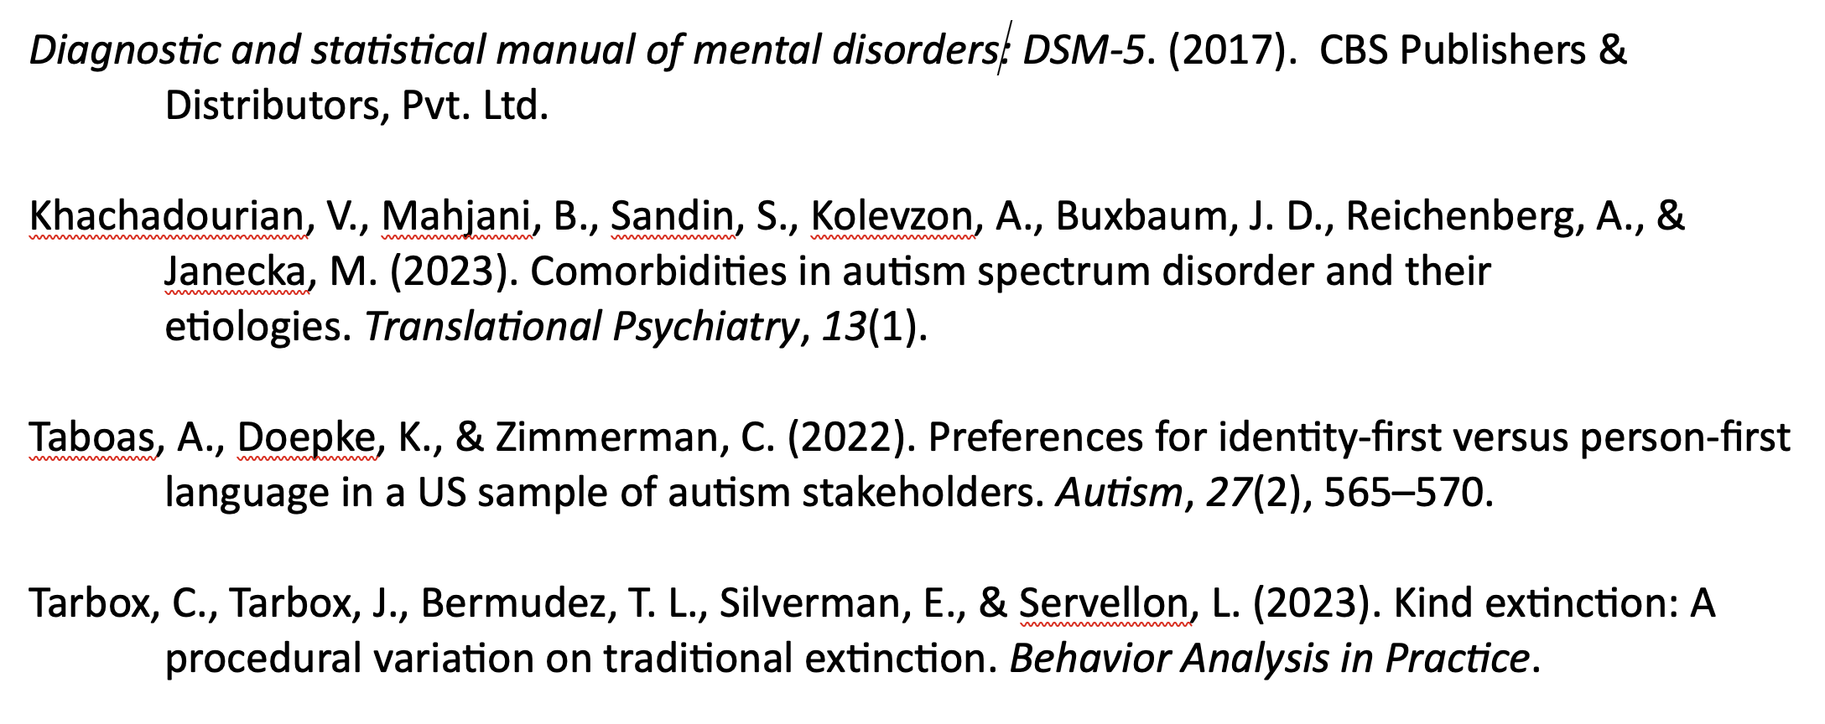
References

