Slide 1
ABA 101: What to expect in ABA Therapy
Rebecca Bovino-Sandquist, M.A., BCBA
Erykah Spriggs, B.S., BCaBA

Slide 2
Introductions
Rebecca Bovino-Sandquist M.A., BCBA
Erykah Spriggs B.S., BCaBA

Slide 3
What is ABA?
ABA is the science of studying behavior and applying data supported techniques to increase and/or decrease behaviors that are meaningful to an individual and their social environment.
Notes:
ES

Slide 4
Basic Principles of ABA
Defines behavior in objective and measurable terms using operational definitions.
Examines the relationship between behavior (what a person does) and its controlling variables (what happens in the environment).
Analyzes socially significant behavior in need of improvement.
Studies behavior through a three-term contingency (What happens before the behavior? What does the behavior look like? What happens immediately following the behavior?
Examination, data collection, and data-based decisions.
Notes:
ES

Slide 5
What ABA is NOT!
Counseling Therapy
Focused on changing an individual’s thoughts
Bribery
Limited to pet training
Limited to autism
Focused on control
Notes:
RBS

Slide 6
ABA Commonly Used Words & Lingo
Registered Behavior Technician (RBT)
Board Certified Assistant Behavior Analyst (BCaBA)
Board Certified Behavior Analyst (BCBA)
Reinforcement
- Positive Reinforcement
- Negative Reinforcement
Punishment
- Positive Punishment
- Negative Punishment
Extinction (Extinction Burst)
Non-contingent Reinforcement
Notes:
ES

Slide 7
ABA Commonly Used Words & Lingo cont.
Functions of Behavior
- Attention
- Escape
- Tangible
- Automatic
Discrete Trial Training (DTT)
Natural Environment Teaching (NET)
Notes:
ES

Slide 8
ABA Commonly Used Words & Lingo cont.
Three Term Contingency (ABC Contingency)
Antecedent
Behavior
Consequence
Motivating Operation
Reinforcer
Preference Item
Notes:
ES

Slide 9
Skills Acquisition & Assessments
- VBMAPP
- AFLS
-ABLLS
- Good learner Assessment
- Social Skills Solutions
- PEAK
Notes:
ES

Slide 10
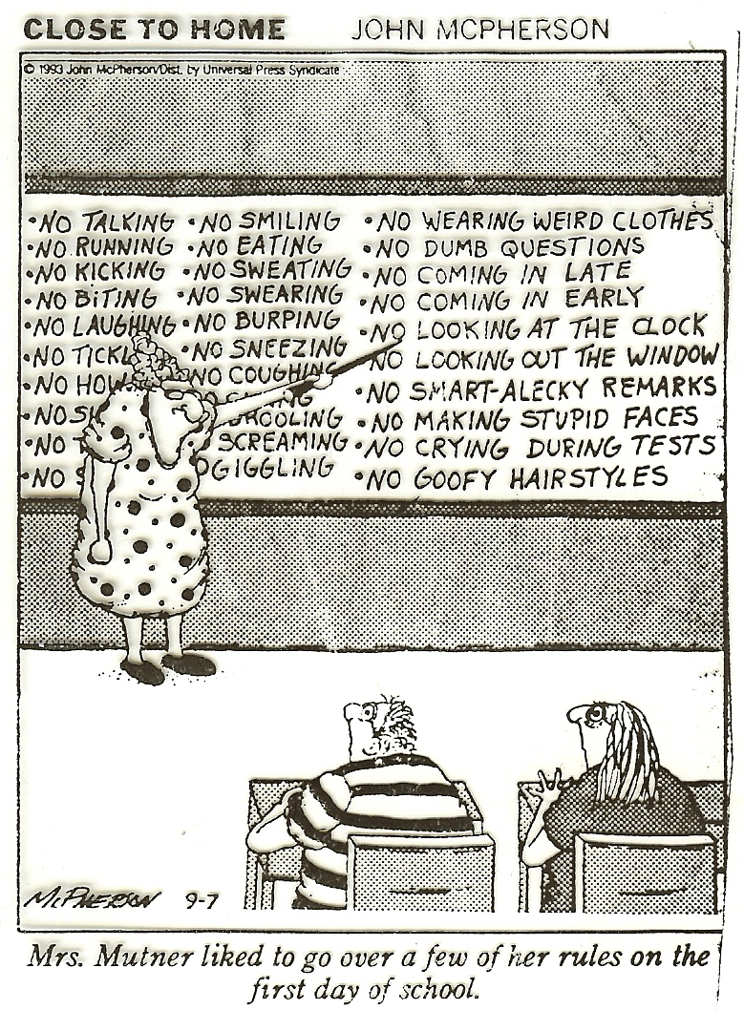
Teaching Replacement Behaviors
Focus on increasing appropriate behaviors and decreasing the opportunity for inappropriate behaviors
Students obtain the same consequence with an appropriate behavior
- Strategies used before the target behavior happens
- Proactive strategies
Notes:
RBS

Slide 11
Teaching Replacement Behaviors
Requesting
Social Skills (roles plays and Peer Buddies)
Request help
Indicate the they do/don’t want to begin or participate in activities, use materials, or interacts with peer
Request a break or an end to the current activity, interaction or task
Request preferred items, activities, and people
Removing a behavior does not necessarily remove the need for that behavior
Break down skills into specific components
Present information to student when they are calm & receptive
Practice skill in low stress, low stimulus setting
Provide positive reinforcement & feedback
Generalize skill in regular environment
Provide support when needed
Teaching Techniques
Notes:
RBS

Slide 12
Prevention Strategies - Differential Reinforcement of Alternative Behavior (DRA)
The reinforcers for the undesirable behavior are used instead for a more desirable behavior. For example, a teacher will pay more attention to students who sit than those who talk in class (this assumes that attention from the teacher is reinforcing).
Notes:
RBS

Slide 13
Prevention Strategies – Contingent Reinforcement
Group Contingencies
Token Economies
Independent Group-Oriented Contingency
Dependent Group-Oriented Contingency
Interdependent Group-Oriented Contingency
• Awards tokens, chips, stickers, check marks , points, or other items/markings to students who demonstrate desired behaviors
• Students periodically exchange tokens for rewards, items or activities they value
• Effective for students resistant to other types of motivational or behavior management techniques
• Teaches delayed gratification (holding tokens until trade-in time)
Type | Definition | Pros | Cons
Independent Group-Oriented Contingency | Each student earns reward based on their own behavior. | No student is penalized for the others’ behavior. Each student can access rewards under exactly the same terms. | Peer pressure is unlikely to be harnessed.
Dependent Group-Oriented Contingency | Reinforcement of entire group is contingent upon one student’s behavior. | The target student becomes “hero”. Peers may root the target student on. | The target student may get negative attention if he/she fails to earn the reward.
Interdependent Group-Oriented Contingency | Reinforcement of the group is contingent on the behavior of the whole class. | Appropriate peer pressure which occurs naturally in the classroom is used to encourage positive behavioral choices. | Scapegoating may occur by blaming one student for the class not earning the reward. One student may sabotage earning the reward for everyone
Notes:
RBS

Slide 14
Prevention Strategies – Noncontingent Reinforcement
Provides reinforcement that maintains an inappropriate behavior independent of instances of the behavior
The student receives the reinforcer at pre-selected time intervals
Disassociates the reinforcer from the problem behavior
Ex. Give attention to a student on a schedule regardless of problem behaviors
Notes:
RBS

Slide 15
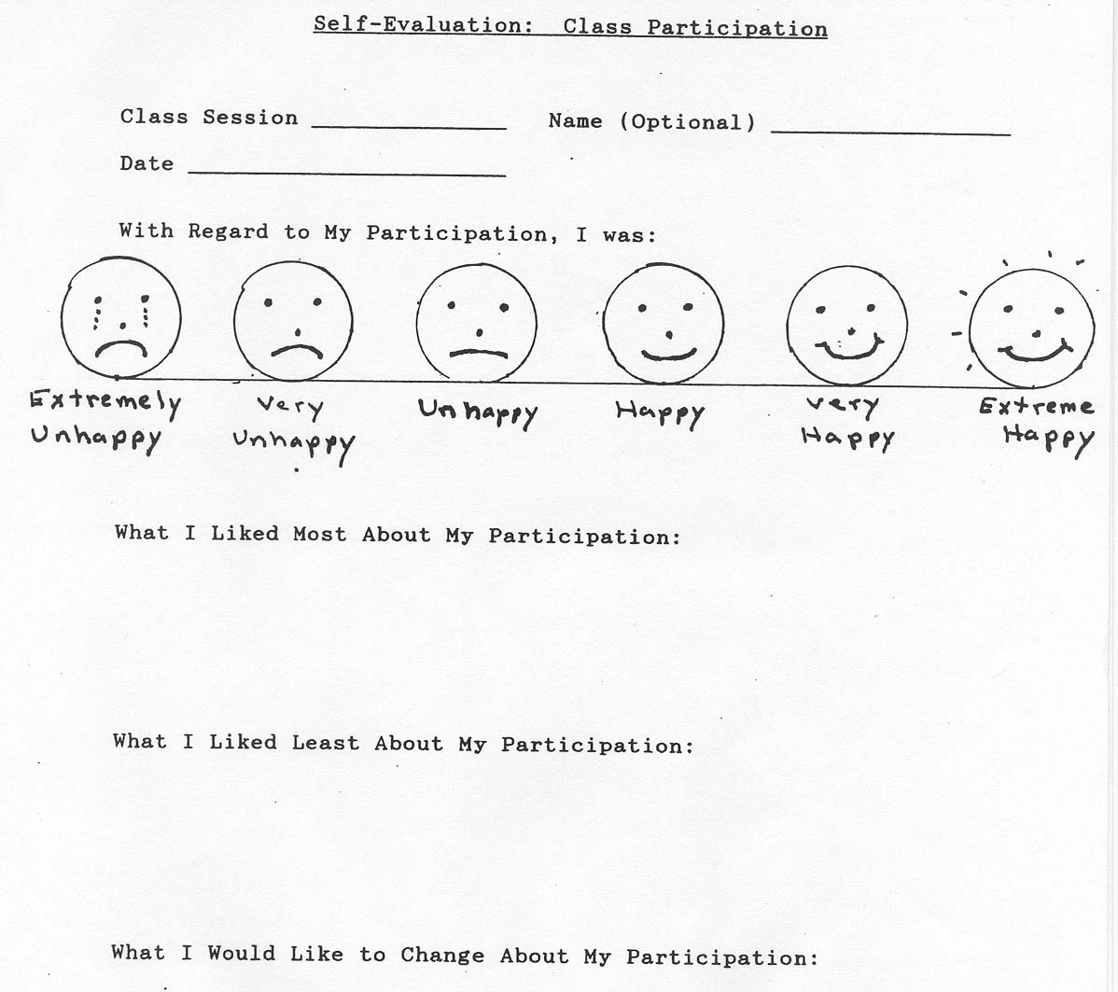
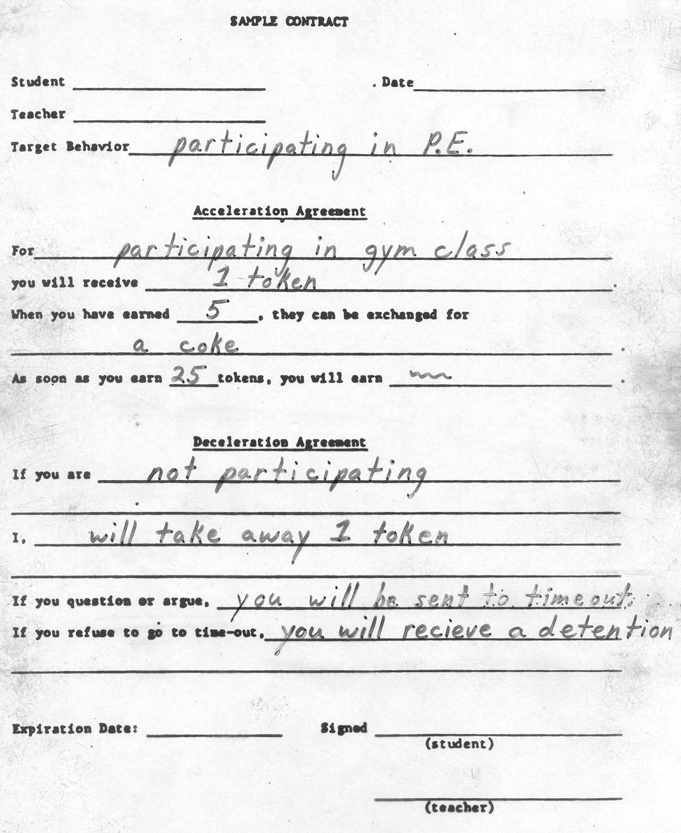
Prevention Strategies cont.
Behavior Contracts
Self-Monitoring
Written agreement developed with input from both teacher and student that sets the stage for accountability and consistency.
Describes rewards based on the occurrence of desirable behavior specifically defined by both teacher and student, and Outlines responsibilities of both the teacher and student.
Outlines time or other constraints, identifies the reinforcers, and any other necessary conditions, and positively oriented by rewarding successes.
Students keep track of whether they are on-task, compliant - following rules and routines.
Praise honest self-reporting
If a student admits to engaging in an inappropriate behavior, always praise for their honesty before providing the consequence
Never change the mark a student has given him/herself without discussing inconsistencies with the student. Be open to changing your marks as well.
Notes:
RBS

Slide 16
Behavior Management & Reduction Strategies
Reduction strategies are used to address inappropriate or problem behavior
- Intervention strategies
- Determined prior to occurrence of the problem behavior
- Implemented consistently
Notes:
RBS

Slide 17
Reduction Strategies – Extinction
Reducing behavior by withholding or terminating the reinforcer that maintains inappropriate behavior.
- Most often used for attention seeking behaviors: purposeful ignoring
- Should be used in conjunction with reinforcement of a replacement behavior.
- Beware of the extinction burst.
Notes:
RBS

Slide 18
Reduction Strategies – Response Cost
A "toll" or "fine" imposed in response to the student's display of inappropriate behavior.
- For example, if you were to take away a point/token/raison/raffle ticket/candy piece away from a student's' collection because of a rude remark or failure to stay on task
Be sure not to use the consequences as a threat against the student
- Example: Instead of saying “You better behave, or I'll take your points away.", say "I'd like to see hands kept to self so that everyone can keep their points." Or just use a "short statement” like "Hands."
Notes:
RBS

Slide 19
Reduction Strategies – Time Out
Exclusionary
Non-Exclusionary
Student is removed from the setting that is reinforcing the behavior. S/he is assigned to another setting that should be incredibly boring (to promote the urge to return to and stay in the classroom).
Examples
- set aside time out room staffed by a monitor.
- a taped off area in the hallway (across from the door so that you can monitor the student)
Students remain in the instructional setting but does not receive any reinforcement while remaining there. S/he can continue to learn by observation but may not be an active participant. Do not allow them to offer answers, receive points or raffle tickets, engage in hands-on activities, or converse with a group of others.
Examples:
- “Head down" (student folds arms on desktop and lowers face into arms for a designated period of time)
- Moving back a few feet from the rest of the group which is seated on the rug for "calendar time"
Notes:
RBS

Slide 20
Problems with Reduction Strategies
Suppression of all behaviors
Models' punishment/ makes environment negative
Evokes negative behaviors
Promotes escape/avoidance behaviors
Notes:
RBS

Slide 21
Is ABA effective for Autism?
YES!
“Behavioral and educational interventions are currently the main treatments for individuals with ASD. Of these interventions, approaches based on applied behavior analytic (ABA) have received the most extensive research.”
https://asatonline.org/research-treatment/research-synopses/
https://nationalautismcenter.org/national-standards/
Notes:
RBS

Slide 22
What does a BCBA do?
Behavior Reduction
Foundational Skills
Social Skills
Motor Skills
Self-help Skills
Communication Skills
Functional Skills
Academic Skills
Vocational Skills
Parent Training
Staff Training
Notes:
RBS

Slide 23
ABA Misconceptions
ABA = Discrete Trial Instruction
ABA is based on the work of one individual
ABA emphasizes control and punishment
ABA is cold and mechanistic
ABA teaches rote skills in artificial settings
ABA is only for preschoolers
Notes:
ES

Slide 24
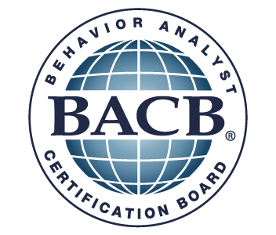
Ethics of ABA
Ethics Code
Treatment is backed by science. Right to effective treatment
Relationship between reinforcement and punishment
Not all BCBA’s are the same. If there are suspected ethical violations, you can report bacblegal@bacb.com
Notes:
RBS

Slide 25
Beyond Autism
Mental Health
OBM
Education
Precision Teaching
Gerontology
Sports
Animal Training
General Health & Wellness
Parent Training
Notes:
ES

Slide 26
Questions

