Slide 1
My Child has Autism, Now What?
Created by: Ciarra Torres and Sarah Weber

Slide 2
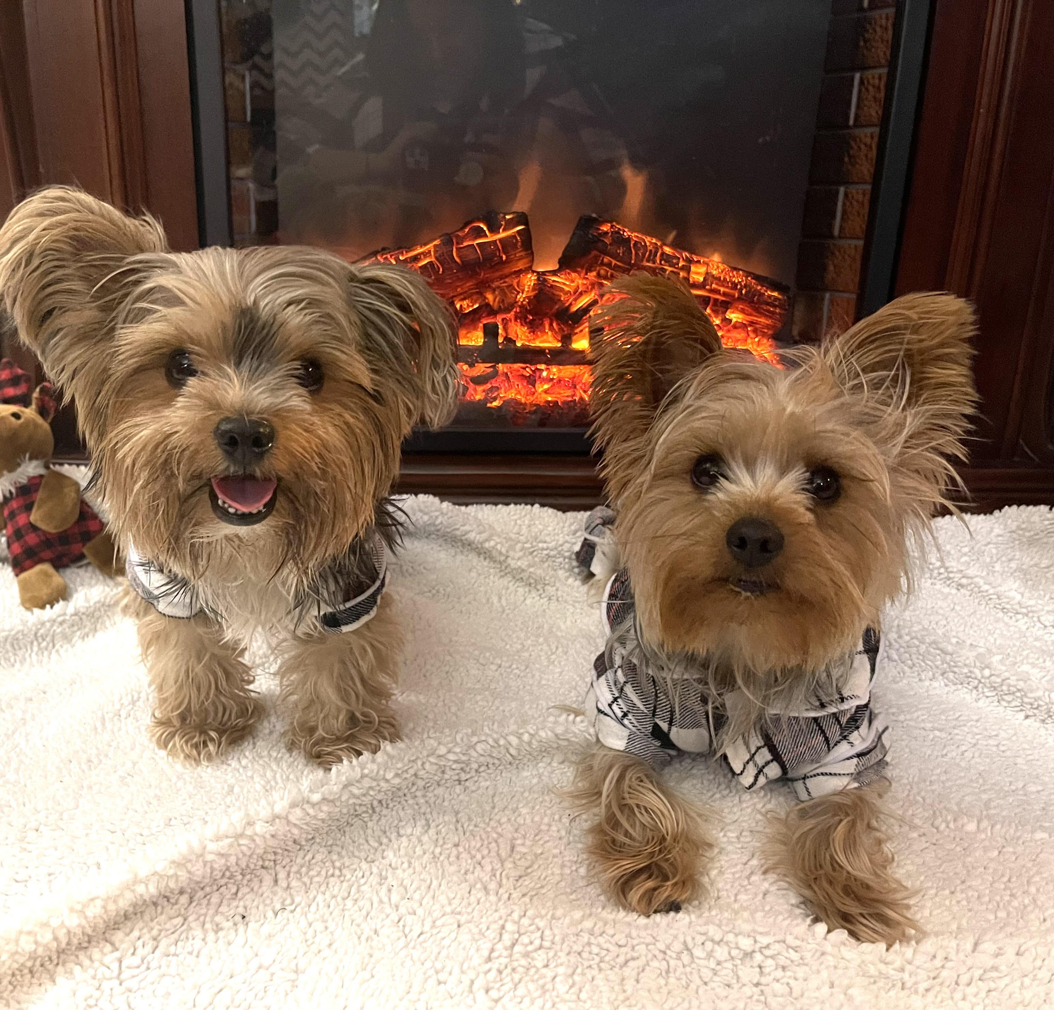
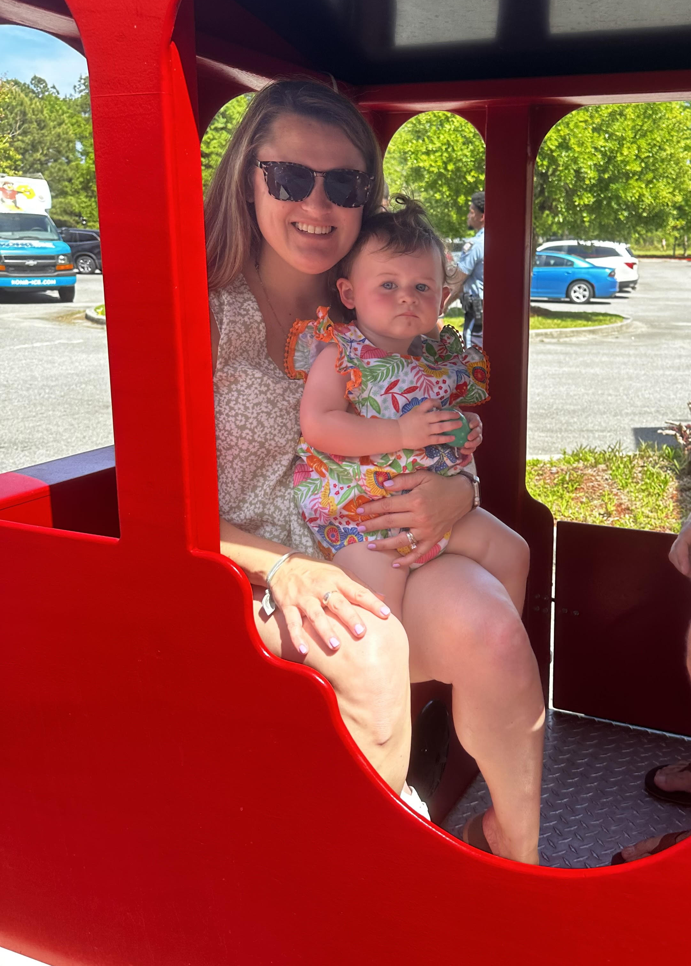
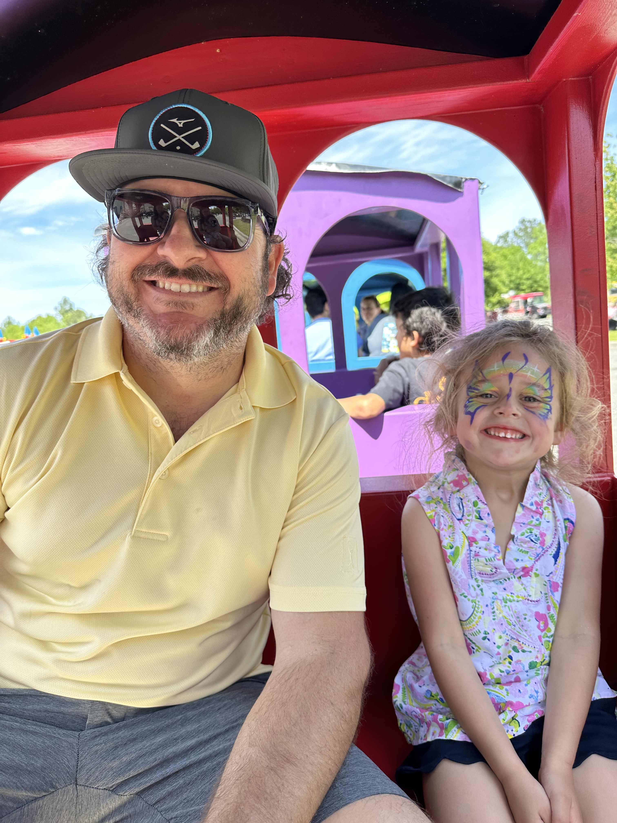
About Us
Ciarra Torres
Employed with MRCA – 5 years
Master’s Degree in Special Education
Experience with a variety of Autism services
Passion for helping children and families on the spectrum
Sarah Weber
Master’s Degree in Applied Behavior Analysis
Board Certified Behavior Analyst est. 2018
10 years of experience in the field
Enjoys teaching others about ABA

Slide 3
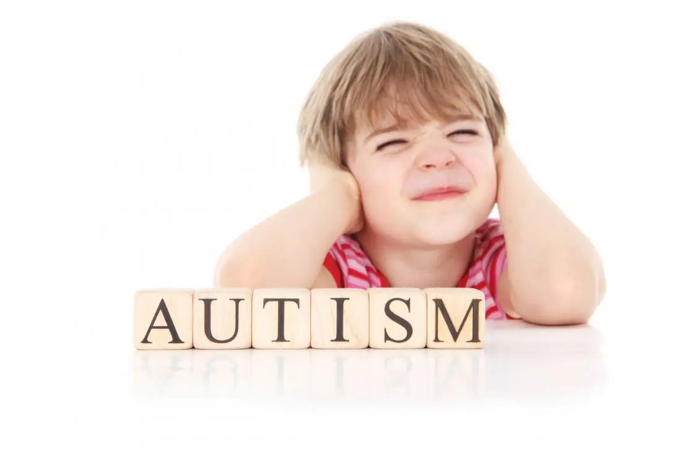
A Little About You
Anyone want to share your story?
Where are you along your Autism Journey?

Slide 4
Myth Busters and FAQs
What are the positives to an Autism Diagnosis?
Is an Autism Diagnosis permanent?
Will my child ever talk, work, or go to college?
What if I disagree with the diagnosis?
Why won’t the psychologist diagnose my child with Autism Spectrum Disorder?
Will my child grow out of it?
Will ABA turn my child into a robot?
Crowd Questions or Myths?

Slide 5
Autism Lingo
Questions First!
Verbiage
Definitions
Acronyms

Slide 6
Special Education Acronyms
https://autismearlylearning.com/special-education-acronyms/

Slide 7
ABA Acronyms
AAC: Assistive Augmentative Communication
ABA: Applied Behavioral Analysis
ABC: Autism Behavior Checklist
ABC: Antecedent, Behavior, Consequence
ABI: Adaptive Behavior Inventory
ABLLS: Assessment of Basic Language and Learning Skills test
ADA: Americans with Disabilities Act of 1990
ADD: Attention Deficit Disorder
ADHD: Attention Deficit Hyperactivity Disorder
ADOS: Autism Diagnostic Observation Scale
ASD: Autism Spectrum Disorder
BCBA: Board Certified Behavior Analyst
CARS: Childhood Autism Rating Scale
CNS: Central Nervous System
DDD: Division of Developmental Disabilities
DHHS: Department of Health and Human Services
DOH: Department of Health
DT: Discrete Trial
EI: Early Intervention
ESL: English as a Second Language
FAPE: Free Appropriate Public Education
FERPA: Federal Educational Rights and Privacy Act
FSP: Family Support Plan
FSS: Family Support Services
GF: Gluten Free
GSNS: Georgia Special Needs Scholarship
IDEA: Individuals with Disabilities Education Act
IEP: Individualized Education Program
IFSP: Individual Family Service Plan
IQ: Intelligence Quotient
LRE: Least Restrictive Environment
OCD: Obsessive Compulsive Disorder
ODD: Oppositional Defiant Disorder
OT: Occupational Therapy
PDDNOS: Pervasive Developmental Disorder, Not Otherwise Specified
PECS: Picture Exchange Communication System
POA: Power of Attorney
PT: Physical Therapy
RBT: Registered Behavior Technician
SSA: Social Security Administration
SSDI: Social Security Disability Income
SSI: Supplemental Security Income
https://www.as-az.org/common-abbreviations/
Notes:
ABC’s of behavior: Antecedent, Behavior, and Consequence

Slide 8
Cycle of Acceptance
5 Stages of Acceptance (sometimes referred to as “Grief”)
Denial
Anger
Bargaining
Depression
Acceptance
Not necessarily linear – that is okay!
https://www.acesaba.com/aba/stages-of-acceptance/?utm_source=rss&utm_medium=rss&utm_campaign=stages-of-acceptance

Slide 9
https://scontent-mia3-1.xx.fbcdn.net/v/t1.6435-9/122327579_1282097755477019_5662525450037724161_n.png?_nc_cat=108&ccb=1-7&_nc_sid=730e14&_nc_ohc=3mq6NT25URMAX9lzGVI&_nc_ht=scontent-mia3-1.xx&oh=00_AfBD48NwSjpc932LpbWauZknJnkL4fPJR_Xs4fBd_P0WAQ&oe=64668972

Slide 10
Example of Diagnosis Time-Line
Diagnosis
Referral & Letter of Medical Necessity
Contact Insurance for Coverage
Medicaid, SSI, and Katie Beckett
Research Referrals
Schedule Consultations
Schedule Assessments for Therapies
Choose School Option

Slide 11
What is Autism?
Autism refers to a broad range of conditions characterized by challenges with social skills, repetitive behaviors, speech and nonverbal communication.
According to the DSM-5 which is the diagnostic and statistical manual for mental health-5th edition, a child must display persistent deficits in each of the three areas of social communication and interaction plus at least two or four types of restricted, repetitive behaviors for a diagnosis of autism

Slide 12
Data and Statistics on Autism Spectrum Disorder
About 1 in 36 children has been identified with autism spectrum disorder (ASD) according to estimates from CDC’s Autism and Developmental Disabilities Monitoring (ADDM) Network.
ASD is reported to occur in all racial, ethnic, and socioeconomic groups.
ASD is nearly 4 times more common among boys than among girls.
About 1 in 6 (17%) children aged 3–17 years were diagnosed with a developmental disability, as reported by parents, during a study period of 2009-2017. These included autism, attention-deficit/hyperactivity disorder, blindness, and cerebral palsy, among others.

Slide 13
Social Communication and Interaction Deficits
Examples include but not limited too:
Social communication skills are lower than their chronological age
Reduced sharing of interests or emotions
Failure to initiate or respond to social interactions
Lack of facial expressions, eye contact, or use of gestures
Difficulty developing and maintaining relationships
Difficulties interacting during imaginative play, making friends, or interest in peers.
Citation: DSM-5

Slide 14
Restricted and Repetitive Behaviors
Patterns of behavior, interest, or activities manifested by at least two of the following (DSM-5):
Repetitive motor movements, use of objects, or speech
Lining up toys
Flipping lights on and off
Inflexibility of routines, ritualized behavior, or insistance on sameness
Displays extreme distress with small changes
Difficulties with transitions
High restricted/fixated interest
Strong attachment to objects
Perseverations on objects, topics, or people etc.
Echolalia
Rigid thinking patterns
Hyper or hypo-activity to sensory input or unusual interest in sensory aspects in the environments
Indifference of pain or temperature
Difficulty with certain noises or textures
Excessive smelling or touching objects
Visual fascination with lights
Notes:
Other examples for repetitive motor movements could be hand flapping, rocking back and forth, and vocalizations
Other examples for inflexibility for routines can include taking the same route, eating same food each day, and greeting rituals.
Other examples for fixated interest is someone who really enjoys talking about pokemon but does not want to engage in other topics during conversation or must carry a toy with them to the store, friends house, school, in the car but gets extremely upset when removed.
Hyper and hypo activity to sensory input can include not being able to tell someone there are hurt or have a fever because they do not understand those elements, contantly looking up at lights in a variety of settings,

Slide 15
Levels of Support
Requires Support (1)
Requires Substantial Support (2)
Requires Very Substantial Support (3)
Citation: DSM-5

Slide 16
Qualification for Services
ABA Therapy
Only provided for Autism Diagnosis
Other therapies (OT/PT/Speech)
Provided for many diagnosis
Recommended hours are provided by referring psychologist for therapies
Therapists (Speech, OT, PT, and ABA) will assess the individual once authorization is processed through insurance or family can self-pay.
Authorization approved
Services begin after scheduling

Slide 17
Insurance
Requires level of support
Primary and Secondary
Medicaid
SSI
Katie Beckett

Slide 18
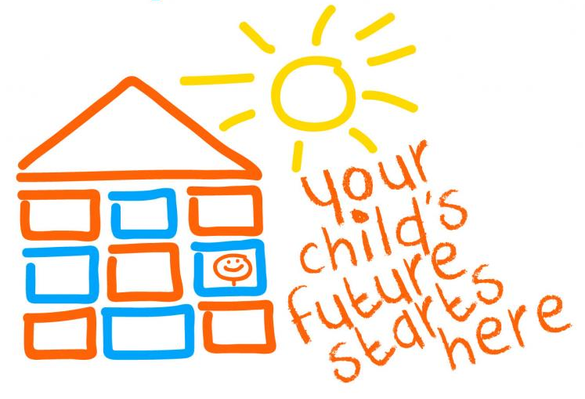
Early Intervention
Importance of Early Intervention
Babies Can’t Wait
Contact the Department of Health
PSI (Pre-School Intervention)
Contact your home school in your district
Therapies
ABA (Applied Behavior Analysis)
Speech and Language Therapy
Occupation Therapy
Physical Therapy
Play Therapy
Behavior Therapy

Slide 19
School Options
I.D.E.A.
Individuals with Disabilities Act
Public
Inclusion
Self-Contained
LRE (Least Restrictive Environment)
IEP (Individualized Education Plan)
IFSP (Individualized Family Support Plan)
GSNS (Georgia Special Needs Scholarship)
Private
Charter

Slide 20
Therapy Options
Applied Behavior Analysis
ABA
Speech Language Therapy
ST or SLP
Occupational Therapy
OT
Physical Therapy
PT
Notes:
Including all therapies for open communication increases the overall treatment for the child or person diagnosed with Autism. Insurances prefer for therapies to collaborate with each other to increase better outcomes for the patient.

Slide 21
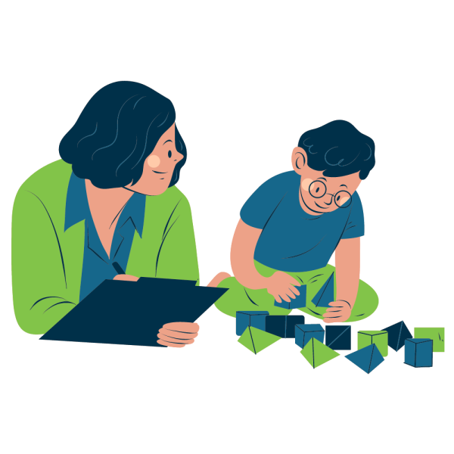
What is Applied Behavior Analysis (ABA)?
Behavior analysis is the science of behavior, with a history extending back to the early 20th century. Its guiding philosophy is behaviorism, which is based on the premise that attempts to improve the human condition through behavior change (e.g., education, behavioral health treatment) will be most effective if behavior itself is the primary focus.
Citation: BACB
Notes:
In lamens terms, the focus of this therapy is to decrease unwanted behaviors that impede the person’s ability to learn while simultaneously teaching replacement skills.

Slide 22
Teaching Types of ABA
Discrete Trial
Group
Naturalistic Teaching
Incidental Teaching
In-home
Clinic
Controlled setting
Shared attention
In the natural setting
Occurs in the moment
Home based services
Controlled environment
Pivotal Response Training
Comprehensive approach
Notes:
DTT: teaching something to the person in a controlled setting such as the table with only specific pictures or objects. Once they show understanding of this skill then it will move to a more natural setting
Group: Less intrusive setting with multiple people
Naturalist setting: teaching occurs of mastered skills from the controlled setting
Incidental teaching: this can occur anytime or anyday as the skills can be taught. For example, routine of putting clothes on, putting dishes away, paying with a card at a machine, finding multiple blue objects outside, labeling a pig at the farm
Pivotal response: focuses on motivation to learn, initiate communication, and monitor their own behaviors. This focus on motivation is crucial: a child who is motivated to change their behavior will experience more success. By focusing on critical over-arching areas, the effects of treatment can carry over into many aspects of a child’s behavior and skills including social, communicative, and academic.
In home setting: Sometimes parents prefer for ABA therapy to occur in their private home due schedule conflicts, personal choice, etc.
Clinic setting: more controlled setting and the ability to change the environment to work on behavior problems as well as skill deficits.

Slide 23
Keep It Together
Get a binder!
Keep important documents in the binder with dividers
Medical
Therapies
IEP/IFSP/504
Psychological Evaluation
Prescriptions
Doctor’s Information
Contact Information
Insurance Card(s)

Slide 24
Reader’s Digest

Slide 25
Citations and Resources
Babies Can’t Wait
https://dph.georgia.gov/babies-cant-wait
IDEA – Individuals with Disabilities Act
https://sites.ed.gov/idea/
Charter Schools
https://www.sccpss.com/charter/Pages/default.aspx
Autism Speaks
https://www.autismspeaks.org/
Centers of Disease
https://www.cdc.gov/ncbddd/autism/index.html

Slide 26
Additional Questions?
Thank you!

