Slide 1
Breaking the Cycle!: How Maladaptive Behaviors Emerge and How to Break the Cycle
Dr. Denice Rios, Ph.D., BCBA-D (she/her/ella)

Slide 2
Portions of this powerpoint are used with permission, from Davidson, D. & Senese, J. (2013, June). Using Positive Behavior Support to Address Challenging Behaviors in the Home. Invited Presentation at the Institute for Human Development’s Evidence-based Practice in Disability Disciplines Conference, Flagstaff, AZ.

Slide 3
Objectives
You will learn about effective ways to teach replacement behaviors.
You will learn about the coercion cycle.
You will learn how motivating operations affect behavior.

Slide 4
A COMMON EXAMPLE OF CHALLENGING BEHAVIOR
Prompted to end video time
Gets extended video time
Bite, pinch, kick
THE PROBLEM

Slide 5
ANOTHER EXAMPLE OF CHALLENGING BEHAVIOR
Prompted to work by herself
Teacher approaches to help
Cry and throw book
THE PROBLEM

Slide 6
AND ANOTHER EXAMPLE
Help taking a shower
Shower cut short
Scream, bite hand
THE PROBLEM

Slide 7
AND STILL ANOTHER
Insulted by peer
Peer backs down
Threaten to kill him
THE PROBLEM

Slide 8
CAN YOU THINK OF YOUR OWN EXAMPLE?
THE PROBLEM

Slide 9
WE WILL USE ONE EXAMPLE TO WALK YOU THROUGH
A MODEL OF POSITIVE BEHAVIOR SUPPORT
“Put your things away”
“Fine! I’ll do it myself”
Kick & Hit
THE PROBLEM

Slide 10
Antecedent
(what you do)
Behavior
(what child does)
Consequence
(what you do)
Challenging Behavior Trajectory
“Put your things away”
“Fine! I’ll do it myself”
Kick & Hit
THE PROBLEM
(has a pattern)

Slide 11
Antecedent
(what you do)
Behavior
(what child does)
Consequence
(what you do)
IN ORDER TO CHANGE THIS TRAJECTORY YOU NEED TO HAVE A CLEAR AND MANAGEABLE GOAL SO YOU CAN ENSURE SUCCESS AND FINISH WITH REWARD
Challenging Behavior Trajectory
“Put your things away”
“Fine! I’ll do it myself”
Kick & Hit

Slide 12
Antecedent
(what you do)
Behavior
(what child does)
Consequence
Consequence
(what you do)
Main Goal
Puts things Away
Reward
Challenging Behavior Trajectory
“Put your things away”
“Fine! I’ll do it myself”
Kick & Hit
THE SOLUTION
(also has a pattern)

Slide 13
Antecedent
(what you do)
Behavior
(what child does)
Consequence
Consequence
(what you do)
Main Goal
Puts things Away
Reward
Challenging Behavior Trajectory
“Put your things away”
“Fine! I’ll do it myself”
Kick & Hit
THE SOLUTION
So why is this so hard?

Slide 14
Antecedent
(what you do)
Behavior
(what child does)
Consequence
(what you do)
Challenging Behavior Trajectory
“Put your things away”
“Fine! I’ll do it myself”
Kick & Hit
BECAUSE IT IS RARELY THIS SIMPLE. CHALLENGING BEHAVIORS ARE OFTEN A SERIES OF MANY PRECURSOR BEHAVIORS

Slide 15
Antecedent
(what you do)
Behavior
(what child does)
Consequence
(what you do)
Challenging Behavior Trajectory
“Put your things away”
No Response
FIRST TRY

Slide 16
Antecedent
(what you do)
Behavior
(what child does)
Consequence
(what you do)
Challenging Behavior Trajectory
“Put your things away”
Whine
SECOND TRY

Slide 17
Antecedent
(what you do)
Behavior
(what child does)
Consequence
(what you do)
Challenging Behavior Trajectory
“Put your things away”
Cry
THIRD TRY

Slide 18
Antecedent
(what you do)
Behavior
(what child does)
Consequence
(what you do)
Challenging Behavior Trajectory
“Put your things away”
“Fine! I’ll do it myself”
Kick & Hit
FOURTH TRY

Slide 19
Antecedent
(what you do)
Behavior
(what child does)
Consequence
Consequence
(what you do)
Main Goal
Puts things Away
Reward
Challenging Behavior Trajectory
“Put your things away”
“Fine! I’ll do it myself”
Kick & Hit
TO ACHIEVE THIS GOAL YOU MAY HAVE TO CHANGE HOW YOU TEACH

Slide 20
Antecedent
(what you do)
Behavior
(what child does)
Consequence
Consequence
(what you do)
Main Goal
Puts things Away
Reward
Challenging Behavior Trajectory
“Put your things away”
“Fine! I’ll do it myself”
No Response
FIRST TRY

Slide 21
Antecedent
(what you do)
Behavior
(what child does)
Consequence
Consequence
(what you do)
Main Goal
Puts things Away
Reward
Challenging Behavior Trajectory
Point to items to put away
“Fine! I’ll do it myself”
Whine
SECOND TRY

Slide 22
Antecedent
(what you do)
Behavior
(what child does)
Consequence
Consequence
(what you do)
Main Goal
Puts things Away
Reward
Model it for the child
Challenging Behavior Trajectory
“Fine! I’ll do it myself”
Cry
THIRD TRY

Slide 23
Antecedent
(what you do)
Behavior
(what child does)
Consequence
Consequence
(what you do)
Main Goal
Puts things Away
Reward
Hand items to the child
Challenging Behavior Trajectory
“Fine! I’ll do it myself”
Cry
FOURTH TRY… YIPPEE!!!!

Slide 24
Antecedent
(what you do)
Behavior
(what child does)
Consequence
Consequence
(what you do)
Main Goal
Puts things Away
Reward
Challenging Behavior Trajectory
“Put your things away”
“Fine! I’ll do it myself”
Kick & Hit
But there are times when my prompts are unsuccessful
And teaching the child to follow my instructions does not teach him HOW to get his own needs met
Notes:
Talk about least to most prompting and that you could have done a more restrictive prompt earlier in the sequence.

Slide 25
COERCION CYCLE
Parent refuses
to buy Candy
Bad News
For Child
Notes:
So why do these behaviors occur at all? Well, we need to look at our own behavior patterns to see how our behavior is controlled by the environment as well.
What could we do differently? (Parent teaches child earlier that tantrums = going to car without candy, but helping to take items out of the cart = candy)

Slide 26
COERCION CYCLE
Parent refuses Child
to buy Candy Tantrums
Bad News
For Child
Bad News
For Parent
Notes:
What could we do differently? (Parent teaches child earlier that tantrums = going to car without candy, but helping to take items out of the cart = candy)

Slide 27
COERCION CYCLE
Parent refuses Child Parent
to buy Candy Tantrums gives in
Bad News Good News
For Child For Child
Bad News
For Parent
R+
Notes:
What could we do differently? (Parent teaches child earlier that tantrums = going to car without candy, but helping to take items out of the cart = candy)

Slide 28
What is R+?
Positive Reinforcement
The presentation of a stimulus contingent on a behavior which results in a future frequency of that behavior

Slide 29
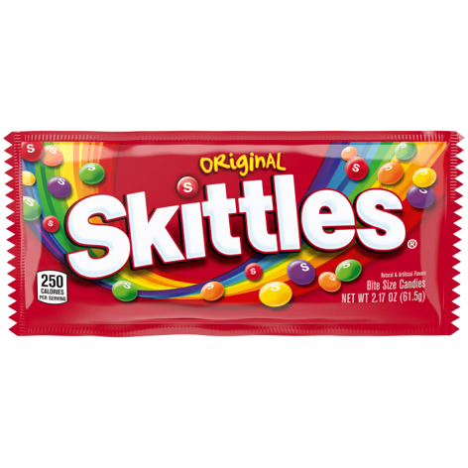
Positive Reinforcement
Child Tantrums
R+

Slide 30
COERCION CYCLE
Parent refuses Child Parent Child quiets
to buy Candy Tantrums gives in Down
Bad News Good News
For Child For Child
Bad News Good News
For Parent For Parent
R+
R-
Notes:
What could we do differently? (Parent teaches child earlier that tantrums = going to car without candy, but helping to take items out of the cart = candy)

Slide 31
What is R-?
Negative Reinforcement
The removal of a stimulus contingent on a behavior which results in a future frequency of that behavior

Slide 32
Negative Reinforcement
Parent gives in (gives candy)
R-

Slide 33
COERCION CYCLE
Teacher
Corrects
Student
Bad News
For Student

Slide 34
COERCION CYCLE
Teacher Student yells,
Corrects Insults teacher
Student
Bad News
For Student
Bad News
For Teacher

Slide 35
COERCION CYCLE
Teacher Student yells, Teacher sends
Corrects Insults teacher student to
Student office
Bad News Good News
For Student For Student
Bad News
For Teacher
R-

Slide 36
COERCION CYCLE
Teacher Student yells, Teacher sends Yelling
Corrects Insults teacher student to Stops
Student office
Bad News Good News
For Student For Student
Bad News Good News
For Teacher For Teacher
R-
R-

Slide 37
COERCION CYCLE
Staff says Person starts Staff sends Person
“Set the Table” breaking Person to Leaves
things his room
Bad News Good News
For Person For Person
Bad News Good News
For Staff For Staff
R-
R-
Notes:
What could we do differently? (Staff teaches person earlier to ask for break)

Slide 38
COERCION CYCLE
“Put your things away”
“Fine! I’ll do it myself”
Kicks & Hits
Kicks & Hits
Stop

Slide 39
COERCION CYCLE
Child Learning Trial:
Antecedent Behavior Consequence
“Put your things away”
“Fine! I’ll do it myself”
Kicks & Hits
Kicks & Hits
Stop
Antecedent Behavior Consequence
Adult Learning Trial:

Slide 40
COERCION CYCLE
Child Learning Trial:
Antecedent Behavior Consequence
“Put your things away”
“Fine! I’ll do it myself”
Kicks & Hits
Kicks & Hits
Stop
Antecedent Behavior Consequence
Adult Learning Trial:

Slide 41
COERCION CYCLE
Child Learning Trial:
Antecedent Behavior Consequence
“Put your things away”
“Fine! I’ll do it myself”
Kicks & Hits
Kicks & Hits
Stop
Antecedent Behavior Consequence
Adult Learning Trial:

Slide 42
Activity: Make your own COERCION CYCLE
Staff Behavior
Client Behavior
Staff Response
Child Response
Notes:
Fill in the boxes to make your own coercion cycle, and then circle the client learning trial and the staff learning trial.

Slide 43
BREAK THIS COERCION CYCLE
“Put your things away”
“Fine! I’ll do it myself”
Kicks & Hits
Kicks & Hits
Stop

Slide 44
BREAK THIS COERCION CYCLE
Praise and more help (work)
Reaches for the item
Help child by handing items to put away
“Fine! I’ll do it myself”
Kicking & Hitting
Never start
Kicks & Hits

Slide 45
BREAK THIS COERCION CYCLE
Praise and more help help
Reaches for the item
Help child by handing items to put away
“Fine! I’ll do it myself”
Kicking & Hitting
Never start
Kicks & Hits
Can I do it later?
Notes:
Talk about the importance of FCT – and matching treatment to function
Escape – talk about people who were at the VBMAPP workshop.

Slide 46
Antecedent
(what you do)
Behavior
(what child does)
Consequence
Consequence
(what you do)
Goal #1
Puts things Away
Reward
Challenging Behavior Trajectory
“Put your things away”
“Sure, thanks for asking”
Kick & Hit
Goal #2
Can I do it later?
TEACH REPLACEMENT (COMPETING) BEHAVIOR

Slide 47
Break the Coercion Cycle by Creating Competing Replacement Behavior
If replacement behaviors are to be acquired and maintained, they must effectively compete with challenging behaviors in producing the desired function
Require less time or effort to employ (it is easier to tell a peer no than it is to fight with a peer)
Result in greater amounts or intensity of reinforcement (e.g., the student who is escape motivated receives a 10-minute break for compliance instead of 5-minutes of time-out for noncompliance)
Produce the function more frequently (e.g., staff attention initially is delivered on a continuous schedule for appropriate behavior)
Result in more immediate reinforcement (e.g., the student receives a break form a task within 10 seconds of making the request)
Notes:
Define each code and give examples how we will meet this during our training

Slide 48
Antecedent
Behavior
Consequence
Consequence
Challenging Behavior Trajectory
Told to stop using computer
Keep more time on computer
Hits Pushes and Kicks
Another example of a REPLACEMENT behavior

Slide 49
Antecedent
Behavior
Consequence
Stop playing and walk away
“Thank you”
Goal #1
Challenging Behavior Trajectory
Told to stop using computer
Keep more time on computer
Hits Pushes and Kicks
Another example of a REPLACEMENT behavior

Slide 50
Antecedent
Behavior
Consequence
Stop playing and walk away
“Thank you”
Goal #1
Challenging Behavior Trajectory
Told to stop using computer
Keep more time on computer
Hits Pushes and Kicks
Goal #2
Ask for 2 more minutes
Another example of a REPLACEMENT behavior

Slide 51
Antecedent
Behavior
Consequence
Challenging Behavior Trajectory
Reminded to Take a bath
Chase/Catch and bring him back
Runs away
Another example of a REPLACEMENT behavior

Slide 52
Antecedent
Behavior
Consequence
Go to bathroom, get undressed
“Thank you”
Goal #1
Challenging Behavior Trajectory
Reminded to Take a bath
Chase/Catch and bring him back
Runs away
Another example of a REPLACEMENT behavior

Slide 53
Antecedent
Behavior
Consequence
Go to bathroom, get undressed
“Thank you”
Main Goal
Challenging Behavior Trajectory
Reminded to Take a bath
Chase/Catch and bring him back
Runs away
Goal #2
Ask to be chased
Another example of a REPLACEMENT behavior

Slide 54
Antecedent
Behavior
Consequence
Challenging Behavior Trajectory
Told to put Candy back in grocery store
Keeps the Candy bar
Cries, kicks, screams
Another example of a REPLACEMENT behavior

Slide 55
Antecedent
Behavior
Consequence
Put the candy back
“Thank you”
Goal #1
Challenging Behavior Trajectory
Told to put Candy back in grocery store
Keeps the Candy bar
Cries, kicks, screams
Another example of a REPLACEMENT behavior

Slide 56
Antecedent
Behavior
Consequence
Put the candy back
“Thank you”
Goal #1
Challenging Behavior Trajectory
Told to put Candy back in grocery store
Keeps the Candy bar
Cries, kicks, screams
Goal #2
Ask for the candy
Another example of a REPLACEMENT behavior

Slide 57
Antecedent
Behavior
Consequence
Challenging Behavior Trajectory
Pulls his hair and bites
Brother leaves her alone
Brother teases her
Another example of a REPLACEMENT behavior

Slide 58
Antecedent
Behavior
Consequence
Tell him to stop
Teasing continues
Goal #2
Challenging Behavior Trajectory
Pulls his hair and bites
Brother leaves her alone
Brother teases her
Another example of a REPLACEMENT behavior

Slide 59
Antecedent
Behavior
Consequence
Tell him to stop
Teasing continues
Goal #1
Challenging Behavior Trajectory
Pulls his hair and bites
Brother leaves her alone
Brother teases her
Goal #2
Tell adult
Another example of a REPLACEMENT behavior

Slide 60
Antecedent
Behavior
Consequence
Challenging Behavior Trajectory
Sent to his Room (escapes)
Asked to set the table
Tips chairs, breaks glass
Another example of a REPLACEMENT behavior

Slide 61
Antecedent
Behavior
Consequence
Sets the table
No escape
Goal #1
Challenging Behavior Trajectory
Sent to his Room (escapes)
Asked to set the table
Tips chairs, breaks glass
Another example of a REPLACEMENT behavior

Slide 62
Antecedent
Behavior
Consequence
Sets the table
No escape
Goal #1
Challenging Behavior Trajectory
Sent to his Room (escapes)
Asked to set the table
Tips chairs, breaks glass
Goal #2
Ask for help or a “pass”
Another example of a REPLACEMENT behavior

Slide 63
Antecedent
(what you do)
Behavior
(what child does)
Consequence
Consequence
(what you do)
Goal #1
Preferred Behavior
Planned Reinforcer
Challenging Behavior Trajectory
Antecedent
Challenging Behavior
Natural
Reinforcer
Goal #2
Replacement
Behavior
Your Turn – Please diagram your own cycle on the next slide
Notes:
Have staff diagram their own coersion cycles

Slide 64
Antecedent
(what you do)
Behavior
(what child does)
Consequence
Consequence
(what you do)
Goal #1
Challenging Behavior Trajectory
Goal #2
Your Turn – Please diagram your own cycle
Notes:
Have staff diagram their own coersion cycles
Share with group, have a few examples up at the board

Slide 65
But, sometimes there is no pattern…
Sometimes behavior seems erratic, even after you have collected and analyzed the ABC’s
Why?
Always consider the Motivating Operation (MO)

Slide 66
Motivating Operations
How behavior analysts think about motivation
Environmental events that influence behavior

Slide 67
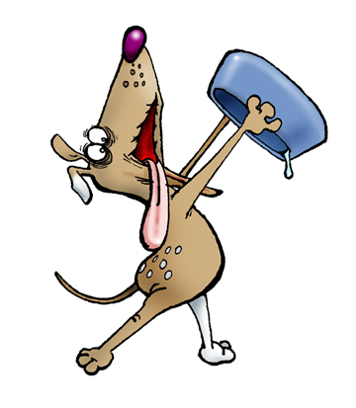
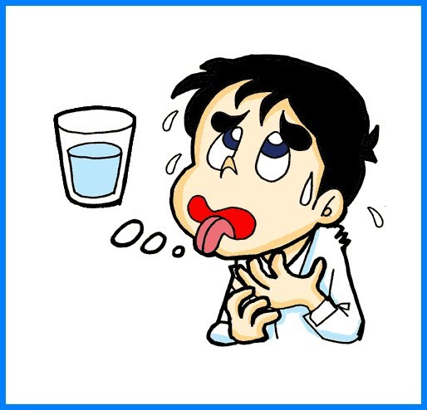
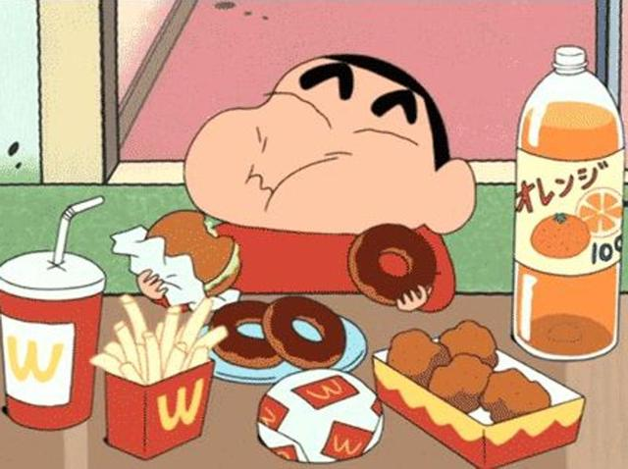
Most Common Motivating Operations
Deprivation: Withholding an item/activity which then increases the value of that item/activity
Satiation: Consuming a substantial amount of an activity/item which then decreases the value of that item/activity

Slide 68
Antecedent
Behavior
Consequence
Consequence
Challenging Behavior Trajectory
Told to stop using computer
Keep more time on computer
Hits Pushes and Kicks
Remember this example?

Slide 69
Motivating Operation (MO)
Behavior
Antecedent
Consequence
Consequence
Stop playing and walk away
“Thank you”
Free Access to Computer
Told to stop using computer
Limited Access to Computer
Hits Pushes and Kicks
Keep more time on computer
How MOs affect behavior
Notes:
Talk about the value altering affect and the behavior altering affect

Slide 70
Antecedent
Behavior
Consequence
Challenging Behavior Trajectory
Reminded to Take a bath
Chase/Catch and bring him back
Runs away
How about this one?

Slide 71
Motivating Operation (MO)
Behavior
Antecedent
Consequence
Consequence
Go to bathroom, get undressed
“Thank you”
Mom has been playing all day
Reminded to Take a bath
Mom has been at work all day
Runs away
Chase/Catch and bring him back
How MOs affect behavior
71

Slide 72
Antecedent
Behavior
Consequence
Challenging Behavior Trajectory
Told to put Candy back in grocery store
Keeps the Candy bar
Cries, kicks, screams
Let’s try this one

Slide 73
Motivating Operation (MO)
Behavior
Antecedent
Consequence
Consequence
Put the candy back
“Thank you”
It’s 1:00, just ate lunch
Told to put Candy back in grocery store
It’s 1:00, hasn’t had lunch yet
Cries, kicks, screams
Keeps the Candy bar
How MOs affect behavior
73

Slide 74
Objective Check
What must replacement behaviors be in order to be effective?
What is a coercion cycle, and how does it explain how challenging behaviors emerge?
How do MOs effect behavior?

